Slide 1
Climate Change: Science and Beyond
Stephanie G. Thomas, Ph.D.

Slide 2
What We’ll Talk About:
How We Got Where We Are Today
Climate Change Fundamentals
How Do We Leverage Change? An Individual & Community Guide

Slide 3
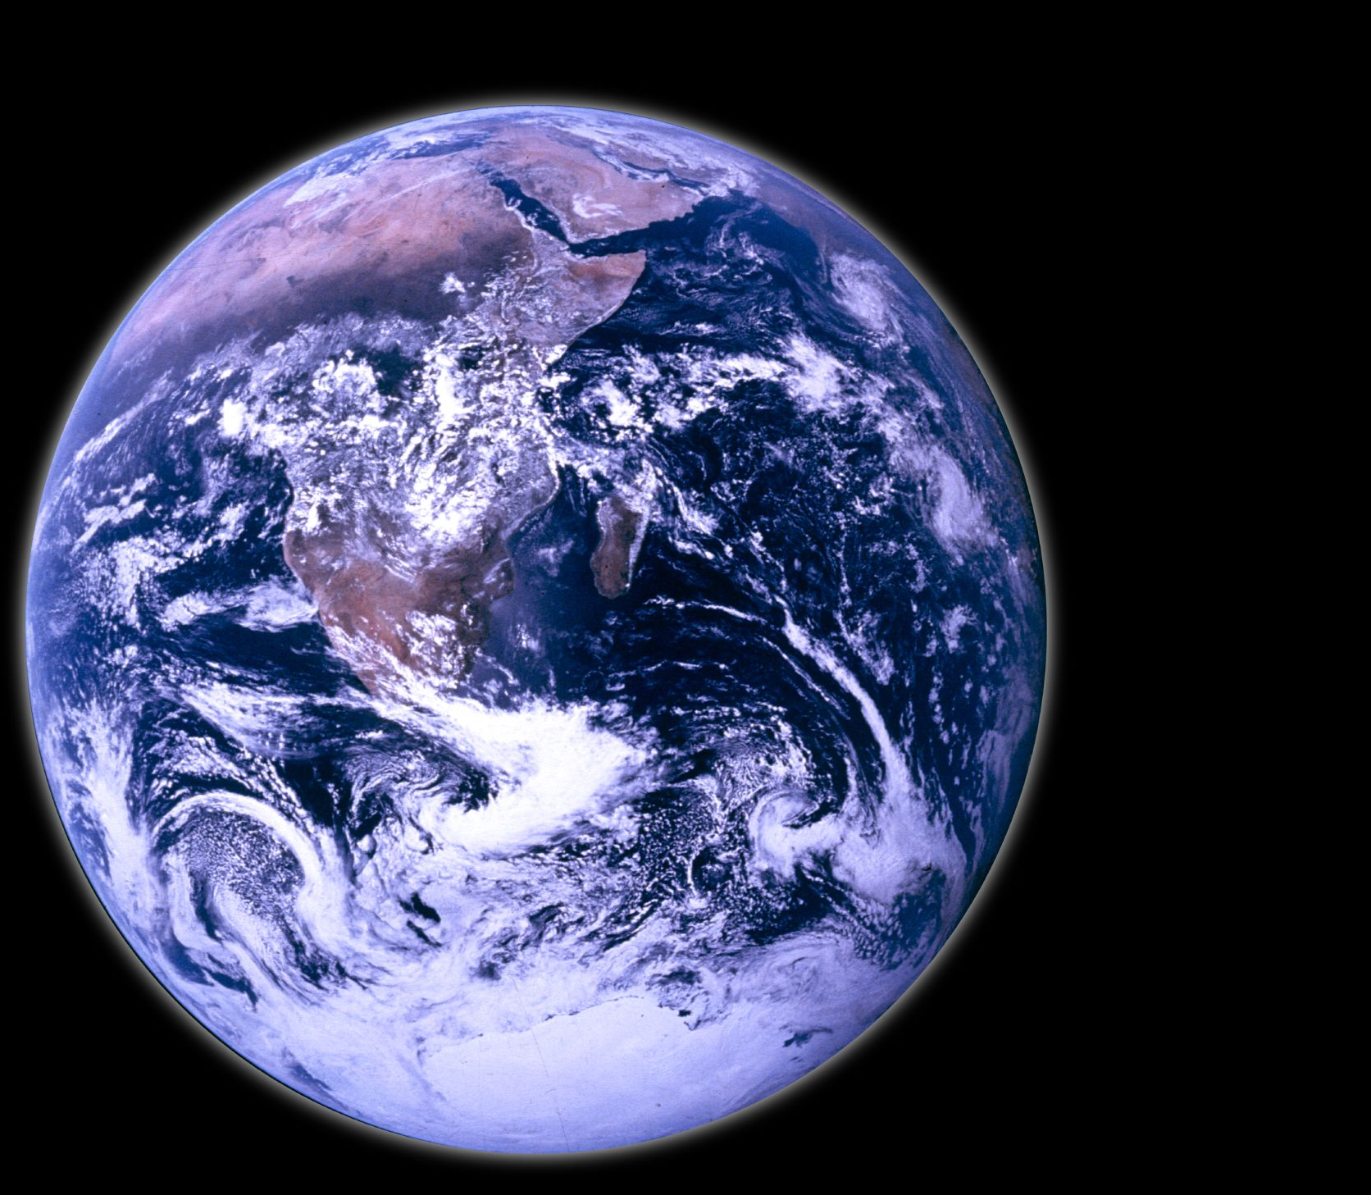
Remember: We Have Inherited the Earth

Slide 4
Let’s Look at Some Climate Fundamentals
WEATHER
Short-term
Individual storms and events, e.g. today’s weather, Hurricane Sandy, the drought of 2011
CLIMATE
Long-term
Weather averaged over a longer period of time
Decadal trends
“Climate tells you which clothes to buy; Weather tells you which clothes to wear”.

Slide 5
How Does Energy Get Distributed?
6% scattered from atmosphere
19% absorbed by atmosphere & clouds
20% scattered and reflected by clouds
4% reflected by surface
51% absorbed by surface

Slide 6
How Does Energy Get Distributed?

Slide 7
Global Warming Is Not a New Idea
Tyndall (1869) | Earth’s climate can be altered through variations in a few trace graces like CO₂ and water vapor | 261 ppm
Arrhenius (1896) | “birth” of modern climate science by showing saturation band of CO₂ expands with increasing atmospheric CO₂ concentration | 295 ppm
Callendar (1938) | human activity is causing atmospheric CO₂ to rise | 311 ppm
Keeling (1970) | If specialists assert that accelerated use of fossil fuels is harmful, what will we do? | 325 ppm
Shaw (1980) | Document shares predictions on atmospheric CO₂ and changing climate in internal ExxonMobil document (which btw is pretty spot on) | 339 ppm
(http://cdn.exxonmobil.com/~/media/global/files/climate/02_technological-forecast-on-co2-greenhouse-effect-1980.pdf)

Slide 8
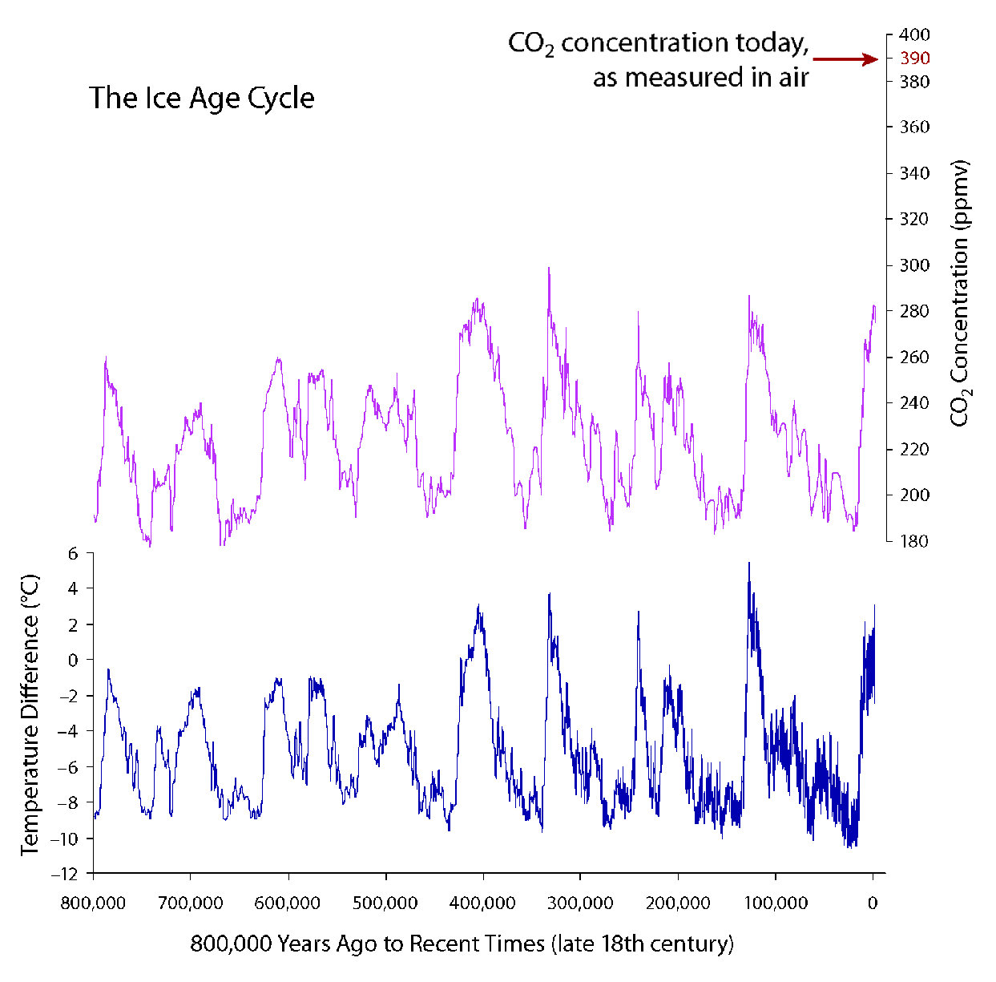
Climate Change: Beyond “natural” cyclicity
Current CO₂ in the atmosphere
Figure from the National Academy of Sciences

Slide 9
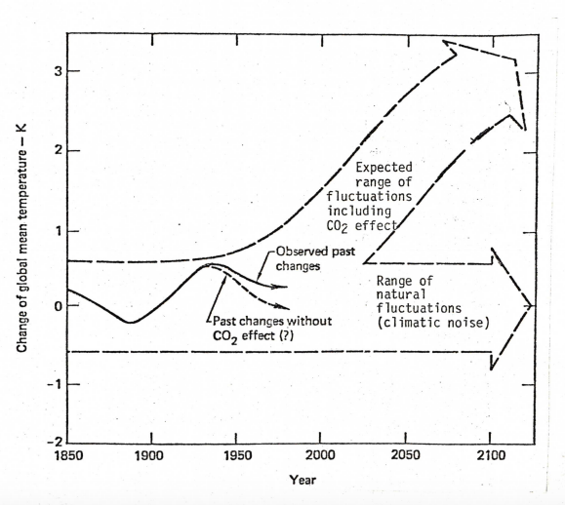
Climate Change: Beyond “natural” cyclicity. Shaw (1980)
Predictions captured by Shaw and others from the late 1970s/early 1980s show the predicted impact of CO₂ on global mean temperature.

Slide 10
But wait...what about “global cooling” in the 1970s?
Not actually that popular of a theory
Partially based on the anthropogenic release of aerosols into the atmosphere

Slide 11
It’s not just climate change...
It is predicted that there will be more plastic in the ocean than fish by 2050
Nitrogen and phosphorus pollution creates “dead zones” in oceans and estuaries
The Sixth Mass Extinction is currently underway
(https://www.ellenmacarthurfoundation.org/publications/the-new-plastics-economy-rethinking-the-future-of-plastics)
(http://www.cbf.org/about-the-bay/issues/dead-zones/nitrogen-phosphorus)
(http://advances.sciencemag.org/content/1/5/e1400253.short)

Slide 12
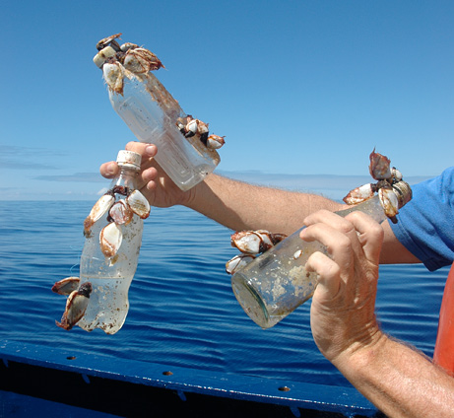
Individual Choices: Do They Matter?
The Myth of Inevitability
Photo From National Geographic

Slide 13
Individual Choices: Do They Matter?
A drop in the bucket is a drop in the bucket – and all those drops add up.
A sense of lack cultivates anxiety and consumption.
The Myth of Insufficiency

Slide 14
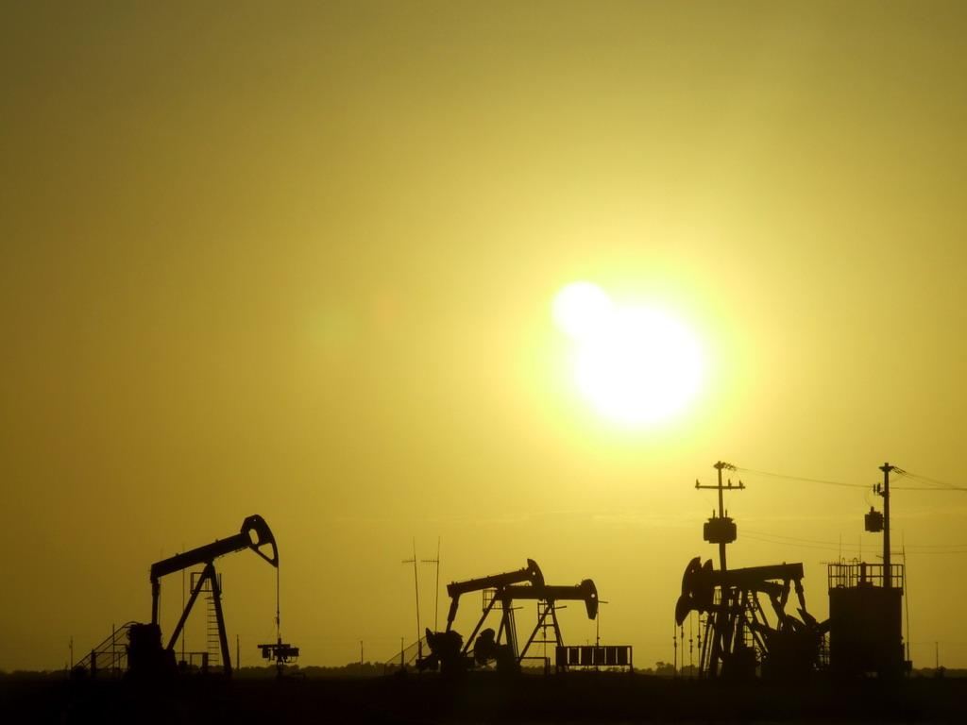
Collective Choices Matter, Too

Slide 15
Create Space for Awareness
Are you aware of global issues?
Are you aware of community issues?
Are you aware of your own actions? Your internal motivations? Your values?
Awareness creates space for right action.

Slide 16
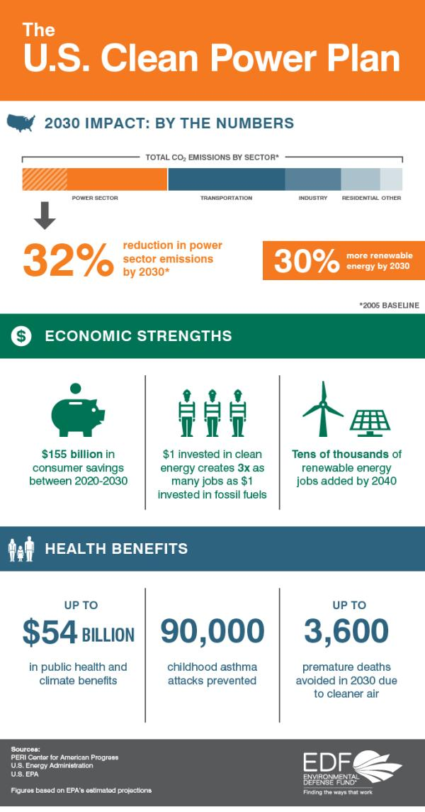
Things we can do
Support local climate action plans
Support the Clean Power Plan and other strategies for reducing emissions
Educate yourself & others
There is strength in numbers
Look and listen for opportunities

