Slide 1
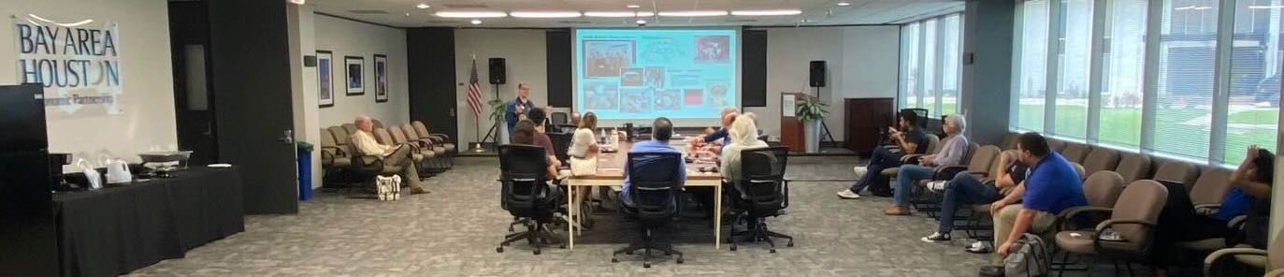
2024-2025 AIAA Houston History Technical Committee Web Page Archive Document
[2025 05 20] Tuesday, May 20, 2025 Building Blocks for Mars Exploration – Why Viking Remains Relevant, presented by Rachel Tillman, Viking Mars Missions Education & Preservation Project (VMMEPP).
Image credit:
Douglas Yazell
AIAA years start July 1 every year.
URL https://www.aiaahouston.org/history_technical_committee/
The Webmaster, the Chair, and I are working to restore my access to this web page. Since I am re-organizing the content of that web page, I am using the following URL for now as I transfer that content to: https://www.aiaahouston.org/test-page/
Image files will be archived here in this presentation file, along with detailed text notes. The history web page will retain a concise summary of events & publications for each AIAA year.
Douglas Yazell, 832-366-5292 iPhone, AIAA Houston History Technical Committee Chair

Slide 2
[2025 05 20] Tuesday, May 20, 2025 Building Blocks for Mars Exploration – Why Viking Remains Relevant, presented by Rachel Tillman, Viking Mars Missions Education & Preservation Project (VMMEPP). The public will have access to her Viking Mars Missions archive, and some of it is already shared online. As an introduction, here is a link to the VMMEPP YouTube channel.
Date: Tuesday, May 20, 2025 Time: 11:46 AM to Noon, CST Place: Bay Area Houston Economic Partnership (BAHEP) Ground Floor Conference Room
Image credits: Douglas Yazell (Click to zoom.)
2024-2025
Events & Publications

Slide 3
[2025 05 15] Thursday, May 15, 2025. Extreme Weather & Changing Climate Town Hall. About 100 people attended this 4th Town Hall on this subject or similar subjects in this same venue since the first one in the year 2017. These events are archived on the University of Houston (UH) Environmental Institute of Houston (EIH) Forums web page. The presentation files from our speakers will be available on that web page by about May 22, 2025. That web page might also present some video files.
Date: Thursday, May 15, 2025 Time: 6:30 PM – 8:30 PM Place: Bay Area Community Center, 5002 E. NASA Parkway, Seabrook TX 77586 Title: Extreme Weather & Changing Climate Town Hall Sponsors: One of the sponsors was AIAA Houston. This web page is part of their website. The home page is here. Speaking for this event sponsor, Douglas Yazell was the first speaker of the night, making a few brief comments. After describing AIAA Houston, he explained that in April of 2021, the AIAA Executive Director wrote a public note saying we must work with the “ultimate sense of urgency” toward the United Nations goal of net zero by 2050, which leads to specific aerospace goals by 2030. The next speaker was Chris Tomlinson of the Houston Chronicle.
Moderator: George Guillen, UH Clear Lake, Retired
Panelists
Bob Stokes, President, Galveston Bay Foundation
Yun Hang, UT Health Science Center
Chris Tomlinson, Houston Chronicle
Isabelle Bunge, Rice University
Daniel Potter, Rice University
Lance Hallberg, UTMB
John Cobarruvias, Insurance Activist
Audio files recorded by Douglas Yazell using the iPhone Voice Memos app: Audio file #1. Audio file #2.
2024-2025
Events & Publications

Slide 4
[2025 05 15] Thursday, May 15, 2025. Extreme Weather & Changing Climate Town Hall.
2024-2025
Events & Publications

Slide 5
[2025 05 15] Thursday, May 15, 2025. Extreme Weather & Changing Climate Town Hall.
2024-2025
Events & Publications

Slide 6
[2025 05 15] Thursday, May 15, 2025. Extreme Weather & Changing Climate Town Hall.
2024-2025
Events & Publications

Slide 7
[2025 05 15] Thursday, May 15, 2025. Extreme Weather & Changing Climate Town Hall.
The three prior forums and town halls on this subject are summarized below in a numbered list using the link above from the UHCL EIH.
2017, November 28, Bay Area Storm Water Flooding Forum, with Host Professor George Guillen of UHCL EIH and Moderator Professor Neal Lane of Rice University, using venue NASA/JSC Gilruth Center. The summary mentions AIAA Houston: “The Environmental Institute of Houston, along with Americans United in Action, Houston Region Concerned Citizens (HRCC), and American Institute of Aeronautics and Astronautics (AIAA) Houston, brought together experts and community leaders…” That is a reference to the AIAA Houston Annual Technical Symposium (ATS) of May 5, 2017. A detailed record of the event is presented on the AIAA Houston website using this link.
2019, March 7, Bay Area Houston Strom Surge Flood Forum, venue Bay Area Community Center. The summary using the UHCL EIH link above mentions AIAA Houston, “Through initial planning with the Environmental Institute of Houston, and support from Sierra Club Houston Group, Galveston Bay Foundation, Americans United in Action and American Institute of Aeronautics and Astronautics (AIAA) Houston, the Houston Region Concerned Citizens (HRCC) grassroots organization brought together experts and community leaders…” That is a reference to the AIAA Houston Annual Technical Symposium (ATS) of May 5, 2017. A detailed record of the event is presented on the AIAA Houston website using this link.
2019, June 25, Local Pollution & Your Health Forum, venue Bay Area Community Center
2024-2025
Events & Publications

Slide 8
[2025 05 15] Thursday, May 15, 2025. Extreme Weather & Changing Climate Town Hall.
Below is partial list of AIAA Houston climate change events.
We see below that a prior event was an AIAA Houston Annual Technical Symposium (ATS) luncheon keynote session of May 5, 2017, “Human-Induced Climate Change Requires Urgent Action.” Three Speakers were invited by Douglas Yazell. First, Professor André Droxler was recommended to Mr. Yazell by Professor Neal Lane of Rice University. Second, Mr. Yazell invited Dr. Stephanie Thomas of Public Citizen. Third, Mr. Yazell invited Mr. Doug Peterson from Exploration Green Conservancy. Doug Peterson led the planning of the four forums and town halls below, and those four events included Professors Droxler and Lane.
AIAA Houston featured climate change events prior to May 5, 2017, too, and after May 5, 2017. The web page of the 2016 AIAA Houston ATS shows that we included Dr. Daniel Cohan of Rice University, along with a display of Tesla, Chevy, and Ford electric vehicles (EVs).
The web page of the 2019 AIAA Houston ATS includes a 10-page presentation file from Mr. Douglas Yazell, “The Human-Induced Climate Crisis and Responses in the NASA and AIAA Communities.“
The web page of the 2020 AIAA Houston ATS includes a presentation file and audio recording featuring Mr. Douglas Yazell presenting, “Climate Reality Project.”
The web page of the history technical committee of AIAA Houston contains climate change reporting from Mr. Douglas Yazell from 2016 to 2025 and earlier. In a post dated June 10, 2016, he wrote, “[NASA Alumni League – Johnson Space Center Chapter (NAL-JSC) organized two climate change meetings; September 2011 and October 2011. See the NAL-JSC website for their link to those charts and a description of the meetings. By 2012, I learned that human-induced climate change requires urgent action, as IPCC’s first Chair Bert Bolin wrote in the conclusion of his 2007 book (A History of the Science and Politics of Climate Change: The Role of the Intergovernmental Panel on Climate Change), and as the AGU stated in their updated position statement title in August of 2013.]”
More AIAA Houston climate change events from the past will be listed here. For example, Professor Gerald R. North of Texas A&M University (TAMU) led an American Geophysical Union (AGU) team which produced a position statement titled, “Human-Induced Climate Change Requires Urgent Action.” The position statement was endorsed by the American Astronomical Society (AAS). He agreed to speak at an AIAA event in NASA/JSC Gilruth Center event, but at the last minute, Professor John Nielson-Gammon of TAMU, the Texas State Climatologist, gave Professor North’s presentation, along with his own presentation. AIAA Houston recorded the audio of that event and we present that on our public website along with a newsletter article and the presentation file.
The AIAA Houston dinner meeting of November 3, 2015 featured a program titled, “Climate Change Engineering, Science & Public Policy.” A summary report is featured on the AIAA Houston history technical committee web page, along with this newsletter article. “Our venue was the NASA/Johnson Space Center (JSC) Gilruth Center Alamo Ballroom. The 2007 Nobel Peace Prize laureate Dr. Bruce McCarl of Texas A&M was the first of two speakers to confirm his acceptance of our invitation. Our event also featured a presentation from Ian Mills of NASA JSC International Space Station (ISS) Robotics Operations.”
2024-2025
Events & Publications

Slide 9
[2025 05 15] Thursday, May 15, 2025. Extreme Weather & Changing Climate Town Hall.
[2025 03 25] Tuesday, March 25, 2025. A virtual Lunch-and-Learn. This presentation was recorded. If we publish the recording, we will publish the link here. We saw 58 people attending the online meeting using Teams. “Aero Command and Control Systems (C2)” AIAA Houston lunch-n-learn AIAA Houston is excited to host Dr. Ali Raz, Asst. Director of Intelligent Systems and Integration at the C4I and Cyber Center at George Mason University, for a FREE virtual lunch-n-learn focused on aerospace command and control (C2) systems. Dr. Raz will first introduce the C2 problem space and activities within AIAA’s Information Command and Control Systems (IC2S) technical committee before presenting his research into C2 solutions for mission engineering in complex systems.
WHAT: “Aero Command and Control Systems (C2)” AIAA Houston lunch-n-learn WHEN: 11am-12pm CST Tue. March 25 WHERE: VIRTUAL on Teams
Abstract: The AIAA Information Command and Control Systems (IC2S) Technical Committee (TC) seeks to address end-to-end solutions for decision making via integration of distributed and heterogeneous set of systems, resources, processes, and policies. IC2S applications are seen in a variety of domains, including both military and commercial applications. For example, in a military context, IC2S may provide operations personnel, warfighters, and decision makers with a common operating picture (COP) of the battlefield, decision aids and synchronization mechanisms; similarly, in a commercial context, IC2S may enable management of air transportation systems or establish space situational awareness by tracking satellites and debris. Command-and-Control (C2) principles remain at the core of modern complex systems and system of systems.
About Dr. Raz Dr. Ali Raz is an Assistant Professor at George Mason University Systems Engineering and Operations Research department and an Assistant Director of Intelligent Systems and Integration at the C4I and Cyber Center. Dr. Raz research and teaching interests are in understanding collaborative autonomy and developing systems engineering methodologies for integrating autonomous systems. Raz’s research brings a Systems Engineering perspective, particularly inspired by complex adaptive systems, to information fusion and artificial intelligence/machine learning technologies that form the foundations of collaborative and integrated autonomous systems.
About AIAA Houston AIAA Houston advances the American Institute of Aeronautics and Astronautics (AIAA) mission across the Houston, Texas metropolitan area. The Houston section executes a set of high-quality programs throughout the year to provide AIAA members — and the Houston aerospace community at large — with opportunities for continuing education, professional growth, and accomplishment recognition. Events are generally open to the public but may include AIAA member-only perks.
2024-2025
Events & Publications

Slide 10
[2025 03 24] Monday, March 24, 2025. The 47th Anniversary of the Death of Science Fiction Grand Master Leigh Brackett (December 7, 1941 – March 24, 1978)
Dr. Albert Allen Jackson IV emailed us about this anniversary. He is the Chair of the AIAA Houston Section astrodynamics technical committee. She wrote pulp & modern science fiction & detective fiction & screenplays. She & Lawrence Kasdan wrote The Empire Strikes Back (the Star Wars move screenplay). She & Jules Furthman wrote the screenplay for the 1946 Howard Hawks movie, The Big Sleep, starring Humphrey Bogart & Lauren McCall. She wrote a March 1951 cover story for Planet Stories, Strange Adventures on Other Worlds, a pulp magazine, Black Amazon of Mars, a Novel of Warrior Worlds.
This was later published, after revision & expansion, as a 1964 paperback novel (part of an Ace Double), People of the Talisman.
She wrote the 1955 novel, The Long Tomorrow. From Wikipedia (& the book cover image source), “The Long Tomorrow is a post-apocalyptic science fiction novel by American writer Leigh Brackett, originally published by Doubleday & Company, Inc in 1955. Set in the aftermath of a nuclear war, it portrays a world where scientific knowledge is feared & restricted. It was nominated for a Hugo Award in 1956.”
Image of Leigh Brackett from the Castalia House website.
Cover image from UNCW dot edu.
2024-2025
Events & Publications

Slide 11
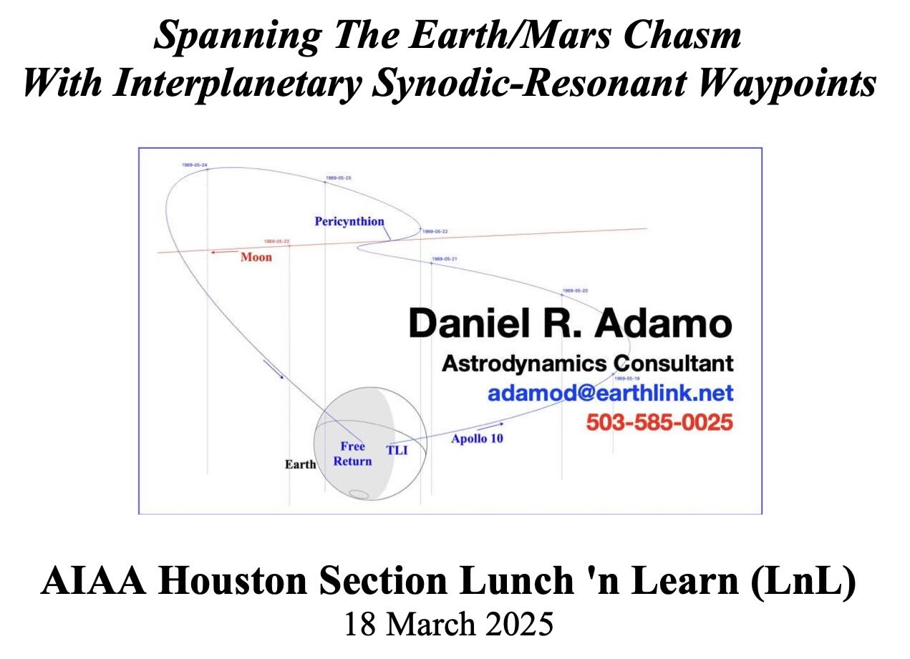
[2025 03 18] Tuesday, March 18, 2025. An astrodynamics lunch-and-learn event presented by Mr. Daniel R. Adamo for AIAA Houston Section. Use this link for details, including his presentation (PDF).
2024-2025
Events & Publications

Slide 12
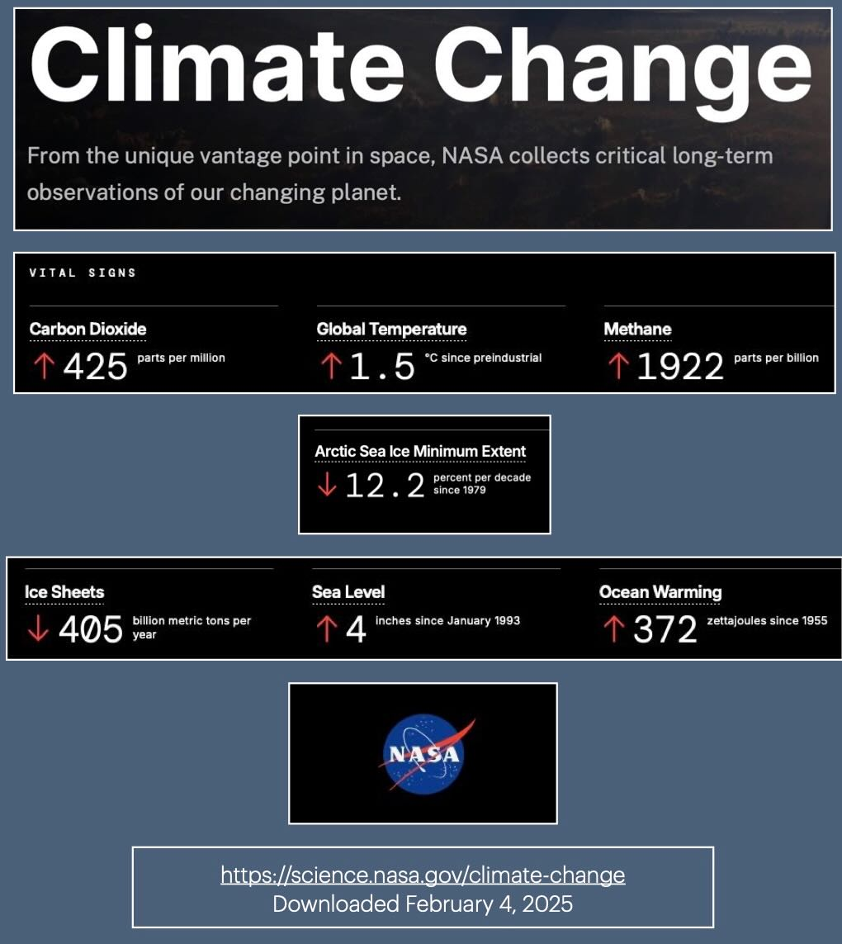
[2025 02 08] Saturday, February 8, 2025. AIAA Houston Section monthly status report (10 slides, 4 MB, PDF) from Douglas Yazell, retired, with two roles in our Section, Chair of our Section’s history technical committee and Chair of our Section’s International Activities Committee (IAC).
2024-2025
Events & Publications

Slide 13
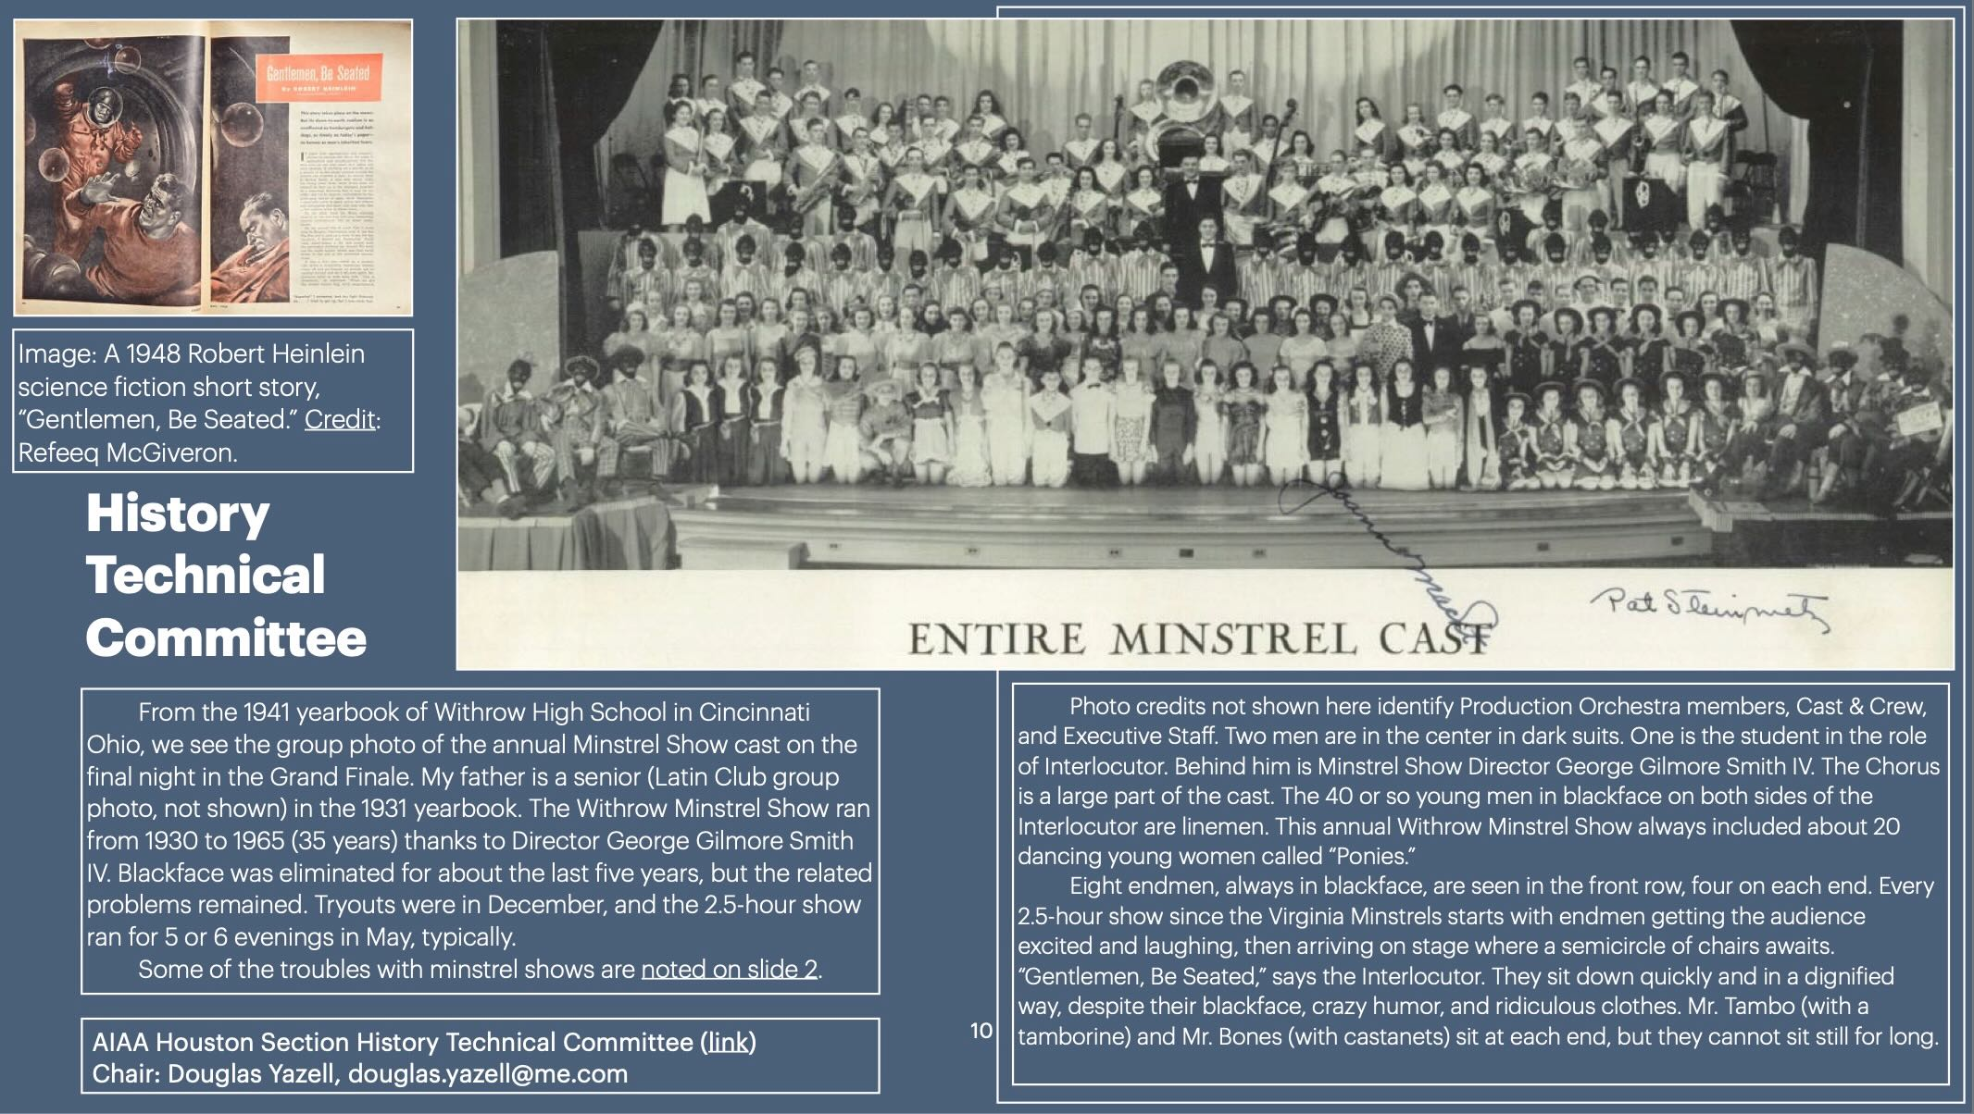
[2025 01 05] Sunday, January 5, 2025. AIAA Houston Section monthly status report (10 slides, 10 MB, PDF) from Douglas Yazell, retired, with two roles in our Section, Chair of our Section’s history technical committee and Chair of our Section’s International Activities Committee (IAC). My ten slides use a new format in order to simplify the presentation and keep the file size small enough to email (about 10 MB).
2024-2025
Events & Publications

Slide 14
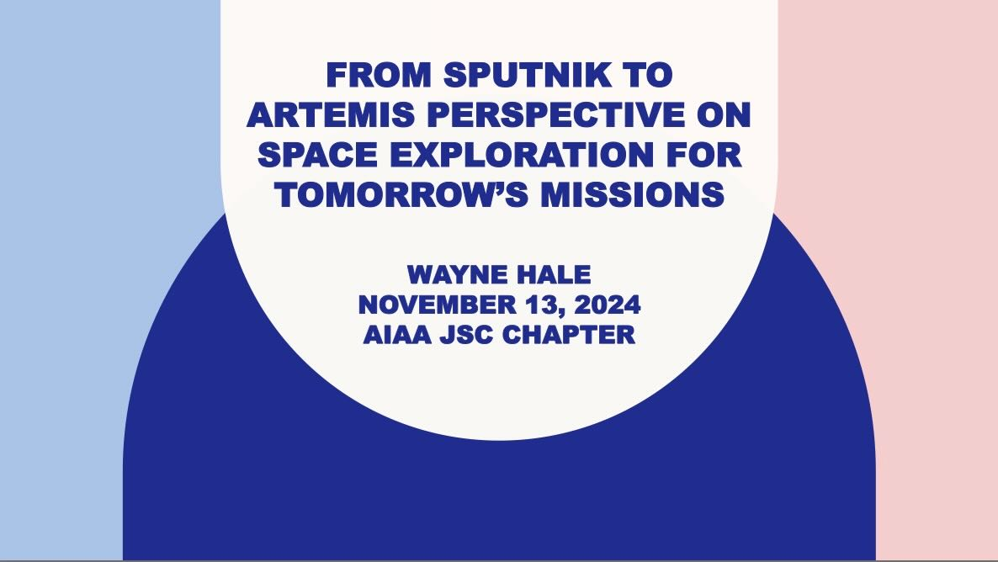
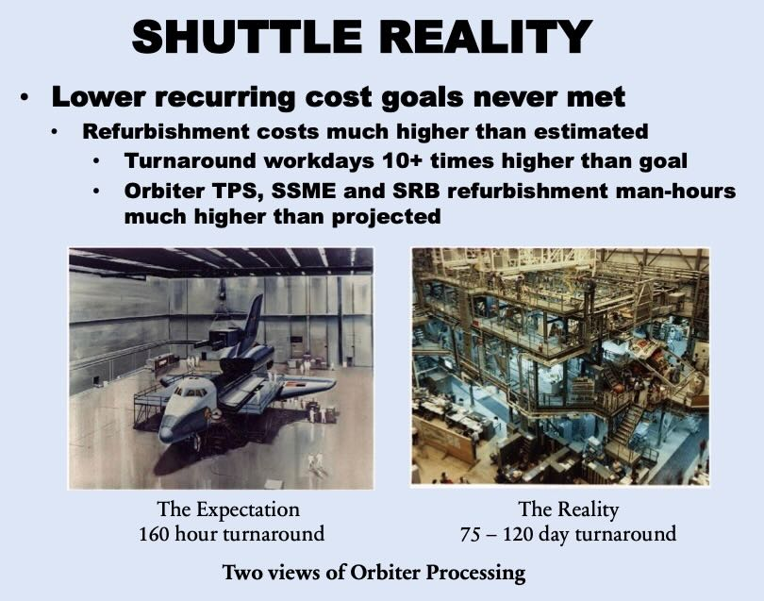
[2024 11 13] Wednesday, November 13, 2024. An AIAA Houston Section Dinner Meeting featuring Wayne Hale, presenting, “From Sputnik to Artemis: Perspectives on Space Exploration for Tomorrow’s Missions.” Here is a link to his presentation ( 91 charts/slides, 10.5 MB PDF). Our event sponsor was Amentum.
Wayne Hale spent 45 years in the aerospace industry, both as a NASA Civil Servant and as a private industry consulting engineer. He also served as a member of the NASA Advisory Council (NAC) for over ten years and a term as a member of the FAA Commercial Space Advisory Committee (COMSTAC). Wayne fully retired at the end of 2023.
Wayne has participated in space flight ventures that were successful and unsuccessful. He described his experience and especially that with recent or ongoing projects and how they may affect the future of space exploration especially as it concerns humans in space. His comments on NASA’s Commercial Crew program, the Artemis Program, Blue Origin, SpaceX, Boeing, and the competition with the People’s Republic of China were included.
[Twelve photos from this event are available using this link for the LinkedIn page of AIAA Houston Section.]

Slide 15
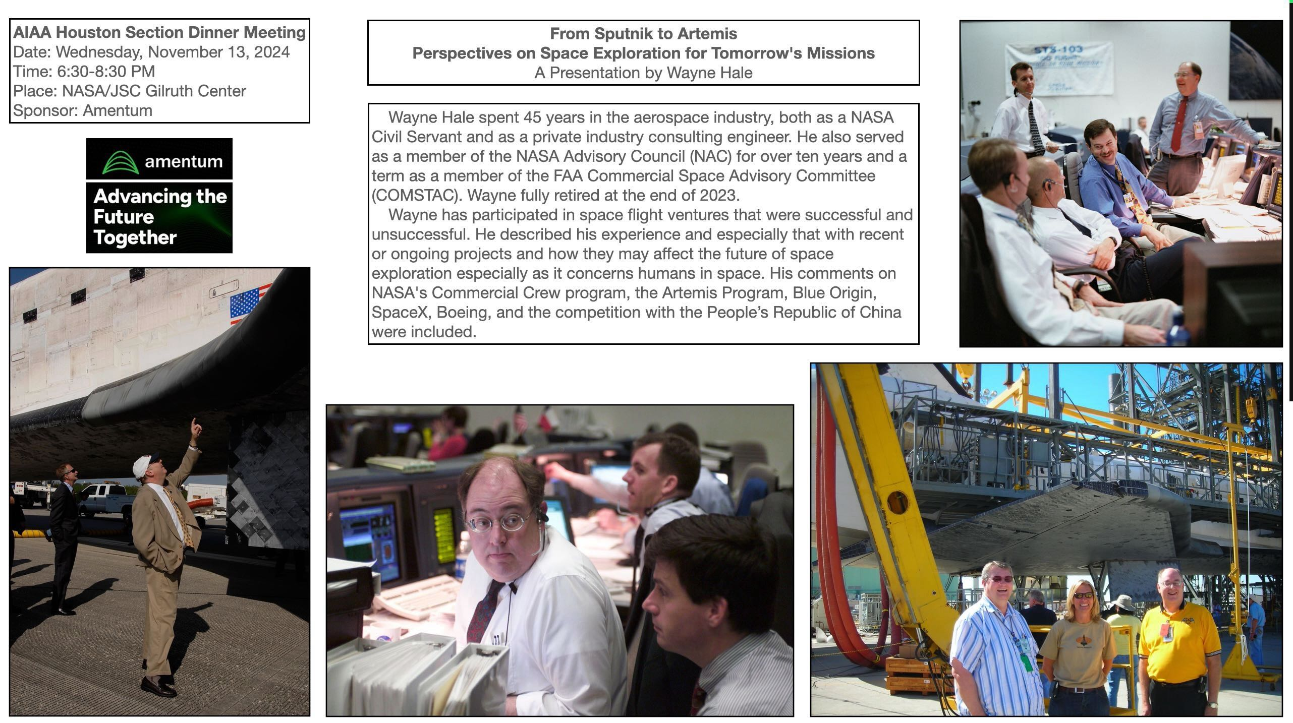
[2024 11 13] Wednesday, November 13, 2024. An AIAA Houston Section Dinner Meeting featuring Wayne Hale, presenting, “From Sputnik to Artemis: Perspectives on Space Exploration for Tomorrow’s Missions.” Here is a link to his presentation ( 91 charts/slides, 10.5 MB PDF). Our event sponsor was Amentum.

Slide 16
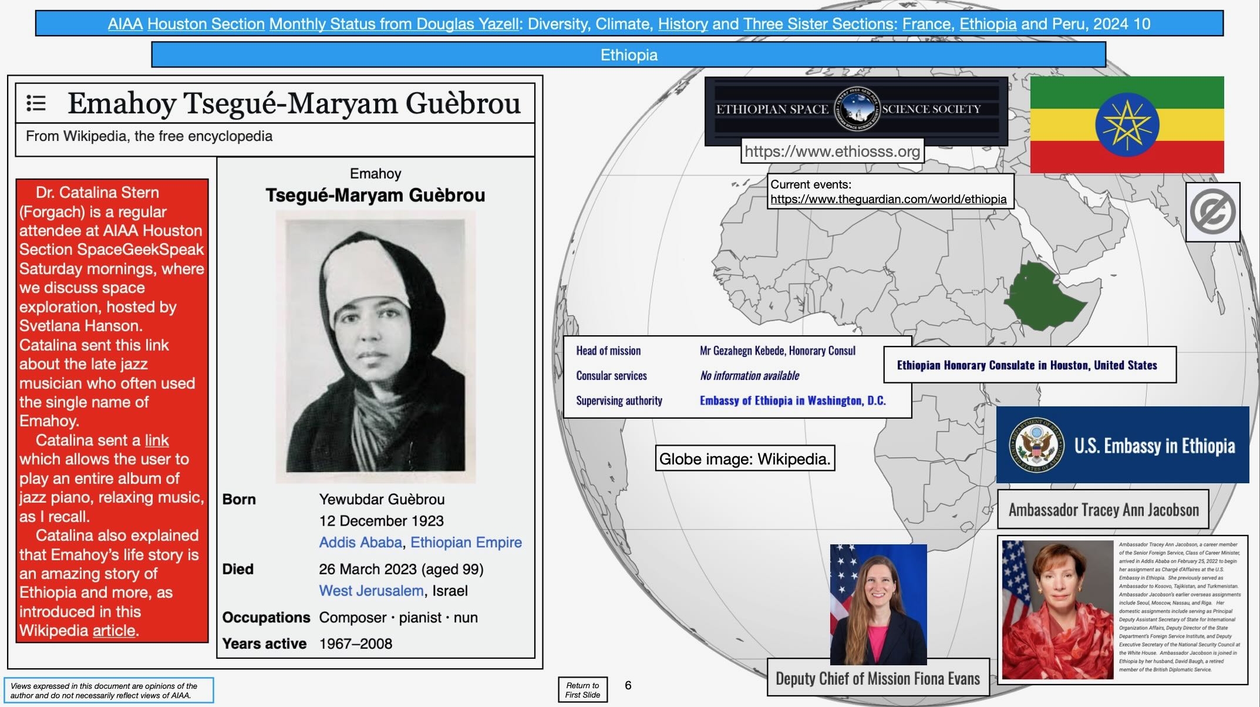
[2024 10 24] Thursday, October 24, 2024. This is my status report (10 slides, 18 MB) for AIAA Houston Section for our September council meeting. I am Douglas Yazell, an AIAA Houston Section retired member. My status report includes climate change news, international activities in our Section, and history technical committee notes for our Section. International activities in our Section include France, Ethiopia, Peru, and Mexico. Note that Mexico is paired with AIAA Houston Section in Region IV (with Texas, Oklahoma, New Mexico, and Arkansas), not Region VII, though Region VII is the international Region. My status report also includes notes on diversity, since I was a member of the AIAA Diversity Working Group (DWG) from 2015 to 2023.

Slide 17
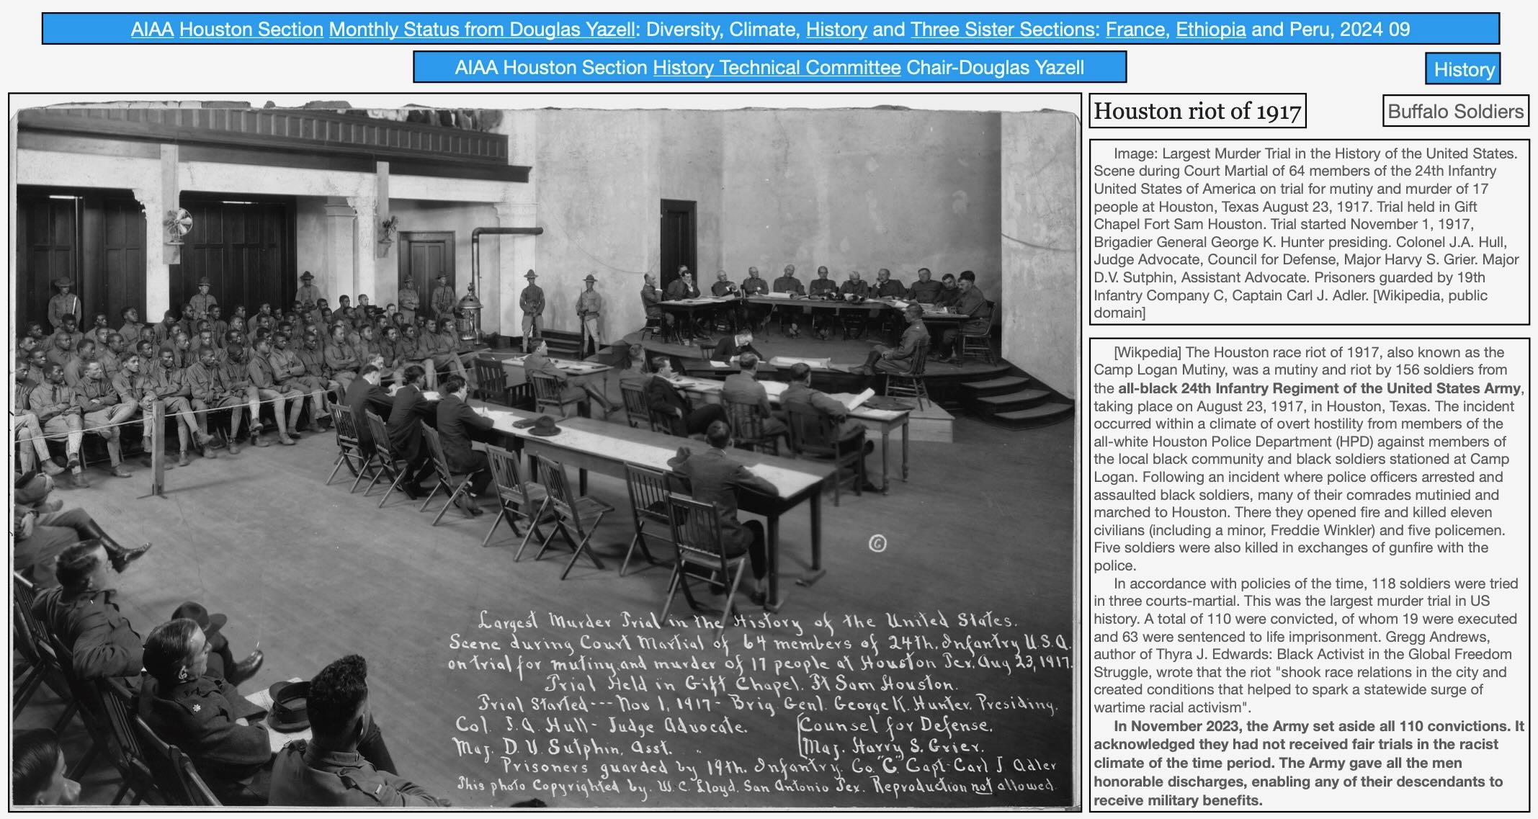
[2024 08 22] Thursday, August 22, 2024. This is my status report (10 slides) for AIAA Houston Section for our September council meeting. I am Douglas Yazell, an AIAA Houston Section retired member. My status report includes climate change news, international activities in our Section, and history technical committee notes for our Section. International activities in our Section include France, Ethiopia, Peru, and Mexico. Note that Mexico is paired with AIAA Houston Section in Region IV (with Texas, Oklahoma, New Mexico, and Arkansas), not Region VII, though Region VII is the international Region. My status report also includes notes on diversity, since I was a member of the AIAA Diversity Working Group (DWG) from 2015 to 2023.

Slide 18
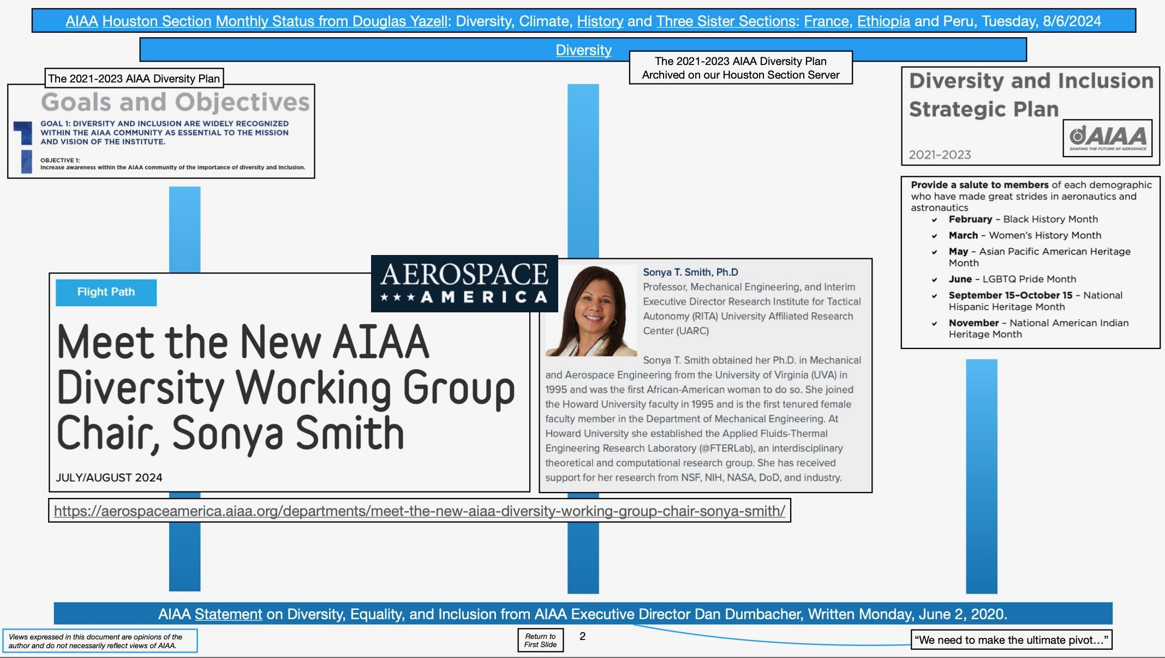
[2024 08 06] Tuesday, August 6, 2024, the date of our monthly AIAA Houston Section Council meeting. Status (10 slides, PDF) from Douglas Yazell, AIAA Houston Section retired member. My status report includes climate change news, international activities in our Section, and history technical committee notes for our Section. International activities in our Section include France, Ethiopia, Peru, and Mexico. Note that Mexico is paired with AIAA Houston Section in Region IV (with Texas, Oklahoma, New Mexico, and Arkansas), not Region VII, though Region VII is the international Region. My status report also includes notes on diversity, since I was a member of the AIAA Diversity Working Group (DWG) from 2015 to 2023.

Slide 19
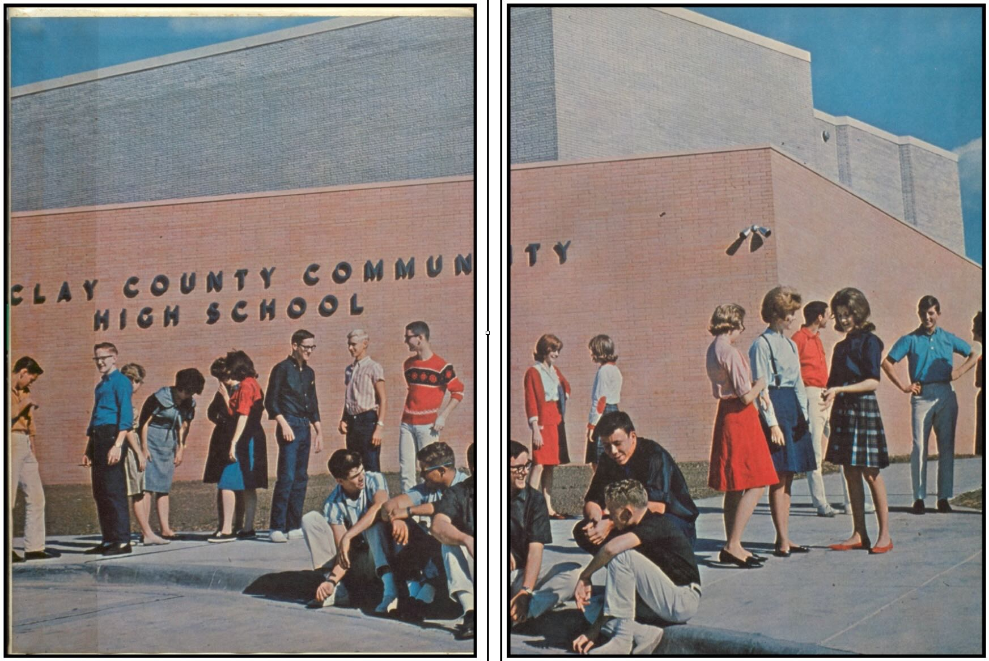
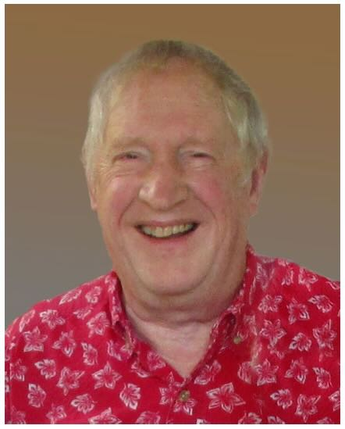
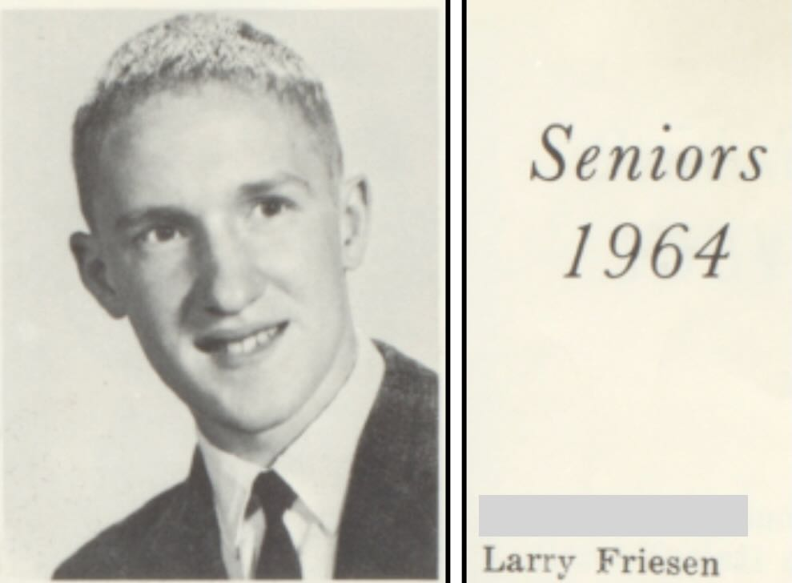
[2024 07 28] July 28, 2024. Obituary. Larry Jay Friesen (September 7, 1946 – July 28, 2024), PhD, an AIAA Associate Fellow and a member of AIAA Houston Section. This document (PDF) is a Houston version of his life story, but it also explains that Dr. Friesen was born and raised in Kansas, including his undergraduate university education. This Neptune Society (cremation services) web page commemorates Dr. Friesen and mentions his birthplace, Salina Kansas. I [Douglas Yazell] will add a few notes about Dr. Friesen.

Slide 20
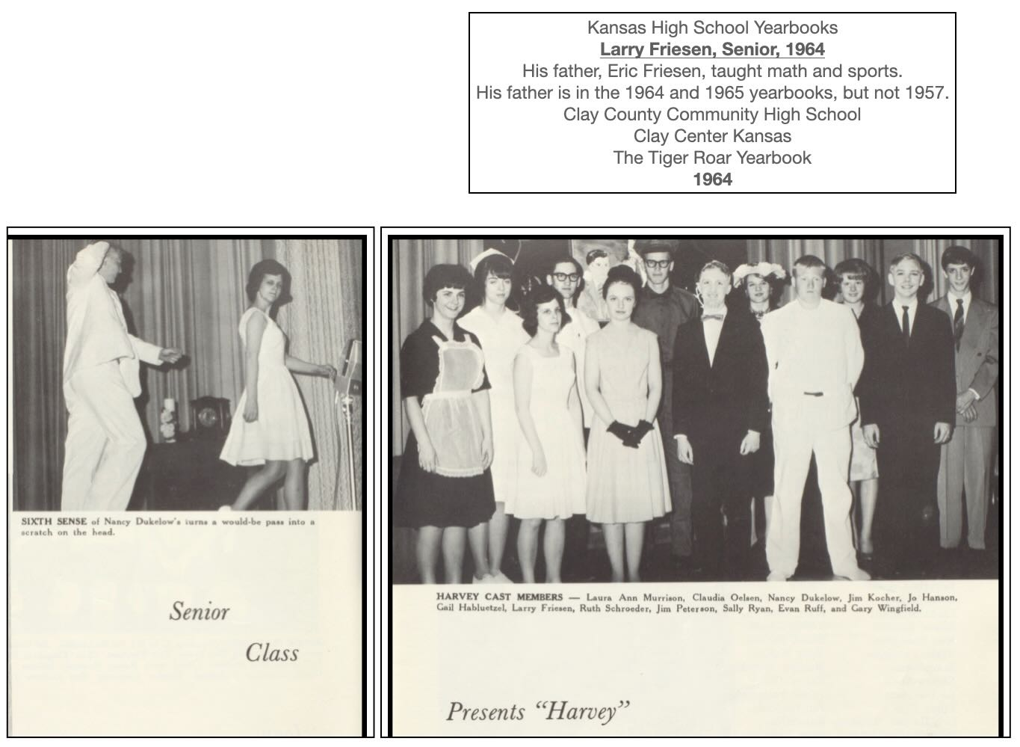
[2024 07 28] July 28, 2024. Obituary. Larry Jay Friesen (September 7, 1946 – July 28, 2024), PhD, an AIAA Associate Fellow and a member of AIAA Houston Section.
Like many public high schools in the USA, his high school in Kansas publishes a public archive (PDF) of their yearbooks, as many as they can find. Dr. Friesen graduated in 1964, and that yearbook is included, but not the prior 3 yearbooks. I created some “Friesen” Keynote presentation slides (exported to PDF) from the 1964 yearbook. His late father Eric Friesen (1917 – 1993) taught math and coached the cross country track team in that school, so I included him. Dr. Larry Jay Friesen was in the cast of a play, Harvey as a senior in high school, and Wikipedia features this description of the play: “Harvey is a 1944 play by the American playwright Mary Chase. She received the Pulitzer Prize for Drama for the work in 1945. It has been adapted for film and television several times, most notably in a 1950 film starring James Stewart and Josephine Hull.”
These yearbooks are included in Classmates dot com (free membership).

Slide 21
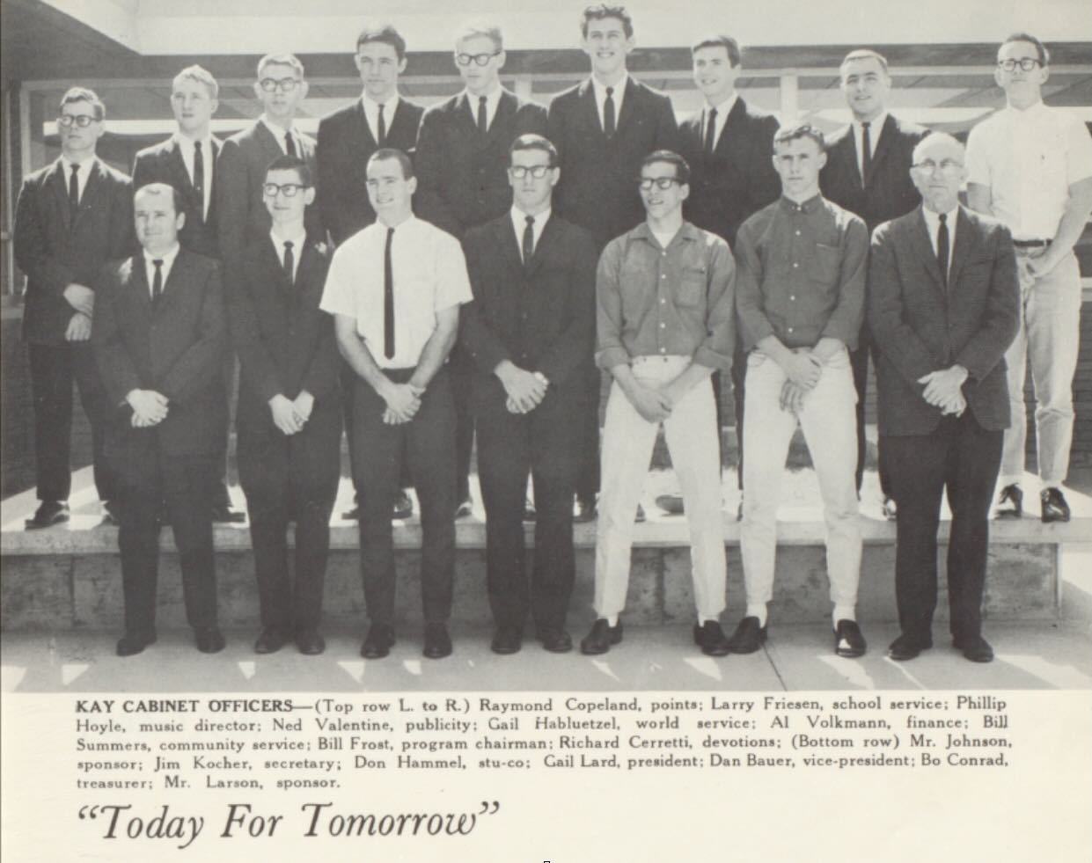
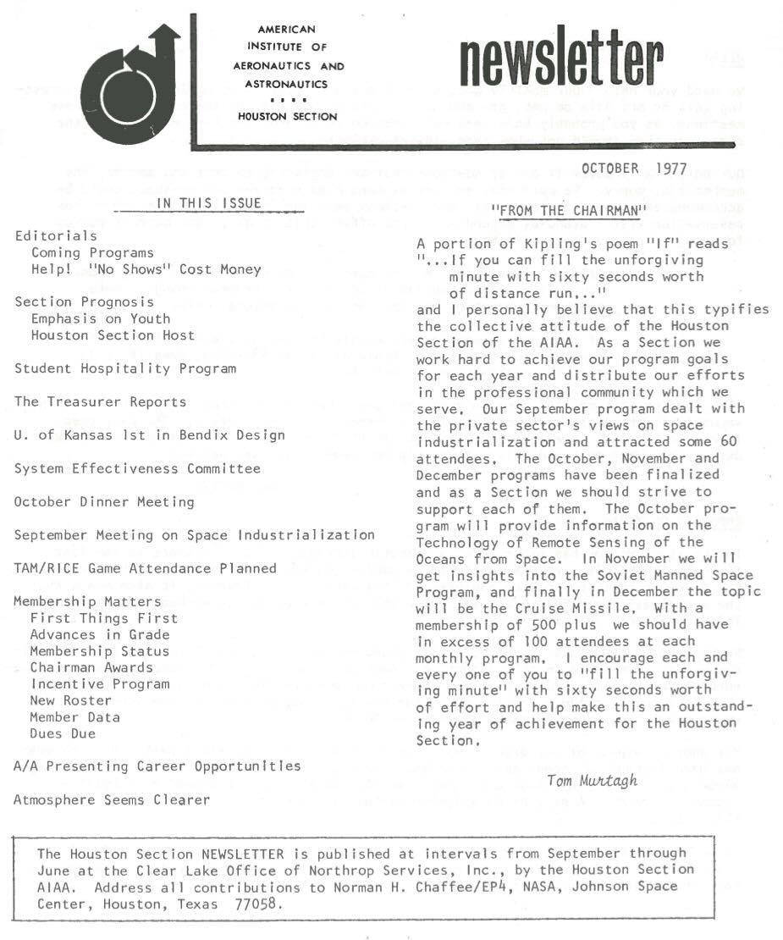
[2024 07 28] July 28, 2024. Obituary. Larry Jay Friesen (September 7, 1946 – July 28, 2024), PhD, an AIAA Associate Fellow and a member of AIAA Houston Section.
When I searched for issues of our newsletter Horizons for our public archive, Dr. Friesen sent me quite a few issues (which I scanned and converted to PDF, then returned), more issues than any other source. The September 1990 issue is the first one we have named Horizons instead of Newsletter, and the earliest issue we found so far is the October 1977 issue.
Kay High School Club:“K” for Kansas

Slide 22
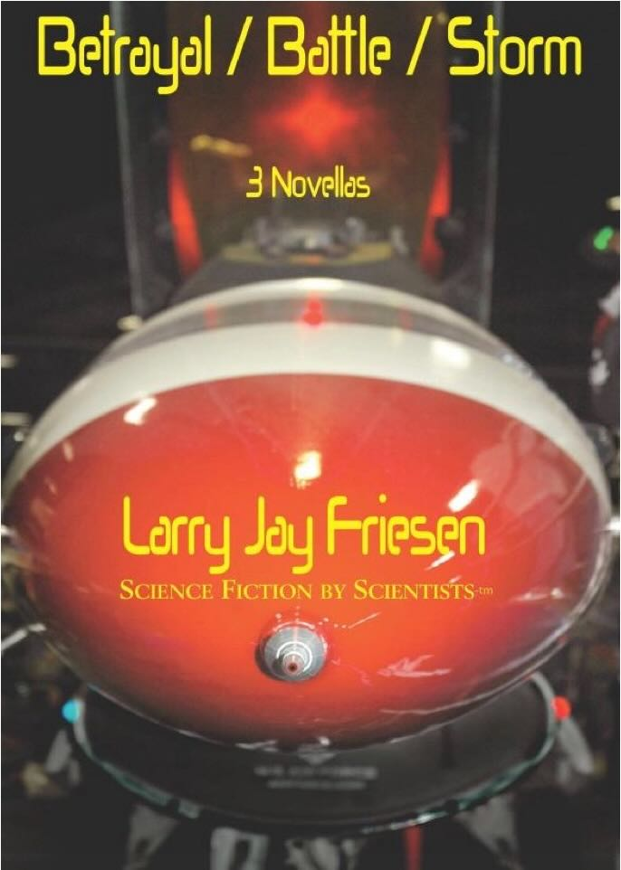
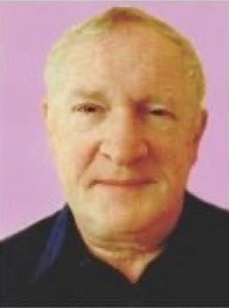
[2024 07 28] July 28, 2024. Obituary. Larry Jay Friesen (September 7, 1946 – July 28, 2024), PhD, an AIAA Associate Fellow and a member of AIAA Houston Section.
As mentioned in a document above, Dr. Friesen is the author of the 2012 book from Firefall Media in a series called Science Fiction by Scientists. The book is featured in a one-page article in the January / February 2013 issue of Horizons, newsletter of AIAA Houston Section. Here is a link to that one-page article, available to the public (PDF).
The book is three novellas and the title of the book is Betrayal / Battle / Storm. The titles of the three novellas, in the order referenced in the book title, are Buddy System, Sail a Dusty Sky, and Armor in Aristoteles.
The one-page feature article includes this biography of Larry Jay Friesen: “With a PhD from Rice University in Space Physics & Astronomy, Larry Jay Friesen worked at [NASA] Johnson Space Center from 1976 through 1998, mostly for McDonnell Douglas and Lockheed Martin. He currently teaches Astronomy and Physics at the University of Houston – Clear Lake. He was elected as an Associate Fellow of the American Institute of Aeronautics and Astronautics (AIAA). He brings a wealth of accurate detail to the highly probable reality of his stories.”

Slide 23
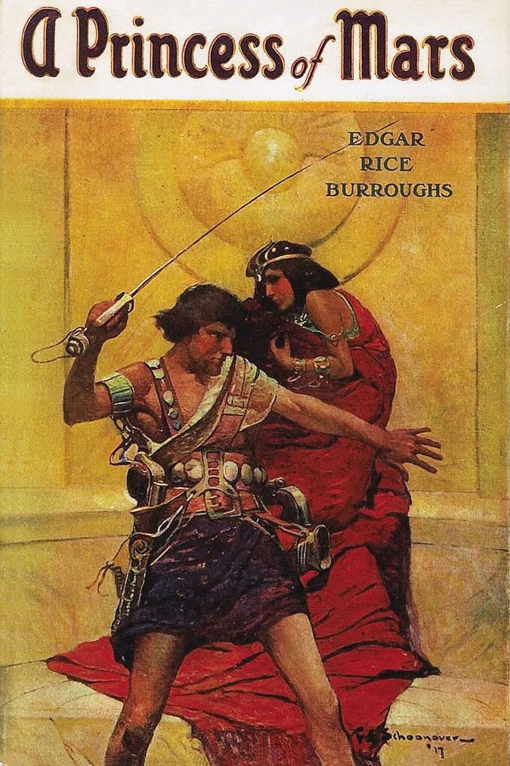


[2024 07 28] July 28, 2024. Obituary. Larry Jay Friesen (September 7, 1946 – July 28, 2024), PhD, an AIAA Associate Fellow and a member of AIAA Houston Section.
A family member told me Dr. Friesen was an expert on Edgar Rice Burroughs (1870 – 1950), creator of John Carter of Mars, Tarzan, Pelluidar, Carson of Venus, and much more. I recall the science fiction author Robert Heinlein (1907 – 1988) writing to defend the Burroughs science fiction, saying it was good science fiction for its time.
I started collecting Ballentine paperback book editions of the Burroughs novels around 1964, but Larry enjoyed original hardcover editions, though he was only 6 years older than me.
The 1917 Frank Schoonover cover of A Princess of Mars by Edgar Rice Burroughs, published by McClurg. Credit: Wikipedia.
The 1918 cover art by Frank E. Schoonover from The Gods of Mars by Edgar Rice Burroughs, McClurg, 1918. Credit: Wikipedia (via Flickr).
The 1919 cover art by J. Allen St. John from The Warlord of Mars by Edgar Rice Burroughs, McClurg, 1919. Credit: Wikipedia via Flickr.

Slide 24
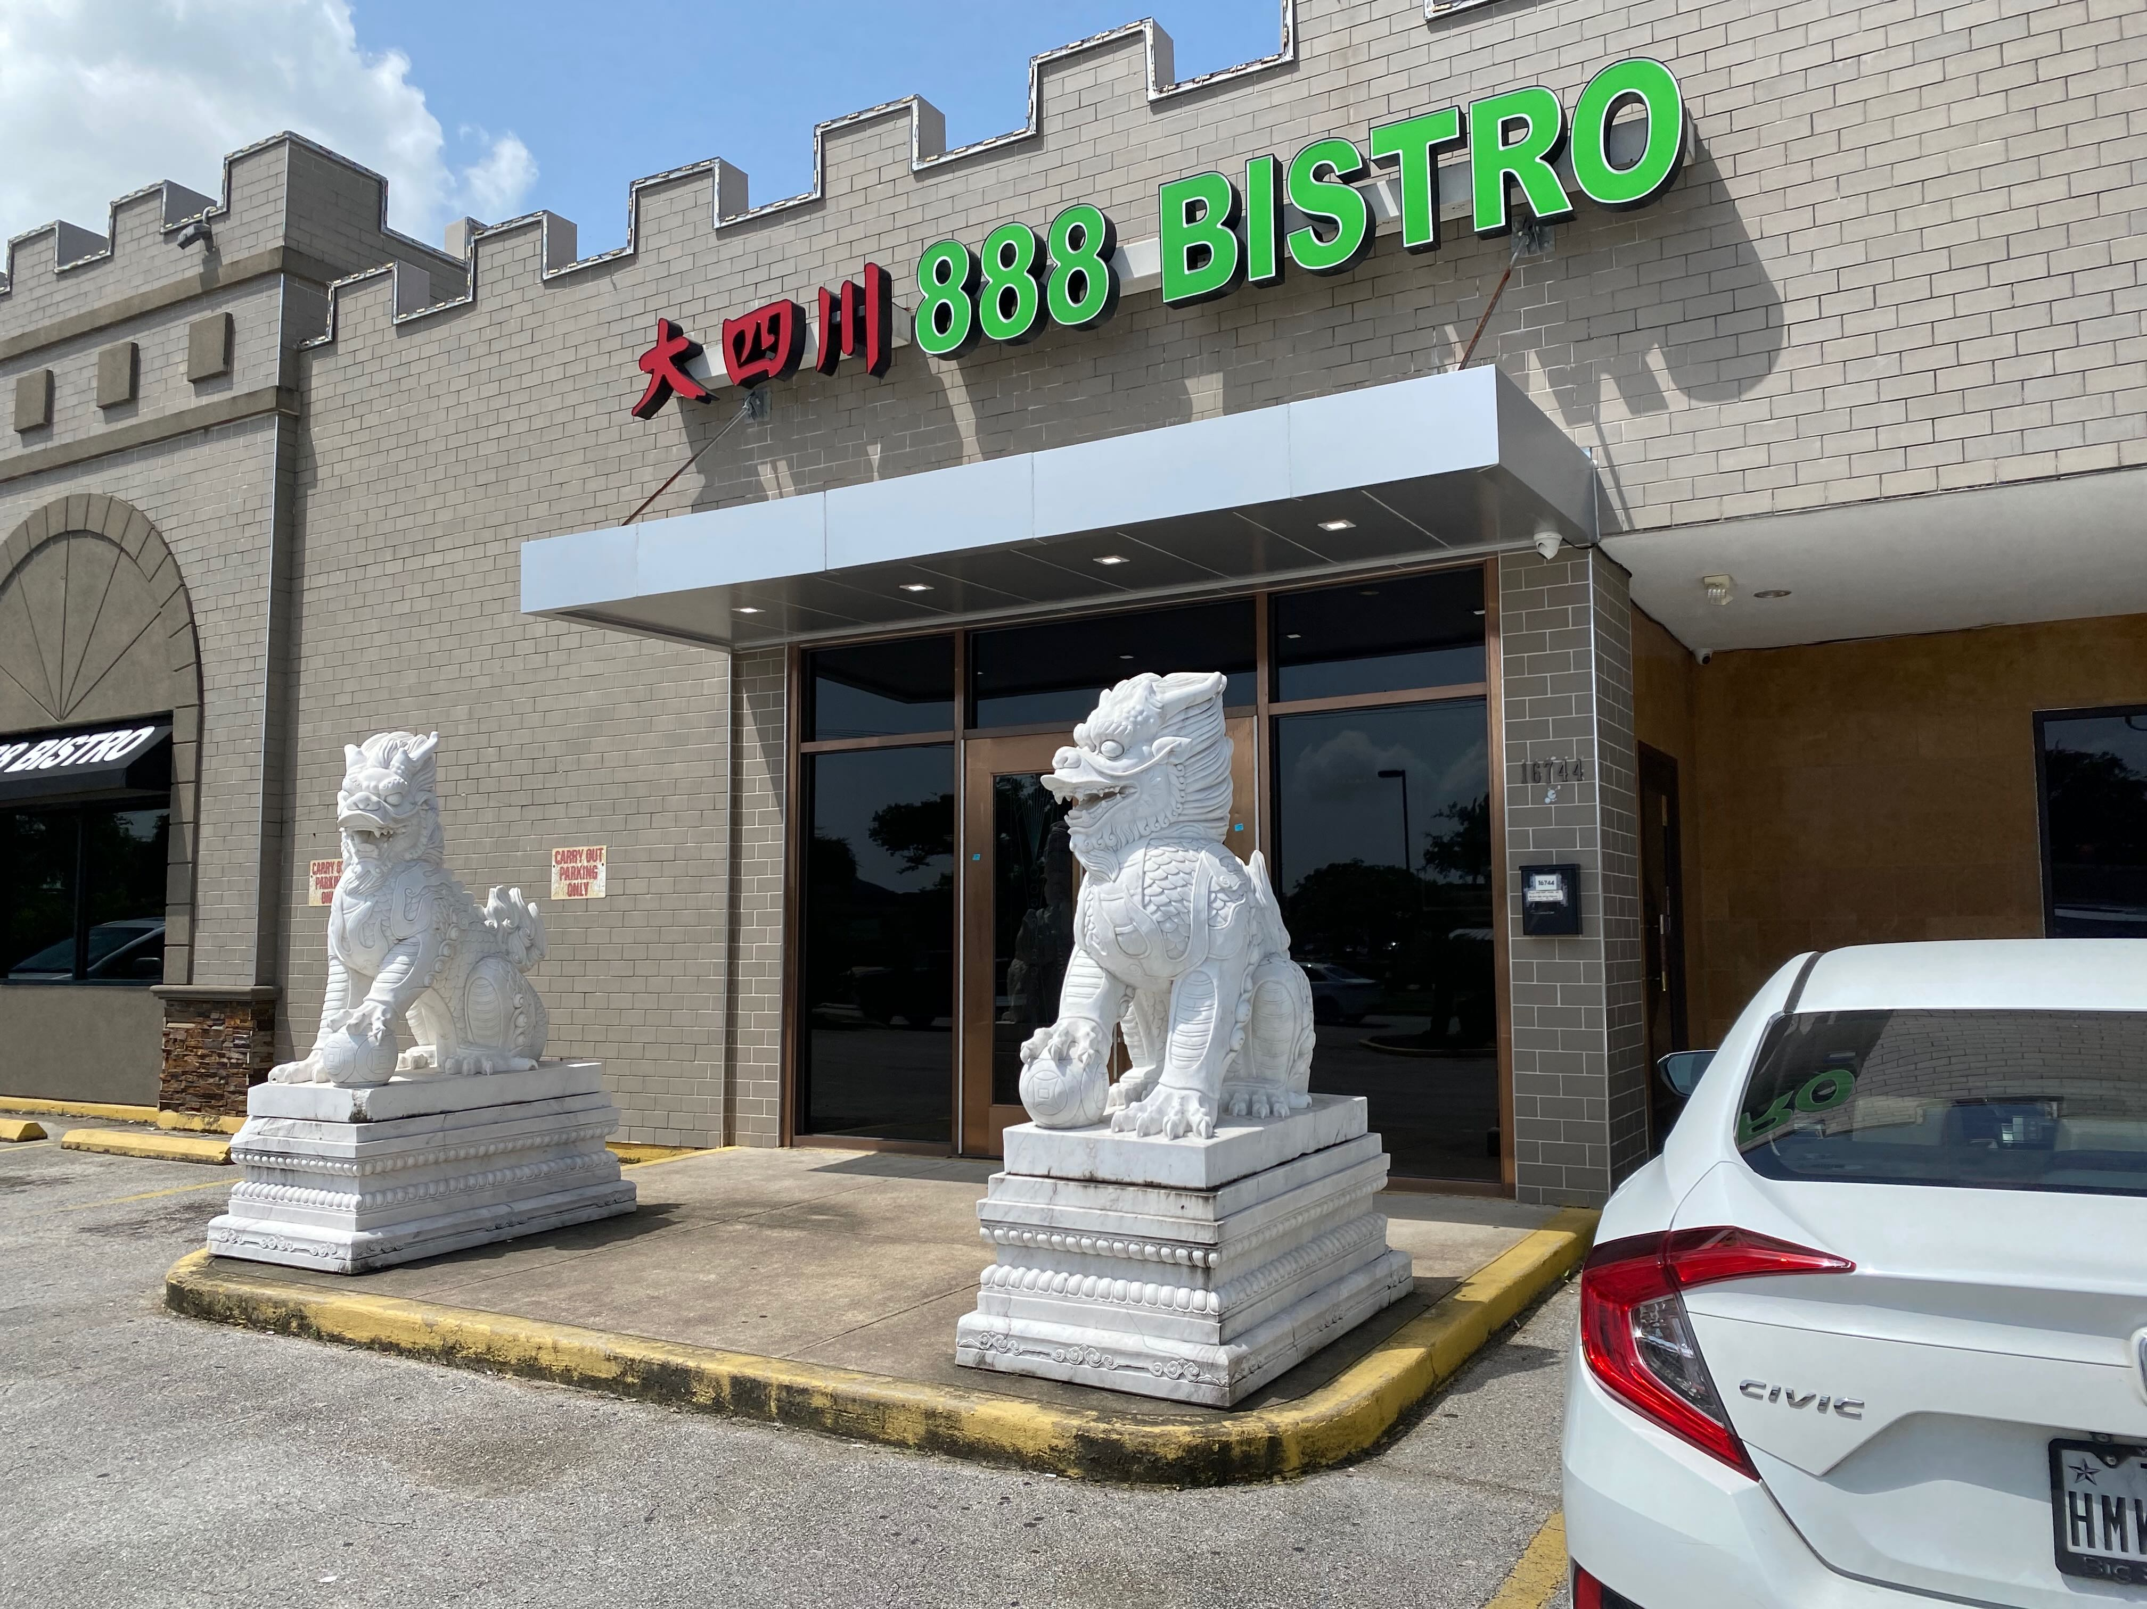
[2024 07 28] July 28, 2024. Obituary. Larry Jay Friesen (September 7, 1946 – July 28, 2024), PhD, an AIAA Associate Fellow and a member of AIAA Houston Section.
A document above mentions a weekly or biweekly lunch in the NASA/JSC community which Dr. Friesen often or almost always attended. I joined them decades ago, and they told me it started with one man as an astronomy brown bag lunch. I suppose it moved to restaurants long before I attended.
I sometimes think of it as an astrodynamics lunch. Four of us were still meeting about monthly just a few weeks ago, including Dr. Friesen, at 888 Bistro on El Camino Real. It is a good location with good food. We moved it from Wednesdays to Thursdays recently. We were starting early, as early as 11:15 AM, but noon is the usual time for lunch. The tradition might or might not continue. [Al Jackson, Jon Zahn, and I [Douglas Yazell] enjoyed lunch there a few weeks ago. Other recent attendees include Tom Hile and Wes Kelly. [September 3, 2025]
Image credit: Douglas Yazell, July 1, 2025.

