Slide 1
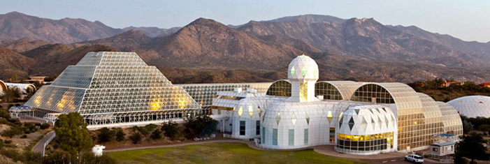
Biosphere 2: a space settlement prototype 30 years ahead of its time
SYSTEMS Biology for sustainable life outside earth
Dr. Greg Stanley
Presentation OCT 24, 2020, to
AIAA HOUSTON – Annual TECHNICAL SYMPOSIUM 2020

Slide 2
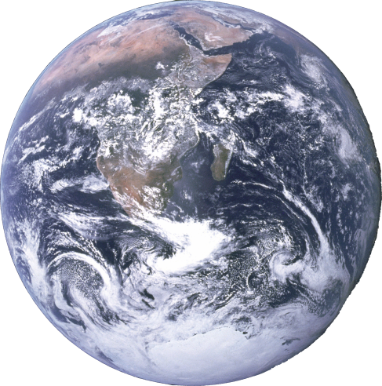
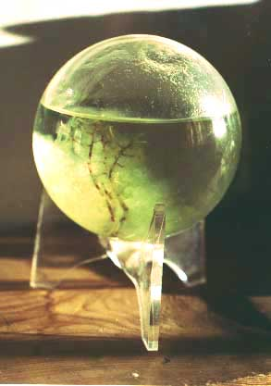
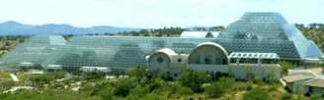
What is a biosphere
All ecosystems inside an “enclosed” volume
Closed system materially (or almost)
Open system for energy and information
Includes atmosphere, seas, geological processes
Sustainable, self regulating given just energy input
1
2
“EcoSphere®”

Slide 3
How small can a biosphere be?
Earth (Biosphere 1) works, but is complex and hard to model
  Many species & interactions
  Many closed material cycles: water, carbon, nutrients, etc.
    Includes geological processes
  Roughly self regulating over all time scales, with adaptation
    Sun is 25% to 30% brighter than at start of life
    Survived ice ages, warm periods, meteor impacts, rise of photosynthesizing organisms/oxygen in atmosphere, etc.
    Individual species arrive, 99% go extinct, but Biosphere survives
How small a biosphere could support people?

Slide 4
Why should we care?
Space settlements benefit by being as close to sustainable as possible
  High cost of importing anything, especially from Earth
  Risk of adequate, timely resupply
  Expansion beyond our solar system will require long trips and bringing enough Earth with us
We need space settlement: life on Earth is temporary
  Biosphere 1 will be boiled off by our expanding, dying sun
    (Even if we survive other potential catastrophes like asteroids, genetically-engineered plagues, war, etc.)
  We’re maybe a third to half of the way through the useful life of the earth. We better get going!

Slide 5
Biosphere 2
Engineering prototype and research tool for sustainable space settlement
  (Unlike, say the ISS which needs resupply)
Holds record as largest and longest-running closed environment test
  7.2 million cu.ft.
    (compare: 223x pressurized volume of ISS)
  8 people, 3800 species
  Sealed for 2 years starting in1991
Cost: around $200M
Facility still there (University of Arizona research lab), open to the public (and the atmosphere --no longer sealed)
This talk is a retrospective on the experiment, the ideas behind it, and the results
At least 30 years ahead of its time

Slide 6
Biosphere 2 details
3.14 acre building (plus basement)
91 foot maximum height at rainforest
40 acre site by Oracle, AZ (N. of Tucson), 3820 ft. el.
  Support buildings, cooling towers
  Energy center with 5.7 MW backup generators, boilers, water chillers
    Power failure: 20 minutes until plants damaged
Closed to material flow, open to energy and information (as would be a space or Mars colony)
  Low air leakage rate – about 10%/year
  Energy input: passive solar, power grid with backup
  Energy removal: cooling tower water and chilled water
  Special sealants for 6500 windows in space frame
  500 ton welded stainless steel liner underneath

Slide 7
Biosphere 2 organized as 7 connected “biomes”
5 Wilderness biomes
  Rainforest (Amazonian, with lowlands, 50 ft. mountain, and cloud forest with misters and condensers to generate rain)
  Savannah (from tropics to thorn scrub)
  Marsh (Fresh → Salt, mangroves, Everglades)
  Ocean (35 feet deep, 1 million gallons, with coral reef, waves, and tides)
  Desert (Baja California fog desert – humid)
IAB (Intensive Agricultural Biome)
Human habitat
Other stuff
… “lungs”, and a basement, referred to as the “technosphere”

Slide 8
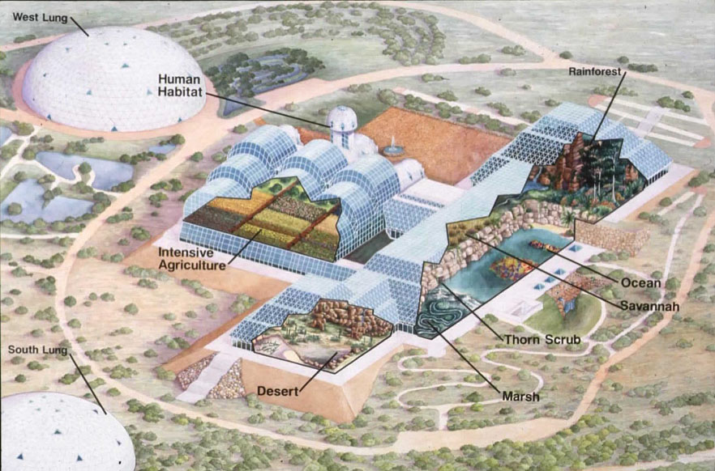
3D cutaway overview

Slide 9
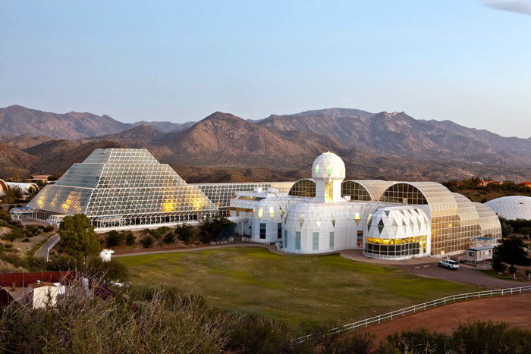

Slide 10
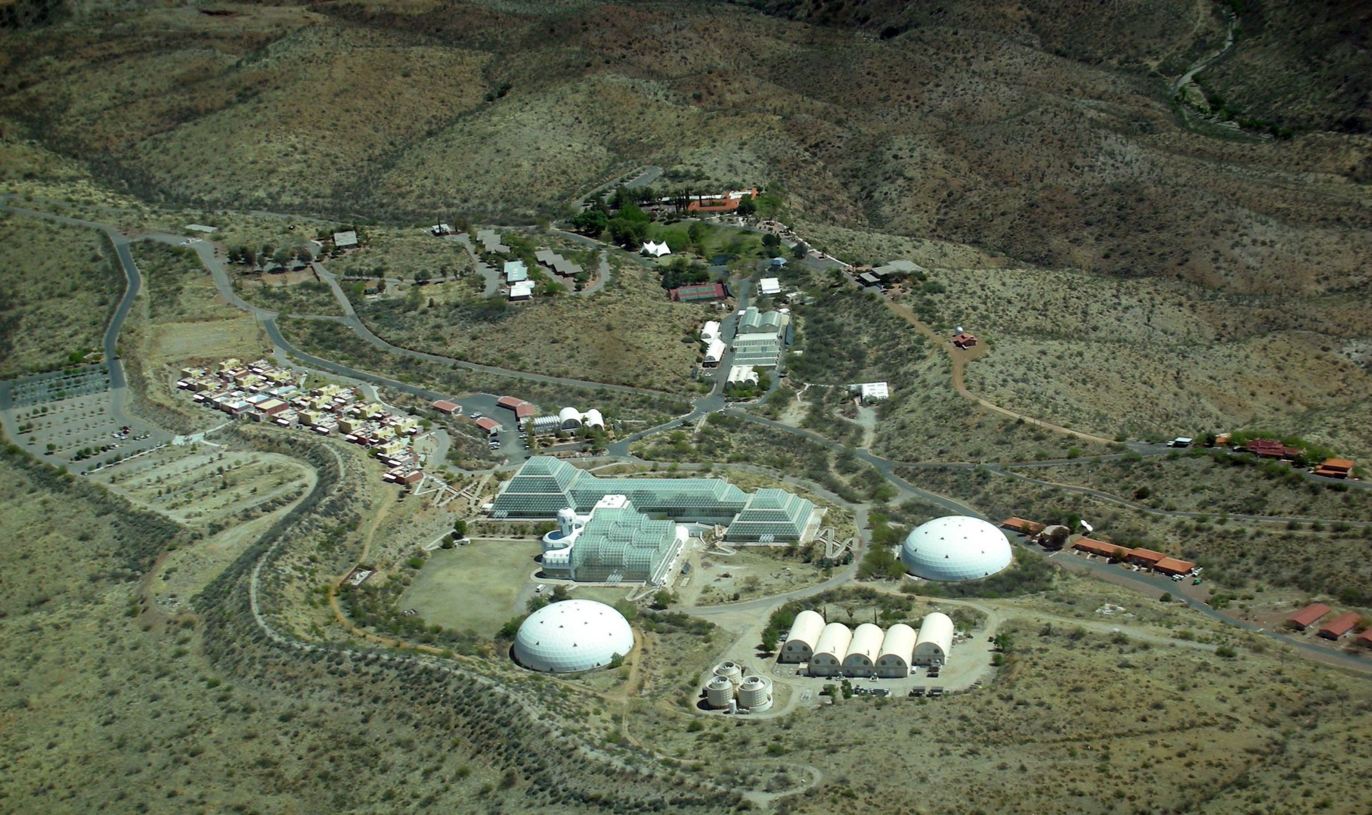
Site overview

Slide 11
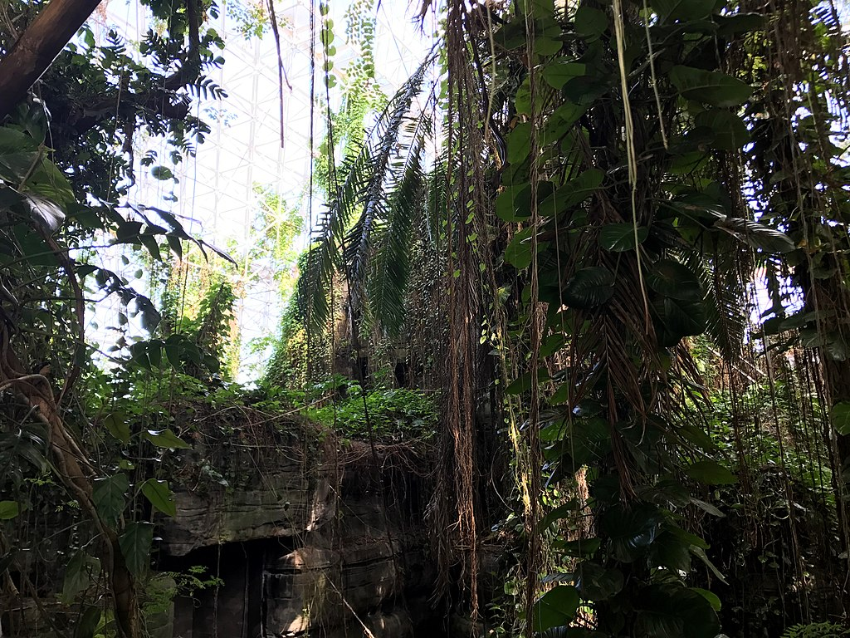
rainforest

Slide 12
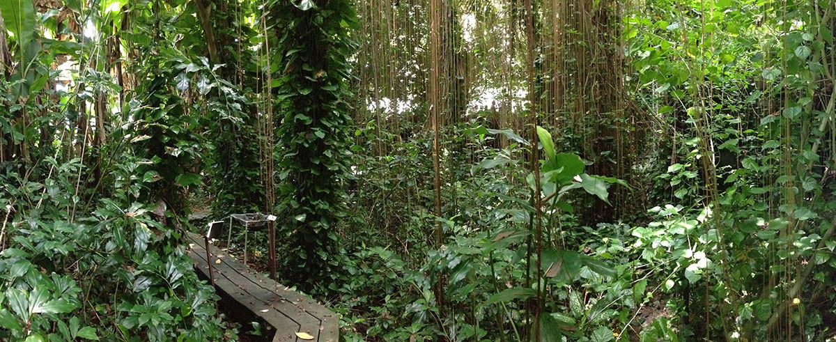
Rainforest lowlands

Slide 13
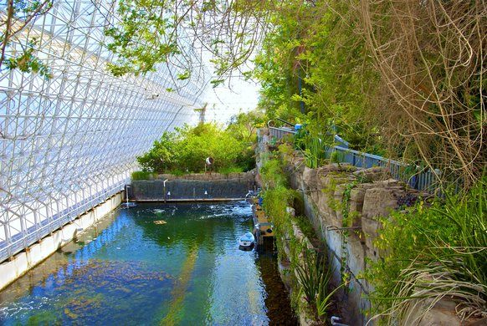
Ocean, view towards marsh and wave maker, savannah at right

Slide 14
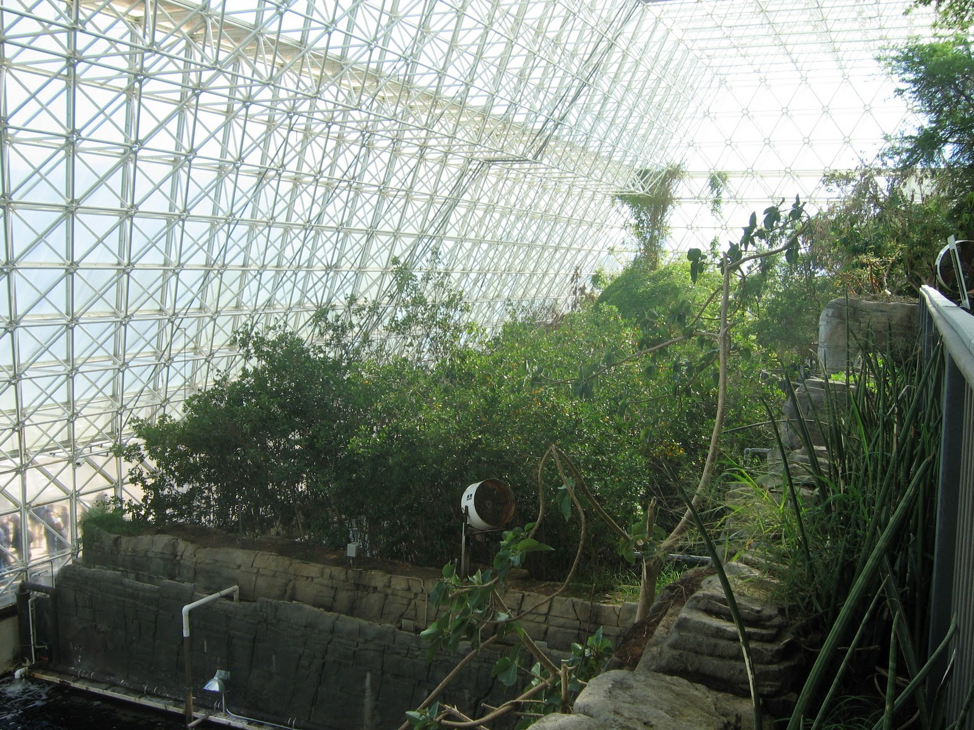
Mangrove Marsh, with terracing somewhat visible

Slide 15
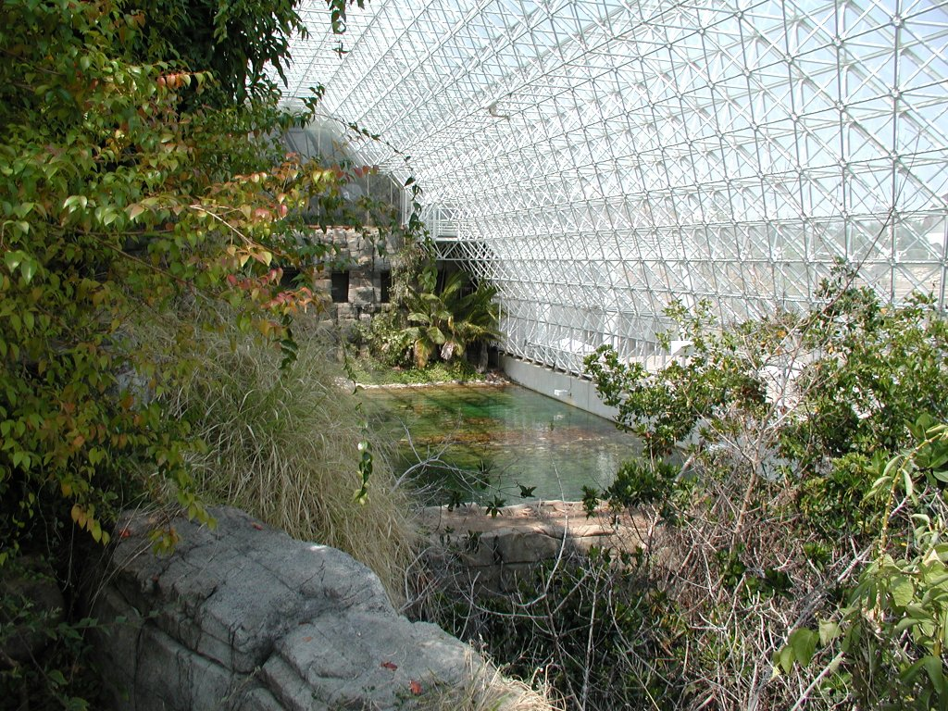
savannah towards rainforest, overlooking marsh, ocean

Slide 16
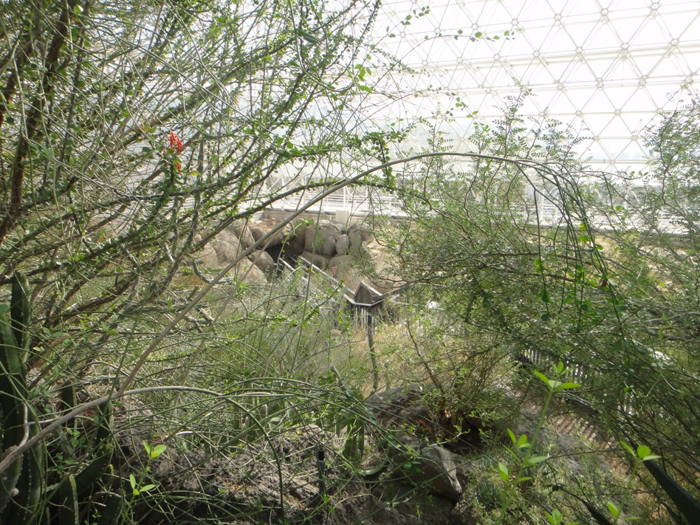
Savannah thorn scrub overlooking desert

Slide 17
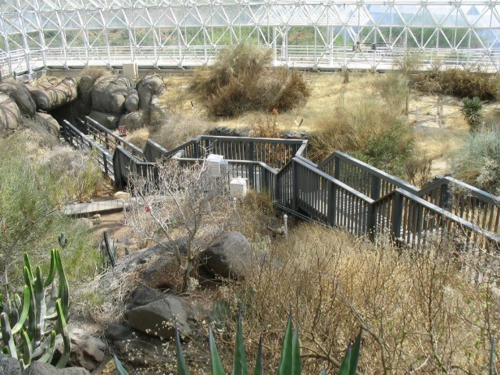
Fog desert

Slide 18
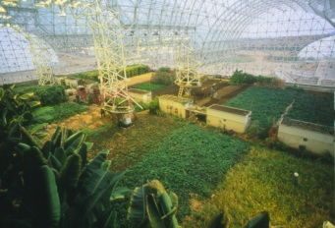
Intensive agricultural biome (IAB)

Slide 19
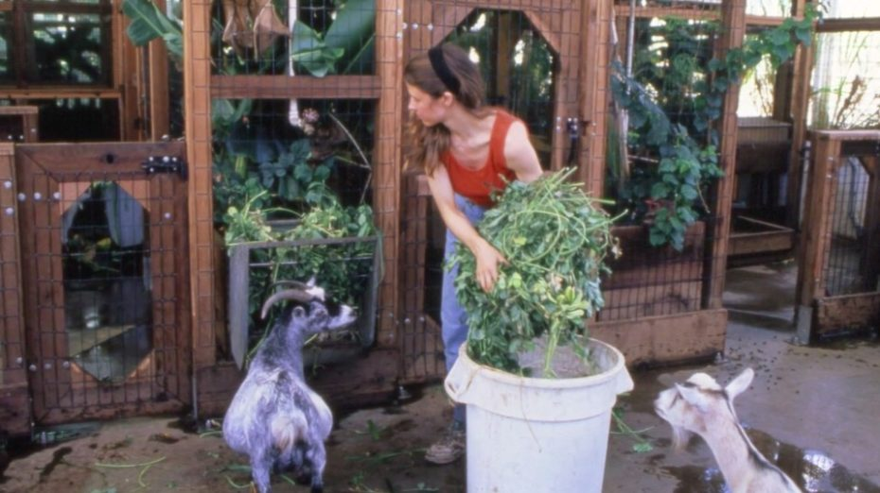
Pygmy goats

Slide 20
“Technosphere” a.k.a infrastructure in basement
HVAC (Heating, Ventilating, Air Conditioning)
  26 AHUs (Air Handling Units) – 14 large, 12 smaller cooling-only
  Heating, cooling, condensing water for drinking and “rain”
  Peak air recirculation rate of 1 million cu.ft./min.
120 pumps, plumbing, wiring
Tanks for water storage
Crop storage
Machine shop
Algae-based nutrient removal system for ocean

Slide 21
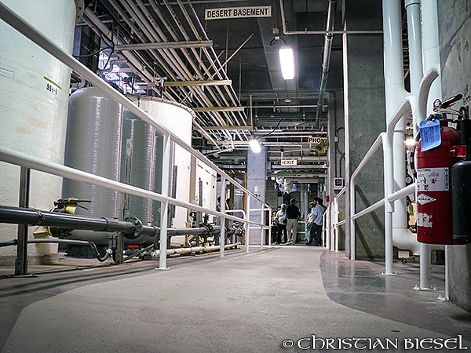
Technosphere (basement)

Slide 22
The co₂ scrubber
CO₂ scrubber secretly added very late in project
  Chemical, not the metal oxide as in space shuttle
Controversial when revealed later
  Many thought it violated “sustainability” spirit of the project
  Secrecy vs transparency issue
Sustainability purist vs today’s pragmatist issue
  Now, space travel is ALL “technosphere”, and we need to start introducing biology to increase sustainability
  This project started at the other extreme: get as close as possible to a sustainable biosphere
  Reality: future systems will be hybrid for a long time

Slide 23
Biosphere 2: other features
Ponds, streams, waterfalls
Monitoring systems for air, water, soil (2500 sensors, analyzers, lab)
Two “Lungs” (1 million cu.ft. each)
  Provide constant pressure slightly above atmospheric
  Avoid blowing out or imploding glass due to temperature changes (remember the ideal gas law!)
  Ensure leaks are outward, not inward (contaminate experiment)
  Like a floating roof tank
    16-ton aluminum disk, 4 tons of synthetic rubber membrane
    Disk level goes up and down during the day

Slide 24
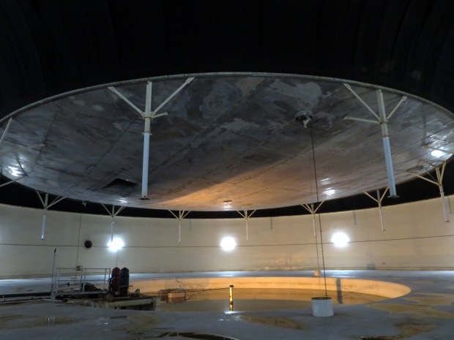
South Lung, inside view

Slide 25
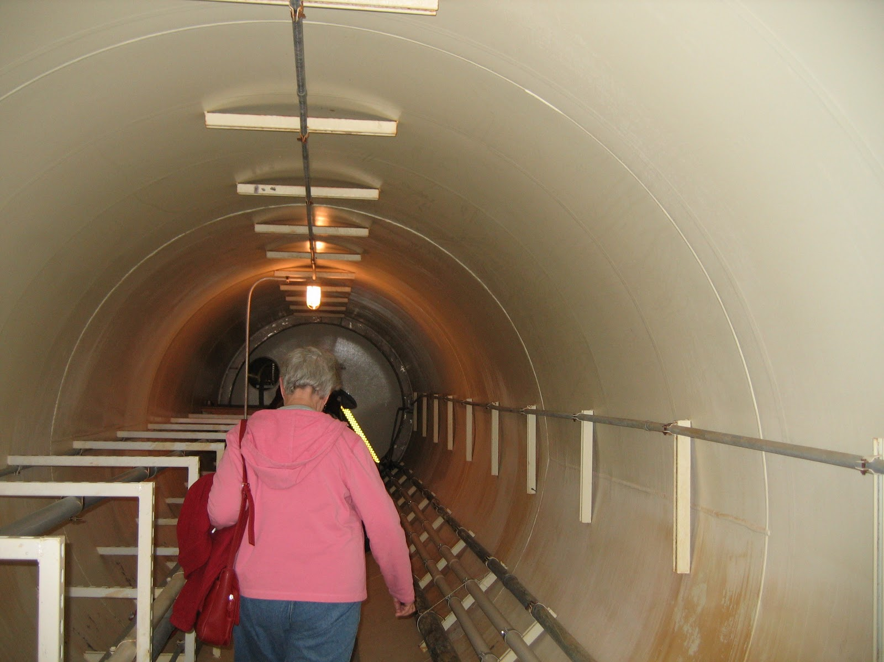
Tunnel between lung and main buildings

Slide 26
How do you Design a biosphere?
What were the goals?
What were the constraints?

Slide 27
Goals of biosphere 2
Demonstrate feasibility of long-term life in a sealed environment (plants, animals, 8 people)
  Complete material isolation: sustain air, soil, water, etc.
  Diet with self sufficiency in food production
  Design as a miniature version of Earth (Biosphere I)
    Better understand earth (global warming, effect of CO2, faster recycling, etc.)
Develop technology usable in space or on Earth
  Technology to help settle the Moon, Mars, …
  Recycling technologies such as soil-bed reactors, algal scrubbers, sewage treatment, …
  Highly productive agriculture
  Building techniques to minimize losses
Study human factors of small isolated workgroups
Tourism and education: an ecopark

Slide 28
DESIGN CONSTRAINTS - examples
Closed loop material cycles - EVERYTHING is recycled
  Food self sufficiency
  Breathable atmosphere
  Water: drinking, waste water, irrigation, “rain”, streams
  No toxic chemicals, including pesticides or herbicides
  Tightly sealed to minimize exchanges with Earth
    Positive pressure (slightly higher than outside atmospheric pressure)
    Ensure any leaks are out of Biosphere 2, not into it
    Avoid large pressure difference blowing out windows
2 years for first closure experiment,100 year life

Slide 29
Testing the Gaia hypothesis
A biosphere should be self-regulating, like Earth
Doesn’t require any mystical belief – it’s an emergent property of interactions among species
Examples predator/prey cycles

Slide 30
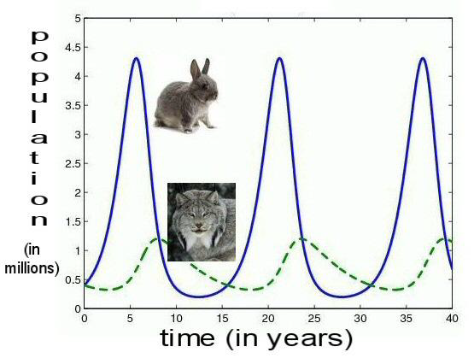
Predator/prey cycles
Hare and Lynx example
Biosphere 2 eliminated this for large animals
  Too much risk of extinctions with small populations
  Humans as “keystone predator”

Slide 31
System stability for biospheres
Control theory has definitions of stability for systems
  Bounded input, bounded output: allows cycles as long as they stay within bounds for given external disturbances
Complex web of species interactions dominates
  System behavior is determined by interactions, not just one species by itself
  Analogous example: understanding individual neurons provides almost no understanding of what the brain does
Different system behavior with each added species
  Case with no predators has very different cycles
    Too many hares, at risk of collapse in years of bad weather
    Diseases may limit populations
System robustness should improve with more species

Slide 32
Species packing
Too hard to accurately model and simulate complex systems like a biosphere.
  Accept that you’ll never know everything. Then what?
Led Biosphere 2 to “species packing”
  If you don’t know exactly what you need, fill a big suitcase!
  Add many species, not knowing which ones will survive
  Expect the system to self-organize, with some extinctions
  Use some actual seawater, soil, etc. to ensure microbes, which could be considered the most important species
  Started with 3800 species

Slide 33
Agriculture
(intensive agriculture biome)
18 plots, producing 3 crops per year
86 crops (including herbs)
  Beans, potatoes, peanuts for protein
  Oats, barley, rice, wheat, millet, sorghum, maize, soybeans
  Sweet potatoes, beets, taro, rape, mustard, safflower, tomatoes, cabbage, carrots, eggplant, peppers, leafy vegetables
  Bananas (in rainforest), papayas, pineapple, guava, apples, grapes, strawberries, oranges, sugar cane
Initially, animals included African pygmy goats (for milk), 35 hens for eggs, 3 pigs for limited meat, fish (tilapia grown in rice paddies)

Slide 34
Agriculture approach
Soil-based, not hydroponic
  Sustainable: no separate chemicals produced elsewhere
  Able to process human and animal waste, inedible parts of food
  Energy efficient, proven on earth
  Soil and marsh microbes capture toxic trace compounds
Integrated Pest Management
  Selection of pest-resistant crops
  Small plots with frequent replanting of different crops
  Variations in varieties of major crops
  Maintaining beneficial insects
  Manual control

Slide 35
“Test module” built before full-sized biosphere 2 (1986)
480 cubic meters (1/400) scale, about 20ft. X 20ft
At the time, the largest closed ecology ever built
Tested major systems
  Feasibility of closed system, ecology of recycling, treating waste in a marsh (water hyacinth, microbes)
  Soil bed reactors to remove trace impurities like methane
  Technical systems (HVAC, computer systems)
  Structure, sealants, stainless steel liner, lung
  Agriculture: sugar cane, sweet potatoes, rice paddies, tilapia
Closures with plants only up to 5 weeks
Three closures with one person, up to 3 weeks (1986-1989)

Slide 36
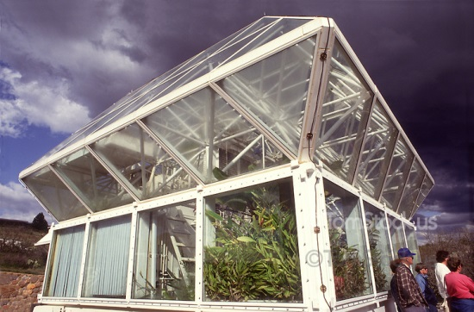
Test module
(Not visible to right: lung)

Slide 37
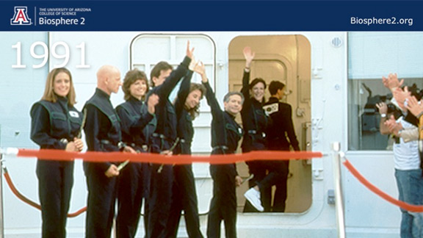
BIOSPHERE 2 Full closures: Missions 1 and 2
Mission 1: huge media event with an Indian chief, Buddhist monks, ceremonies, speeches
Mission 1 (Sept. 1991- Sept. 1993) - had controversies, problems, but was completed and a lot was learned.
Mission 2 (Mar. 1994 – Sept. 1994) ended prematurely in chaos

Slide 38
So, what happened in mission 1?

Slide 39
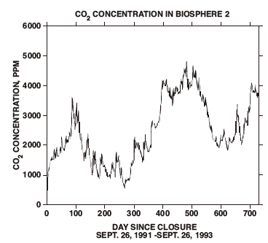
Co₂ was a huge concern before closure, and a major focus
CO₂ levels on earth 350 ppm then, 400 ppm now
CO₂ levels in Biosphere 2
  1000 ppm in summer
      14.5 daylight hours
  5000 ppm maximum in winter
      9.5 daylight hours
  600 ppm daily fluctuation
      Due to high ratio of biomass
      carbon to atmospheric carbon
      (2 orders of magnitude vs. earth)
CO₂ levels on Space shuttle: 5,000 ppm
CO₂ levels unhealthy at 10,000 ppm

Slide 40
Co₂ MANAGEMENT
Lowering temperatures at night (reducing plant respiration)
Suspending composting during low-light season
Activating and deactivating desert and savannah by controlling irrigation
Cutting, drying, storing biomass to sequester carbon
Planting fast-growing plants to increase photosynthesis
Some use of CO₂ scrubber in winter (100 ppm effect)
Could be considered successful, but a lot of work
Made harder by unusually-overcast winters, and starting with too much carbon (compounds) in the soil (more coming… )

Slide 41
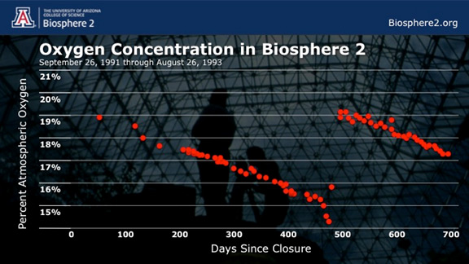
The UNEXPECTED O₂ decline

Slide 42
the O₂ decline cause
Due to rich soil, fresh concrete
  Unusually rich soil (high in organics) placed in Biosphere 2
  Led to high O₂ consumption by soil microbes consuming it
  Resulting CO₂ wasn’t all absorbed by plants
  Resulting CO₂ absorbed as calcium carbonate on fresh concrete
For second mission, they coated concrete to avoid the first mission O₂ problem (and didn’t need O₂ injection)
  Soil didn’t stabilize until around 1998, long after missions

Slide 43
O₂ problem as a reminder of biology/geology interactions
On earth, calcium carbonate (limestone) was created by life (coral and marine shell), and the largest repository of carbon on earth (by far) is in rock
    Rock (limestone, etc.) : 60,000,000 gigatons
    Kerogens (e.g., oil, also from life): 15,000,000
    Ocean: 38,400
    Biomass (living and dead): 2,000
    Atmosphere: 720
So, as on earth, carbon went into rock, unfortunately taking O₂ with it.

Slide 44
Agriculture results
Highly productive (claimed most efficient ever), but still not quite enough
81% of food was grown inside for Mission 1
  Remaining 19% from seed stock and food grown inside system prior to closure
  Low-calorie starvation diet – this was subsistence agriculture
  Relied only on natural light (reduced by 50% by glass/space frame)
  Mission 2 achieved 100%, partly by adding artificial light (high-pressure sodium lamps)
Pigs and chickens took too much food, so were eaten

Slide 45
Diet and health
Low calorie nutrient dense diet advocated by Dr. Roy Walford (UCLA) in previous work on diet and aging
  He wrote the book and got to live the dream as a biospherian
Carefully tracked entire diet by computer
Lost 16% of their body weight in first year, stabilized and recovered some in second year
Overall health good, improved cholesterol, blood pressure
System supplied all vitamins except D

Slide 46
Species packing: survival results
Started with 3800 species.
  As expected, not all survived.
  Example: in the rainforest, 61% of 282 species of plants survived the 2 year experiment
  Plants were individually tagged and tracked
Proved self-organization and adaptation happens
  Explosion of ants, cockroaches, katydids
  Rainforest overgrown with morning glories, other invasives, requiring manual intervention
  Rainforest grew rapidly, doubling size
  Pollinating insects died, several bird species
  Desert Biome shifted considerably towards species adapted to humid conditions
Suggests the “Gaia hypothesis”, but time was too short to see all the cycles play out, and humans did have to intervene.

Slide 47
Other sustainability results
Proved feasibility of a sustainable biosphere(more or less)
  Notable problems like O₂ were explained and preventable
  People came out alive and healthy after 2 years
    It wasn’t a given that this was possible before this
System removed harmful compounds without toxic buildup
  Soil bed reactors for the atmosphere, algae scrubbers for the ocean
  CO₂, NO_{x}, H2S, ethylene, CO, methane, ozone
  Exception: N₂O, which is normally decomposed by radiation in the stratosphere
They were able to track and model elements in closed loop cycles
  Accelerated cycles vs. earth, e.g., daily and seasonal CO₂ cycles
Small closed systems are vulnerable

Slide 48
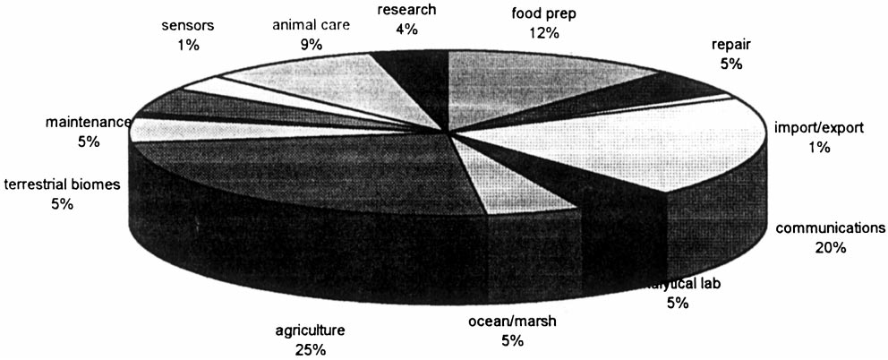
How did they spend their time inside biosphere 2?

Slide 49
Group dynamics
External relationships suffered
Halfway through first mission, group had split into 2 factions, barely on speaking terms
Power struggles outside on how to proceed were reflected inside
  Importance of maintaining closure vs other research
  Decisions on importing air or food
  “Holistic” view vs. “reductionist” view of science.
Made worse by effects of O₂ deprivation
  Equivalent to elevation of 13,400 ft.
  Fatigue, sleep apnea
Still worked together as a team to achieve their goals
2 team members got married right after exiting

Slide 50
end
SYSTEMS Biology for sustainable life outside earth

Slide 51
SUPPLEMENTAl material
SYSTEMS Biology for sustainable life outside earth

Slide 52
Why put a greenhouse in the arizona desert?
Photosynthesis is key to maintaining O₂ & CO₂
Glass blocks ultraviolet light, part of “PAR” – Photosynthetically Active Radiation
  Glass and the space frame structure block about 50%
So, a lot of sunlight/clear sky is needed
  Want many days without clouds, rain, haze, smog
  Higher elevations of Arizona are perfect!
  Outweighs the additional costs of air conditioning (and some heating in winter)
At first, they didn’t consider artificial lights
  Despite the fact that on Mars there’s less sunlight, and you’d need to mostly be buried to avoid radiation anyway

Slide 53
Biosphere 2 project milestones through mission 1
Space Biospheres Ventures (SBV) started July 1984
  Owned by Decisions Investment (Ed Bass), initial $30M
Conference on vision and feasibility: Dec., 1984
  Signed up outside scientific advisory committee
Basic design & engineering done: 1986
Test module construction done: 1986
Test module closed experiments: 1986-1989
Construction start: Jan, 1987
Support buildings completed: Mar.,1989
Plants, animals, agriculture in place before closure
9 one-week test closures before Mission 1
Mission 1: closure (8 people): Sep. 1991 – Sep. 1993

Slide 54
Biosphere 2 mission 2 ended in chaos
Mission 2 started March, 1994, intended 10 months
April 1994: dispute led to ousting of management
  Federal marshals and police arrived with restraining order, took over the site, stopped communications
  Ed Bass hired Steve Bannon (!) to run SBV
  Two members of first crew broke in, unsealed the airlock, broke some windows
  Team captain quit to join wife (the suspended SBV CEO)
Many in the Scientific Advisory Committee quit
June, 1994 SBV dissolved
September, 1994: Mission 2 ended prematurely
Scientific credibility at an all-time low at that point

Slide 55
After the mission 2 chaos
Columbia University ran it 1995 - 2003
  Biosphere 2 modified from closed system to open air flow
  No longer applicable for space habitats- focus on earth: e.g., CO₂ effects on plants & ocean acidification
Offered for sale in 2005 by Decisions Investments Corp (Ed Bass)
Sold briefly to a real estate development company in 2007, leading to fears of subsequent demolition
University of Arizona took over running it in 2007
University of Arizona assumed ownership in 2011
Various earth science & farming experiments ongoing
  None sealed, but large, nearly-isolated facility is unique

Slide 56
The money
Privately funded (Ed Bass – Texas billionaire)
SBV (Space Biospheres Ventures) set up as a for-profit corporation, initial $30M
  Expected to sell technology
  Tourism & education – ecology theme park
Up through first 2-year experiment, estimates of $150M - $200M
Rumored yearly cost to run: $25M, of which $16M are energy costs
  This is, after all, a greenhouse in the Arizona desert!
Unnamed source on Wikipedia put total cost at $200M by 2007

Slide 57
Human habitat
Private apartment for each biospherian with upstairs and downstairs, shower & toilet (but no toilet paper – bidets were used)
Kitchen, meeting area, recreation facilities, exercise room, communications center
Lab space, medical clinic

Slide 58
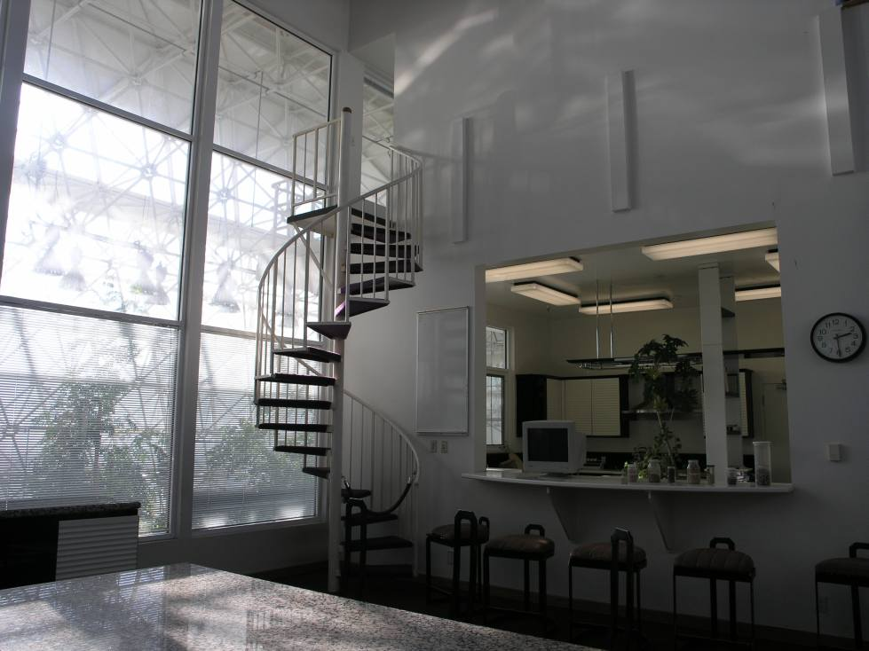
Human habitat (meeting room)

Slide 59
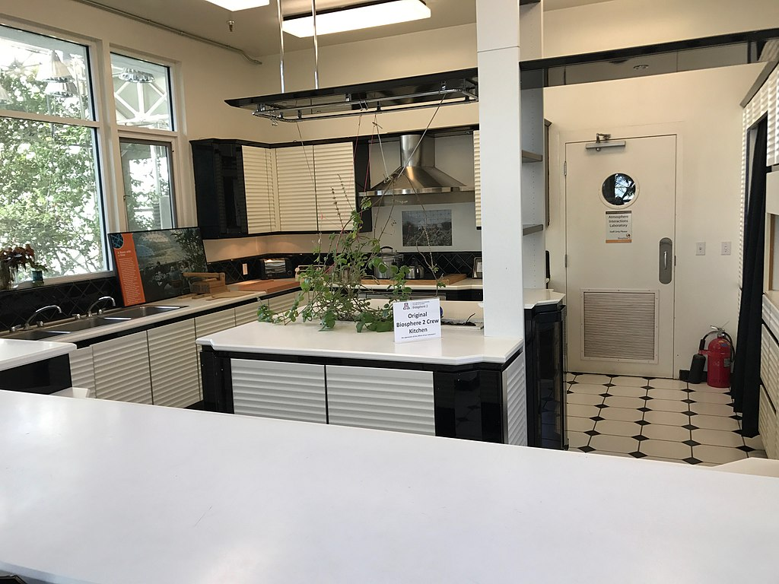
kitchen

Slide 60
Examples of Some of the species placed in the wilderness biomes
Hummingbirds, bees, bats, moths, butterflies
Snakes, reptiles, turtles, 40 geckos, 50 toads
Ants, termites, cockroaches
Predators for mites, mealy bug, cockroaches, pillbugs
Oysters, crabs, coral
Agave, jojoba, rubber trees, mosses, ferns, trees producing gum and soaps.

Slide 61
Daisyworld: a toy “demo” of the gaia hypothesis
A simple mathematical model of a “toy world”
  Sun whose output is rising over time
  Only 2 species: black daisies and white daisies
Temperature regulation based on balance between black daisies and white daisies
  Black daisies
    absorb more light, warm the planet
    do better at low temperatures because they get warmer
    die off at higher temperature because they get too warm
  White daisies
    reflect more sun, cooling the planet
    do better at higher temperature because they stay cooler due to reflecting the sun

Slide 62
Some test module results
First facility to use biological means to simultaneously purify air (vs. catalytic burners), completely recycle water & human waste, remove toxic trace compounds
Tested and modified technology
  Leak rate of 24%/year
  Estimated parameters in dynamic simulation models for O₂, CO₂
Some food grown
  Soil-based rather than hydroponic,
  Not enough area for sustaining long-term human habitation

Slide 63
Breaking the seal: The missing fingertip and the duffel bag
12 days into mission, Jane Poynter had a threshing machine accident, cutting off the tip of her finger
Evacuated for medical attention
Returned hours later with a duffel bag
  She claimed it only had spare parts and plans
PR disaster, media claiming experiment was compromised, bringing in food, letting in air
(The lead programmer had a $1000 bet with a biospherian that Biosphere 2 would be opened within 100 days)

Slide 64
The unexpected O₂ decline
Rapid, steady decline in O₂, without correlated CO₂ increase
  20.9% down to 14.5% after 16 months
  Equivalent to being at 13,400 ft.
  Unknown reason at the time, not seen in test module
  Led to fatigue, sleep apnea
2 unusually dark, overcast el-Nino winters weren’t the cause, but didn’t help
31,000 lbs liquid O₂ added, returning atmosphere to 19%: Jan, 1993
Another PR disaster!

Slide 65
were they a cult?
Well, maybe yes, to some extent…
  Close-knit group for many years
  Based on shared ideology and vision of going to Mars
  Important roles closed to outsiders
  Closed meetings, lots of rumors about what went on
  John Allen, the leader, ran a commune in New Mexico (Synergia), and a theatre group (“Theatre of All Possibilities”)
    Accusations of psychological humiliation, corporal punishment
Accusations were somewhat overblown
  “doomsday cult”, “western civilization is over”, “just a failed theatre group”, etc.
Accusations definitely hurt their scientific credibility

Slide 66
MAYBE Yes, KIND OF, but…
Accusations of lack of scientific training were overblown
  There was expertise in their group, at least some with appropriate degrees
  They tapped and managed outside scientists, expertise as well.
While there was some weirdness, this was a serious project
That’s probably what it took to get this unusual project done

Slide 67
monitoring systems
2500 sensors and automated analyzers, plus manual lab
  Temperature, pressure, humidity, wind velocity, flow, water levels, fan status, pump status, power, PAR, etc.
  Chemical compounds: CO, CO₂, O₂, O₃, NO_{x}, N₂O, NH₃, H₂S, SO₂, CH4, total hydrocarbons, for air, potable water, other water, soil
15 internal and external networked computers
“Global Monitoring System”
  Computerized monitoring, analyzing, and storing data
  Automated and manual chemical analyzers for air & water
  Health of the computers and networks
  Comprehensive diagnostics postponed, never implemented

Slide 68
CONTROL SYSTEMS
Control temperatures, humidities, wind velocities
Control via Air Handling Units (AHU’s)
  Flows of cooling tower water and chilled water
  Steam heating flow (heating, and reheat for humidity control)
  Throttling of inlet air flow to blowers
Challenges
  Wanted tight control – scientific experiment, not a house
  Significant variations in targets across biomes, heights
  Sun/shade variations inside
  Weather variations outside (sun/shade , day/night)
    All-glass, without shade, louvers, or tinting, for photosynthesis
    Cloud passing overhead caused noticeable changes
    Hot summer sun, winter snow
  Interactions between AHUs & biomes due to shared cooling water
  Interactions between biomes due to open air boundaries
  Need for condensation for potable water and utility water
  Sensor & valve reliability
  Graceful degradation with failures. Only some spare parts.

Slide 69
Control systems (continued)
Optimization goals: economics and constraints
  Humidity maximums, air velocity min & max
  Cooling tower water cheaper but less effective than chilled water
  Number of AHUs used and airflow at each
  Supervisory control for optimization, startup sequencing
Initial proposals used industrial-style controls
  Temperature to energy flow cascade controls (feedback)
  Feedforward for solar input energy and history, between biomes
Subcontractor never got sensors, valves, low-level controls to work very well
  Local builder with little understanding of control systems
  Abandoned tight control, optimization
  Ended up with a set of templates for targets for simple controllers for different conditions

Slide 70
early prototype top-level global monitoring system display

Slide 71
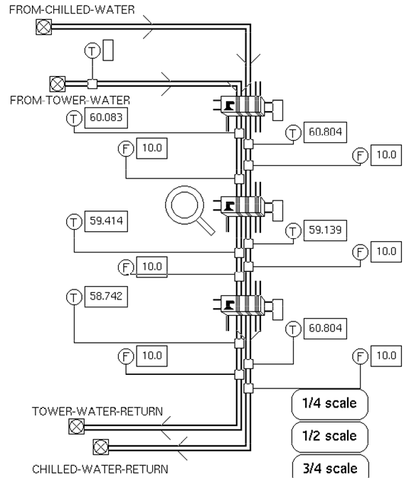
Example cooling subsystem

Slide 73
simulation for test module experiments
Biological system dynamic simulation
  Focus on O₂, CO₂, etc.
  Biological objects following Odum’s ecology textbooks
    “Primary producers” (plants)
    “Decomposers”, others
    Differential equations associated with each type of object
  Flows of material and energy as connections between the objects
  Parameter estimation to match test data to simulation
  Work mostly by University of Arizona

Slide 74
OBJECT-ORIENTED simulation

Slide 75
Examples of variables tracked IN simulation

Slide 76
Announcement TEXT
Biosphere 2 was a unique experiment in a materially closed ecological system, as a prototype for sustainable space settlement. It was at least 30 years ahead of its time. When 8 “biospherians” were sealed in the 3.14 acre facility for 2 years starting in 1991, it was (and remains) the world’s largest and longest-running closed environment test. The facility is still there and open to the public, although it is no longer sealed.
This talk is a retrospective on the experiment, the ideas behind it, and the results.

Slide 77
The speaker
The speaker, Dr. Greg Stanley, was involved in the Biosphere 2 project as a consultant, mainly in 1989-1990, and was present at the first closure in 1991. He led the work done there by Gensym, providing computerized monitoring, control, and some dynamic simulation.
Dr. Greg Stanley creates, develops, and manages innovative technology, especially based on artificial intelligence. He created computer applications for users as diverse as the Iridium satellite communications network, AT&T, Biosphere 2, ExxonMobil, the Abu Dhabi National Oil Company, Saudi Aramco, a Japanese nuclear industry/government consortium, and BMC. Applications include fault diagnosis, process automation and control, dynamic simulation, and network management. He worked at Exxon in technical and management roles in process control, engineering, IT, artificial intelligence, and dynamic simulation. He built products and managed product development at Gensym, the leading provider of real-time expert systems. He helped product development for software and engineering companies such as SAT, BMC, SmartSignal, and Integration Objects. Technical specialties include chemical engineering, artificial intelligence, fault diagnosis, process control, dynamic simulation, network management, and estimation theory such as data reconciliation and Kalman filtering, as well as product architecture and software development to implement these applications. Greg has a PhD in Chemical Engineering from Northwestern University, and a BS in Chemical Engineering from Purdue University. He has published over 25 peer-reviewed technical papers.
Other technical material is available at the Greg Stanley and Associates/ Performity LLC site:
https://gregstanleyandassociates.com/whitepapers/whitepapers.htm
Other space settlement related material is available at
https://performity.com/Resources/Space/space.html

