Slide 1
Modeling & Testing of the Capsule Parachute Assembly System (CPAS)
February 21, 2013
Leah M. Romero – leah.romero@escg.jacobs.com – 281-461-5158

Slide 2
Cpas Overview

Slide 3
CPAS Overview
Capsule Parachute Assembly System (CPAS) is the parachute system for the Orion vehicle used during re-entry
  Similar to Apollo parachute design
Collaboration between NASA JSC, ESCG, and Airborne Systems
A Government Furnished Equipment (GFE) project responsible for:
  Design
  Development testing
  Performance modeling
  Fabrication
  Qualification
  Delivery

Slide 4
CPAS Concept of Operations
Low Altitude and Pad Abort Sequence (direct to mains)
Nominal Mission and High Altitude Abort Deployment Sequence
Notes:
CPAS has three basic operational phases
Mortar deployed Forward Bay Cover parachutes to assist removal of FBC
Thrusters assist in cover removal
Mortar deployed drogues to decelerate and stabilize the capsule
Mains to achieve the steady state landing velocity and hang angle
Mains are individually deployed by mortar deployed pilot parachutes following drogue release or possibly (in a low altitude abort) directly to mains (skip drogues)

Slide 5

CPAS Analysis Focus
Flow from flight performance requirements from the CPAS Project Technical Requirements Specification (PTRS) Revision
  Meet during specified failure conditions
Rate of Descent (ROD)
  Crew and vehicle structure safety
Parachute Loads
  Drogue and Main single riser loads
    Individual parachute failure
  Drogue and Main cluster loads
    Sum of individual riser loads
    Vehicle structural failure
Rotation Torque Limit
  Main risers induce rotation
  Orient vehicle edge into water for landing
Full Open Main
Canopy
Projected Diameter
Suspension Lines
Riser

Slide 6
Agenda
Airdrop Testing
  Gen I & II
  EDU
Parachute Analysis
  Simulations
  Preflight Analysis
  Post-Flight Analysis
Development of a Parachute Model
System Verification & Validation
Future of CPAS

Slide 7
Airdrop testing
Gen I & II
EDU

Slide 8
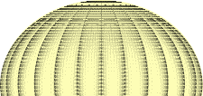
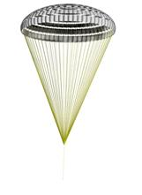


CPAS Parachutes
Extraction Chutes (~28 ft)
  Pulls the vehicle out of the aircraft. Used for testing only.
Programmer Parachutes
  Used to create the proper test conditions for the Drogue, Pilot, or Main chutes. Used for testing only.
  Can sometimes be an identical chute as the Drogues, but the use is different.
Forward Bay Cover Parachutes (FBCPs) (~7 ft)
  Pulls off Forward Bay Cover (FBC) from vehicle
Drogue Parachutes (~23 ft)
  Stabilizes the vehicle for Main deployment.
Pilot Parachutes (~10 ft)
  Pulls out the Main chutes.
Main Parachutes (~116 ft)
  Slow the vehicle to landing.
Extraction Chute
Programmer Chute
FBCP
Drogue Chute
Pilot Chute
Main Chute
Not to Scale

Slide 9
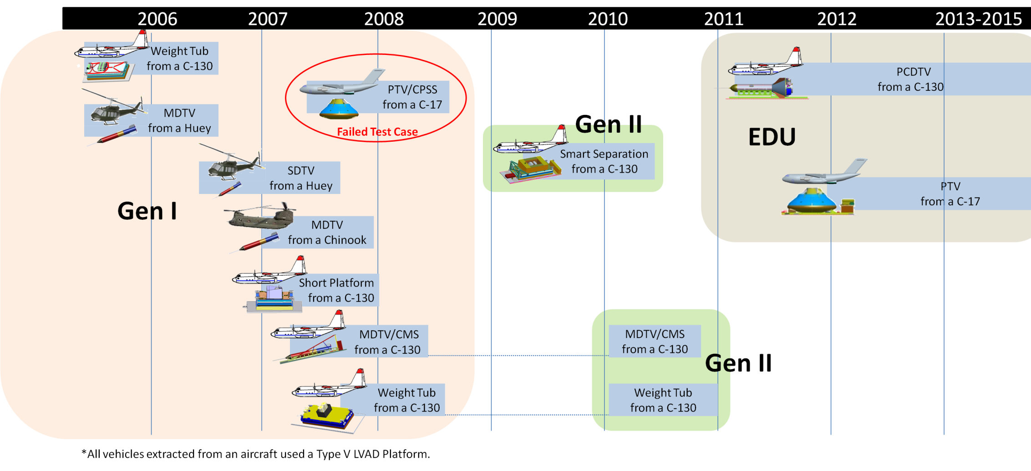
Evolution of Test Vehicles & Techniques
Smart Separation Objectives
  Test Smart Separation software and upgraded Avionics suite
EDU Objectives
  Test representative parachute systems
  Test failure modes
Gen II Objectives
  Test failure modes
  Investigate potential design changes
Gen I Objectives
  Characterize single parachute inflation parameters
  Demonstrate the system

Slide 10
Airdrop testing
Gen I & II
EDU

Slide 11
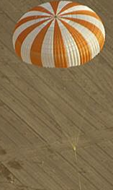
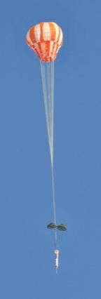

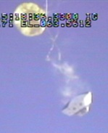
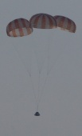

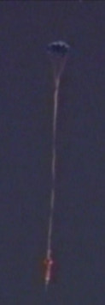

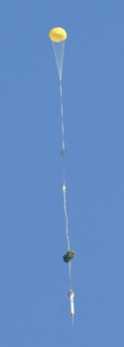
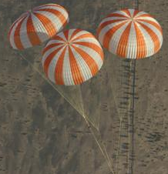
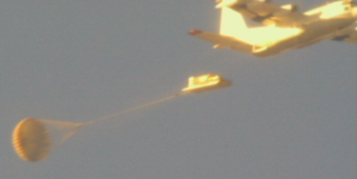
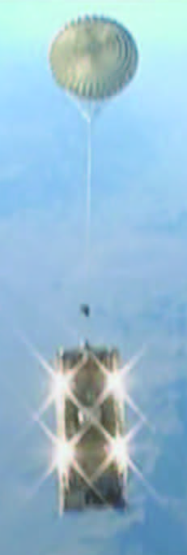
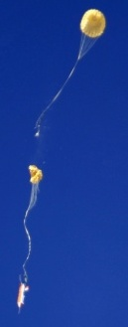
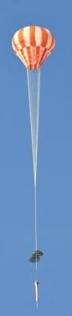
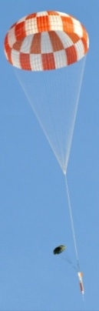
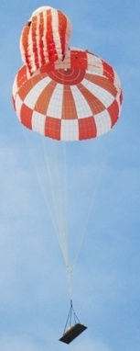
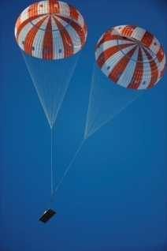

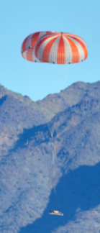

CPAS Gen 1 and Gen 2 Test Progression
Gen 1 Testing
Gen 2 Testing
Aug ‘07 – Jan ‘08
Oct ‘07 – Jul ’08, May ‘10
Jan – Mar ‘07
Jun – Dec ‘07
3 Tests
2 Tests, PA-1, 1 Failed Test
4 Tests
3 Tests
Single Main Chute Tests
Cluster Chute Tests
Pilot Chute Tests
Drogue Chute Tests
April 2010
Sept‘ 09 - Mar ‘10
July 2010
Sept - Dec 2010
2 Tests, 1 Failed Test
2 Tests
1 Test
3 Tests
TSE-1 A, B, & C “Smart Separation”
MDT 2-1, 2-2
Skipped Stage
CDT 2-1
Main Line Length Ratio
MDT 2-3, CDT 2-2, 2-3
Increased Porosity

Slide 12
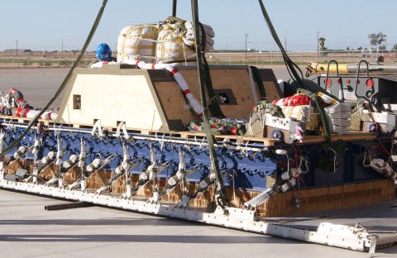
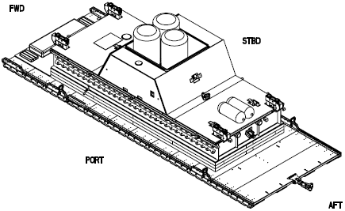
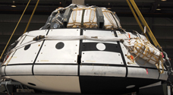
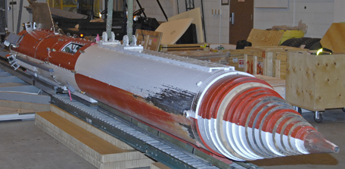
Gen I & II Test Vehicles
Each test vehicle was designed to achieve a specific test objective
Weight Tub
  Test the parachute system with a representative weight
  Significantly tested and proven operations with a quick turn around
Small or Medium Drop Test Vehicle (SDTV or MDTV)
  Heritage vehicle from the X-38 program
  High dynamic pressure
  Cradle Monorail System (CMS)
Parachute Test Vehicle (PTV)
  Wake similar to the Orion capsule
  Cradle and Platform Separation System (CPSS)
Gen I MDT-3 CAD
Gen II CDT-2-3 CAD
Gen II CDT-2-3 Build Up
Gen I MDT-3 Build Up
Gen I PTV (CDT-2)

Slide 13
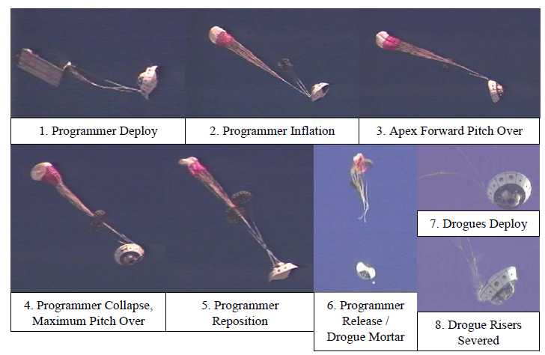
Gen I CPAS PTV Failure (CDT-2)
Cause of failure – test technique, not parachutes
  Inability of programmer to remain inflated due to test vehicle wake
    Programmer trailing distance was insufficient
    Stabilization parachutes caused additional, not simulated wake
Contributing factors
  Late completion of ConOps
  Small, unproven reefing used on the programmer (20%)
  Lack of robust extraction and separation simulations
Notes:
Test technique failure, not chutes

Slide 14
PTV Failure Recovery
Increased knowledge regarding wake effects
  Computational fluid dynamics (CFD) anchored to wind tunnel testing
Improved understanding of vehicle separation
  Smart separation algorithm was created
    Validated on 3 Gen II tests – Test Support Equipment (TSE) series
  Separation simulations
    Two-body 6-Degree of Freedom (DOF)
    Models the separation and close proximity dynamics
Lessons learned from PTV failure
  Smart separation algorithm used to separate the PTV2 from the CPSS
  Aerodynamic databases will be based on PTV wind tunnel data
  Stabilization parachutes will not be used
  Simulations will account for wake effects
  All protuberances will be eliminated or rounded

Slide 15
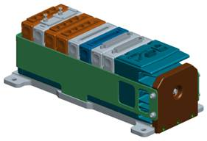
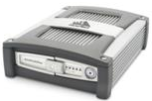
Gen II Avionics Advancements
Data Acquisition System (DAS) - cRIO
  Centralized unit for controlling and storing data from multiple instruments
    Allowed for time-synchronization of data
  Larger storage capacity
Upgraded Velocity Measurement Instrumentation
  NovAtel SPAN-SE
    Accurate measurement assists in ROD
  Crossbow Nav440
    Higher velocity uncertainties than NovAtel
    Triggers smart separation
  Both are integrated GPS/IMU
    Mitigates drop outs during extraction phase
cRIO
NovAtel SPAN-SE
Crossbow Nav440
Notes:
cRIO = Compact Reconfigurable Input/Output

Slide 16
Gen II Avionics Advancements
Upgraded Load Measurements
  Gen I used Tension Measuring System (TMS) units attached to each riser - had high uncertainty
  Gen II used 30,000 lbf strain links attached between the riser and confluence fitting
    Provide adequate data for the Main parachutes
    Provided noisy data on the Drogue parachutes due to the turbulent wake environment
Increased Fidelity in Atmospheric Data
  Windpack and balloon released to travel through similar air column as test
  Ground weather stations on the drop zone
    Anchors windpack and balloons with ground surface winds

Slide 17
Airdrop testing
Gen I & II
EDU

Slide 18
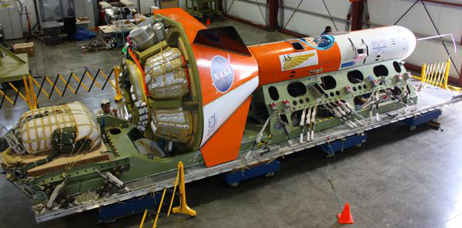
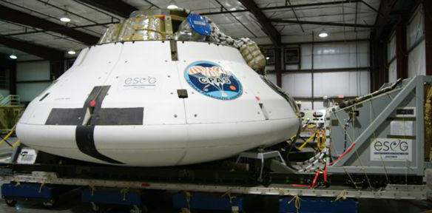
EDU Test Vehicles
Mid-Air Delivery System (MDS) & Cradle and Platform Separation System (CPSS)
  Allows the PCDTV and PTV to be deployed from an aircraft cargo bay
Parachute Compartment Drop Test Vehicle (PCDTV)
  Tests the full CPAS system utilizing a stable vehicle
  Dart shape based on the Solid Rocket Booster and Ares booster parachute test program
    Allows for achievement of high dynamic pressure
PTV/CPSS
  Tests the full CPAS system with representative vehicle aerodynamics
  Unable to achieve high dynamic pressure with current test techniques

Slide 19
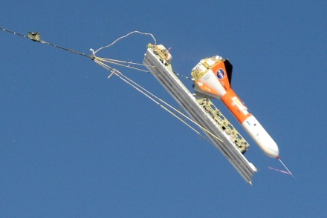
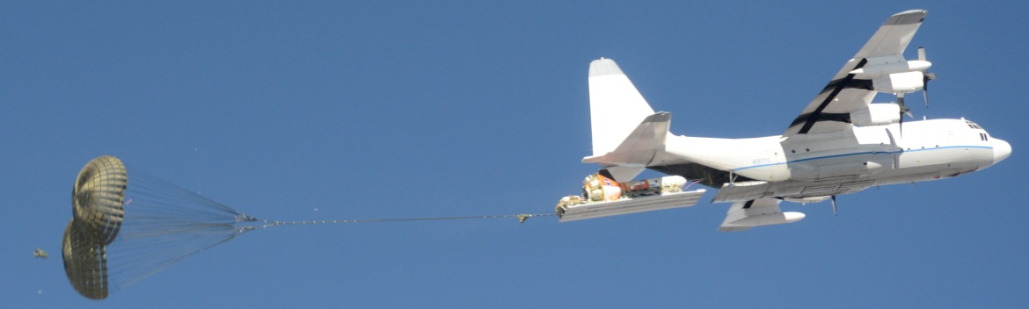
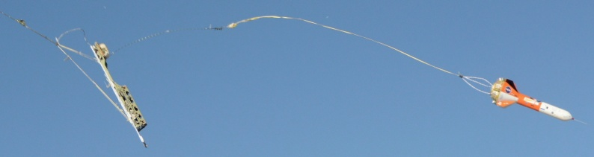
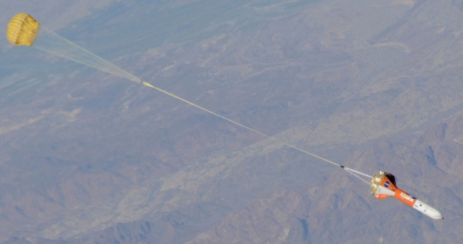
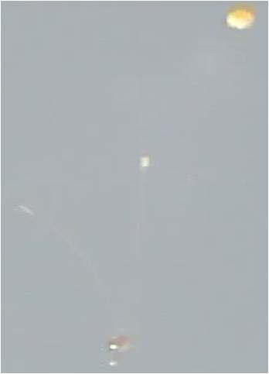
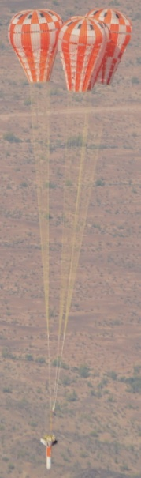
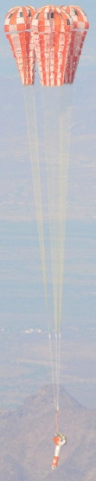
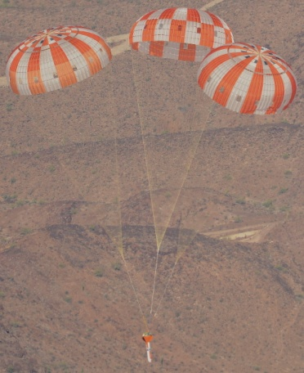
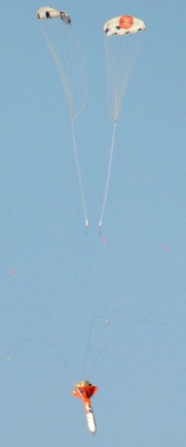
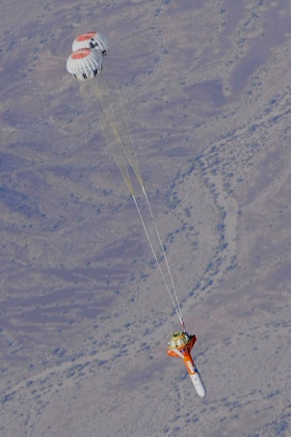
PCDTV/MDS Test Sequence
Extraction from a C-130 at 25,000 ft MSL
Separation
Drogues Deploy
One reefed Gen II Drogue as Programmer Deploy
Programmer Inflated
Pilot Deploy
Mains
Full Open
Drogues Inflated
Mains 2nd Stage
Main 1st Stage

Slide 20
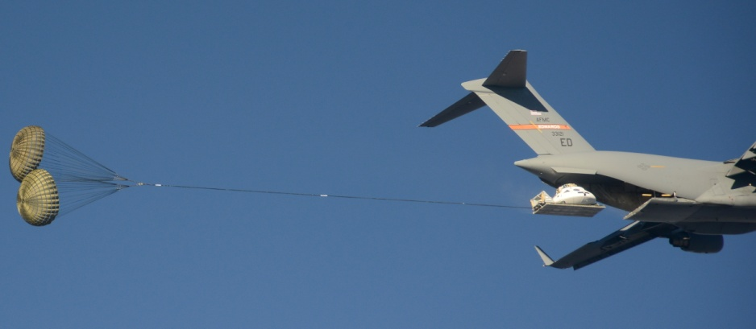
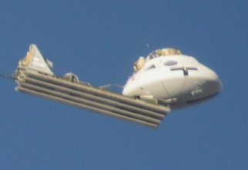
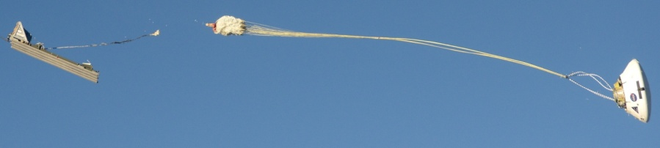
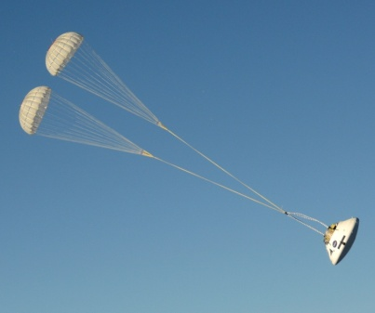
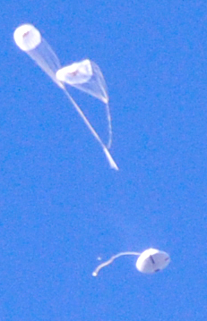
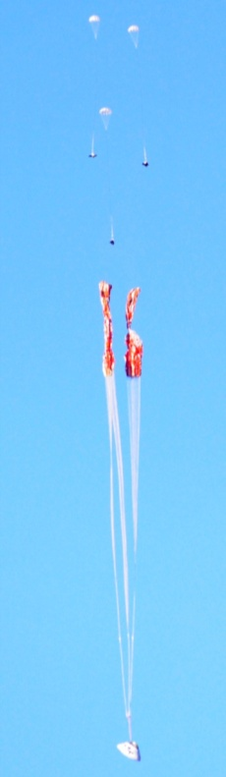
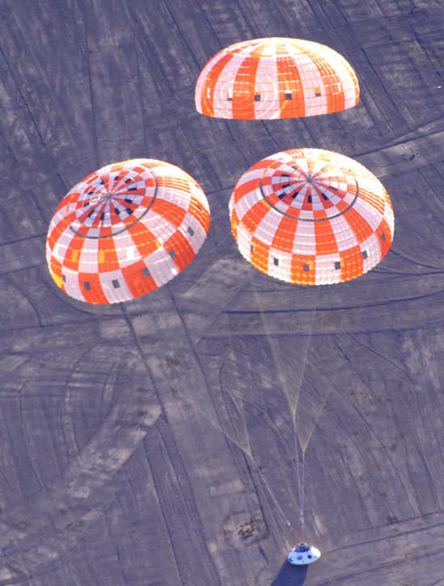
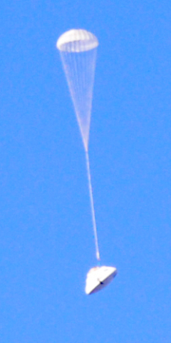
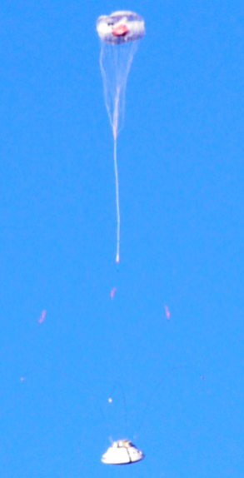
PTV/CPSS Test Sequence
Smart Separation after Ramp Clear
Extraction from C-17 at 25,000 ft with two 28 ft Extraction Parachutes
Two full-open Gen II Drogues as Programmers deployed
Programmer cut
One Drogue deployed
Programmers Inflated
Drogue Inflated
3 Pilots lift 3 Mains with nominal reefing
PTV Touchdown
Smart Drogue Release using SDR

Slide 21
Parachute analysis
Simulations
Preflight Analysis
Post-Flight Analysis

Slide 22
Simulation Tools
CPAS uses numerous simulation tools for preflight predictions, mission support, and post-flight data analysis and reconstructions
  Determine configuration design
  Ensure safety of test and personnel
  Assess test objectives and solve unexpected test results
  Parachute model development
Tools have evolved from low fidelity spread sheets to high fidelity independent parachute simulations
End-to-end trajectories currently require use of multiple simulations
  Desired to consolidate number of simulations
Many of the simulations are developed and maintained by NASA JSC EG
Support and processing tools developed and maintained by ESCG
Notes:
Desired to consolidate number of simulations → to reduce work via lowering number of interfaces necessary

Slide 23
Evolution of Simulation & Analysis Tools
Time | 2006 | 2007 | 2008 | 2009 | 2010 | 2011 | 2012 | 2013
Preflight Predictions | DSSA v.Beta_5a, v.Beta_5b4, v.Beta_5b5 | v.Beta_8e | v.Beta_8f1 | v.Beta_8f3, v.Beta_8f5 | v.Beta_8g, v.Beta_8g1 Monte Carlo capability | v.Beta_8g2 through v.Beta_8g5a | v.Beta_8g6 through v.Beta_8h1 | v.Beta_8h1
 | DTV-Sim v.14 |  | v.15 |  | v.16 | v.17
 |  |  |  |  | Monte Carlo capability
 |  |  | Pallet Sim
 |  |  | CAP Sim |  |  | Separation Simulation
 |  |  | DSS | Monte Carlo capability
 |  |  |  |  |  | ADAMS
 |  |  |  |  |  |  | FAST
Mission Support | X-38 Legacy Footprint Tool | (Primary) | (Primary) | (Primary)
 |  |  |  | Sasquatch (Secondary) | (Primary) |  | Polygons
 |  |  |  |  | Pressure Altitude Calculation
Post Flight Reconstruction | Spreadsheets
 |  | DSSA v.Beta_8e | v.Beta_8f1 | v.Beta_8f3, v.Beta_8f5 | v.Beta_8g, v.Beta_8g1 Monte Carlo capability | v.Beta_8g2 through v.Beta_8g5a | v.Beta_8g6 through v.Beta_8h1 | v.Beta_8h1
 | DTV-Sim v.14 |  | v.15
 |  |  | DSS
 |  | FDP v.1.07 |  | v.1.09, v.1.10
 |  |  |  | BET/BEA/ BEW Scripts
 |  |  |  |  |  |  | ADAMS
 |  |  |  |  |  |  | FAST
Gen I
Gen II
EDU
Notes:
Have specific simulations for specific objectives
MC capability

Slide 24
Parachute analysis
Simulations
Preflight Analysis
Post-Flight Analysis

Slide 25


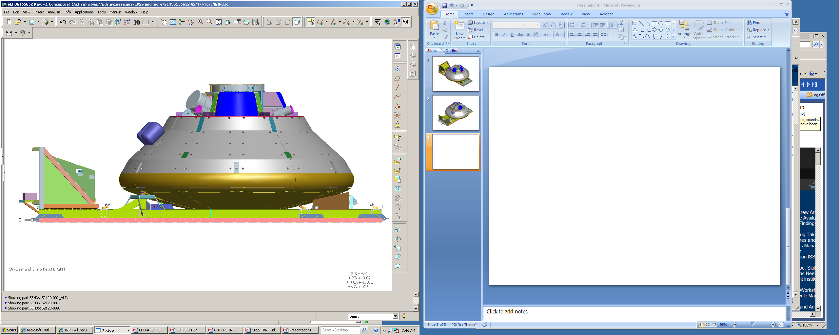
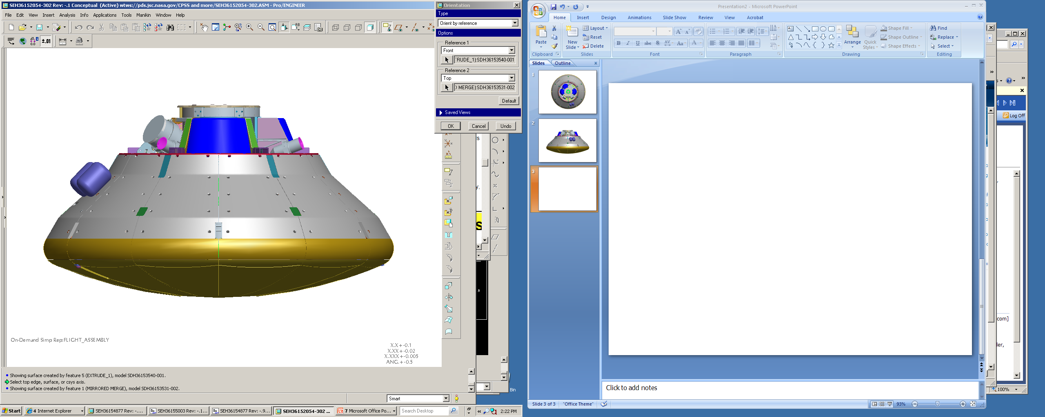
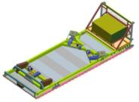







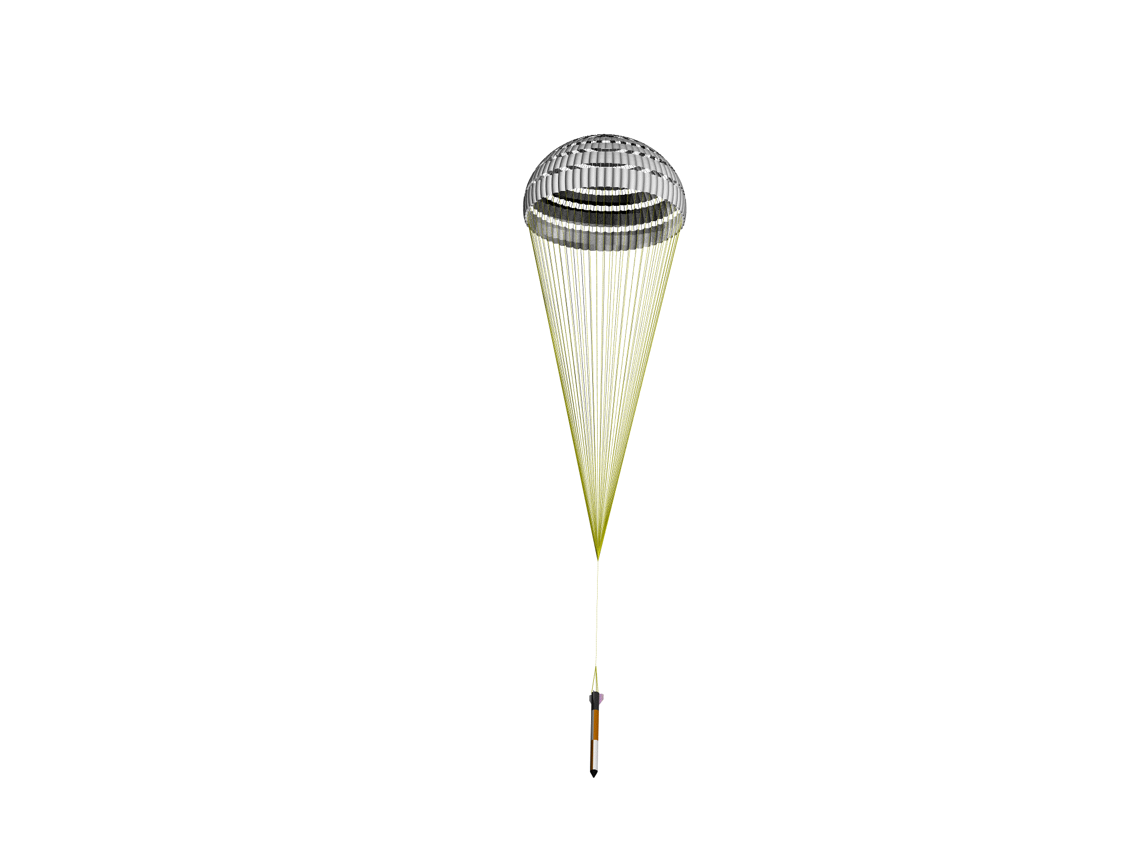


EDU-A-CDT-3-7 Test and Simulation Architecture
DSSA/ADAMS
ADAMS
C-17 with a single 15 ft GFE Drogue parachute prior to extraction
PTV/CPSS separation
DSS/FAST
DTV-Sim
Three Pilots deploy Three CPAS Main parachutes
Extraction parachute cuts away to deploy recovery parachute
Static-line deploy Two Full Open Programmers
Mortar deploy CPAS Drogue parachute
Mortar deploy three CPAS Pilot parachutes
Not to Scale
Notes:
Sep sim necessary for PTV because the interactions are more complex than the PCDTV/MDS

Slide 26


Preflight Predictions: Dynamic Pressure & Altitude
All cases reach Main steady state above altitude limit
Notes:
Assessing risk of test
Qbar – drives loads
Safe altitude limit

Slide 27

Preflight Predictions: Monte Carlo – Loads
0 valid cases exceed Main cluster limit (based on 50/25/25% load share)
High rate case
0 valid cases exceed Drogue Limit Load

Slide 28

Preflight Predictions: Footprint Analysis

Slide 29
Parachute analysis
Simulations
Preflight Analysis
Post-Flight Analysis

Slide 30
Post-Flight Data Analysis
Windpack and balloon data
  BEA: Best Estimate Atmosphere
  BEW: Best Estimate Winds
Vehicle data used to create Best Estimate Trajectory (BET)
  Dynamic pressure
  Parachute loads*
  Drag area (C_{D}S)*
Photogrammetry
  Fly-out angles during steady state
*completed for each phase of each parachute

Slide 31
Wind Components Profile (CDT-3-5)
Winds < 30 ft/s mostly out of SW

Slide 32
Dynamic Pressure
~11 psf lower than nominal prediction at Main deployment

Slide 33
Load Scaling
Scaling due to load cells being below fairlead
  Energy lost due to friction
Scale loads to match IMU data
Before Scaling
After Scaling

Slide 34
Photogrammetrics
Used to characterize Main parachute behavior in a cluster
  Quantify fly-out angles, geometric inlet area, and twist angles
  Understand collisions and other parachute dynamics
  Rate of Descent (ROD)
  Reefing line tension
Provides insight into dynamics which is related to data gathered

Slide 35



Fly-Out Angles During Steady State
Mains inflating
Collisions

Slide 36
Development of a Parachute model

Slide 37
Test Reconstruction
Use BEA/BEW/BET
Iterate parachute parameters
  Automated process
  Start with latest Model Memo values
Document parachute parameters that cause simulation to match the BET
Combine parameters from all tests to create distributions
Distributions are published in semiannual Model Memo
  Assess parameters through benchmarks

Slide 38
Finite Mass Inflation Curve Fit
Determine Parachute Parameters:
  Start time, t_{i}
  Initial Airspeed, V_{i}
  Drag coefficient from equilibrium velocity, C_{Do}
  Time average drag areas
    Start Drag Area, (C_{D}S)_{a}
    End Drag Area, (C_{D}S)_{b}
    Full open drag area, (C_{D}S)_{o}
  Or describe area reefing ratios, ε_{i}, ε_{i+1}
Generate inflation curve with guessed parameters:
  Fill constant, n
  Profile shape, expopen,
  Optional: guess ε_{i+1}
Compute difference between inflation curve and test data
Sum the difference to compute area between curves (error)
Iterate n and expopen to minimize the error area
  Optional: optimize ε_{i+1}
(C_{D}S)_{b}
Initial guess
(C_{D}S)_{a}
t_{i}
Minimize total area
Optimized
Notes:
Left side = details

Slide 39

Main Best Fit Inflation parameters
Inflation parameters from individual parachute reconstructions for each stage are recorded in a spreadsheet

Slide 40
Transition from Uniform to Statistical Distributions
Left Tail |  | Right Tail
Zσ | % Outside CI | Zσ | % Inside CI
-1σ | 31.73% | +1σ | 68.27%
-2σ | 4.550% | +2σ | 95.45%
-3σ | 0.2700% | +3σ | 99.73%
TMIN×(1-EF)
TMAX×(1+EF)
Bounds
(formerly Flight Test Dispersions)
Distribution bounds usually fall between 2 and 3 (equivalent) standard deviations from mean
Notes:
Difference between design and test dispersions
Difference between uniform and statistical
Capping

Slide 41
System Verification & Validation

Slide 42

CPAS Verification & Validation Cycle
Design the parachute subsystem
Test the design thought flight and ground tests
Development and Qualification test data is gathered
Document the test data and advancements in parachute physics knowledge
Verify the parachute subsystem meets flight performance requirements
  If No, update the document for requirement clarification
  If No, update the design so that it can meet the requirement
Validate flight performance requirements at the integrated Crew Module level
Conduct integrated flight tests
Run-for-the-record simulations

Slide 43
DSS Credibility Assessment Score (CAS)
Notes:
If planned activities occur and we receive 4 scores of 3 and 4 scores of 4, DSS’s CAS will change to 3.5/4.0

Slide 44
Future of CPAS

Slide 45

Future of CPAS
Simulation & Model development
  Transition to end-to-end simulation in an independent parachute model
  Time varying ROD model using fly-out angles
  Refinement of statistically derived dispersions
Testing
  EDU (plan as of Feb 6, 2013)
    2013: 3 tests – 2 PTV, 1 PCDTV
    2014: 5 tests – 4 PTV, 1 PCDTV
      Includes first Forward Bay Cover (FBC) test
    2015: 2 tests – 2 PTV
  EFT-1 in fall 2014
CDR
Qualification Tests
Lockheed Martin’s MPCV

Slide 46
Special Thanks
CPAS Analysis Team
  Pat Galvin
  Eric Ray
  Kristin Bledsoe
  Usbaldo Fraire
  Joe Varela
  Johnny Blaschak
  Fernando Galaviz
Koki Machin
Robert Rimes
Jeff Brown
Mike Frostad
Entire CPAS team

Slide 47
For More Information…
2009 AIAA ADS Conference
  Overview of the Crew Exploration Vehicle Parachute Assembly System (CPAS) Generation I Drogue and Pilot Development Test Results, R. Olmstead
  Overview of the Crew Exploration Vehicle Parachute Assembly System (CPAS) Generation I Main and Cluster Development Test Results, K. Bledsoe
2011 AIAA ADS Conference
  Proposed Framework for Determining Added Mass of Orion Drogue Parachutes, U. Fraire
  Summary of CPAS Gen II Testing Analysis Results, A. Morris
  Load Asymmetry Observed During Orion Main Parachute Inflation, A. Morris
  Challenges of CPAS Flight Testing, E. Ray
  Verification and Validation of Requirements on the CEV Parachute Assembly System Using Design of Experiments, P. Schulte
  Development of Monte Carlo Capability for Orion Parachute Simulations, J. Moore
  Photogrammetric Analysis of CPAS Main Parachutes, E. Ray
  A Hybrid Parachute Simulation Environment for the Orion Parachute Development Project, J. Moore
  Measurement of CPAS Main Parachute Rate of Descent, E. Ray
  Development of the Sasquatch Drop Test Footprint Tool, K. Bledsoe
  Development of a Smart Release Algorithm for Mid-Air Separation of Parachute Test Articles, J. Moore
  Simulating New Drop Test Vehicles and Test Techniques for the Orion CEV Parachute Assembly System, A. Morris
  Verification and Validation of Flight Performance Requirements for Human Crewed Spacecraft Parachute Recovery Systems, A. Morris
2013 AIAA ADS Conference
  Extraction and Separation Modeling of Orion Test Vehicles with ADAMS Simulation, U. Fraire
  An Airborne Parachute Compartment Test Bed for the Orion Parachute Test Program, J. Moore
  Application of a Smart Parachute Release Algorithm to the CPAS Test Architecture, K. Bledsoe
  Application of Statistically Derived CPAS Parachute Parameters, L. Romero
  A Boilerplate Capsule Test Technique for the Orion Parachute Test Program, J. Moore
  Testing Small CPAS Parachutes Using HIVAS, E. Ray
  Improved CPAS Photogrammetric Capabilities for Engineering Development Unit (EDU) Testing, E. Ray
  Reefing Line Tension in CPAS Main Parachute Clusters, E. Ray
  Skipped Stage Modeling and Testing of the Capsule Parachute Assembly System, J. Varela
  Reconstruction of Orion EDU Parachute Inflation Loads, E. Ray

Slide 48
Questions?

Slide 49
Backup

Slide 50
Parachute Deployment Envelope
Orion
Nominal Entry
PCDTV
35K LVAD
Drogue contingency deploy envelope
Nominal Entry Drogue Deploy
Drogue mortar fire
Pilot mortar fire
Main inflation
Pilot/Main deploy envelope
Notes:
Example deployment

Slide 51

Gen I Helicopter Tests
Helicopter tests were simple to execute and analyze
Test Conducted
  Pilot Development Tests (PDT)
    Vehicle used: SDTV
  Drogue Development Tests (DDT)
    Vehicle Used: MDTV
Programmer parachute set up the desired dynamic pressure
  Poor understanding of programmer drag lead to a failure to achieve the desired test condition
Small DTV Suspended Beneath UH-1

Slide 52
Gen I LVAD Platform with Weight Tub
Low Velocity Aerial Delivery (LVAD)
  Certified US Army cargo aircraft extraction method
  Uses a Type V platform and standard Army extraction parachute
Short Platforms (12 ft by 9 ft platform)
  Significant pitch under the programmer by ~180º
    Pilot or Main parachute slings could have been severed
  Near-failure causes
    Unstable & not well-characterized aerodynamics
    Programmer trailing distance from platform
      Changed on MDT-2 with no significant stability increase
    Programmer size
MDT-1 During Main Deploy

Slide 53
Gen I/II Missile Shaped Vehicles
Cradle Monorail System (CMS)
  Allowed the MDTV to be deployed by a C-130A aircraft
  Constructed on a 32 ft by 9 ft Type V platform to use the LVAD extraction technique
No separation simulation created
  Used low fidelity analysis methods and engineering judgment
  Separation occurred at the time of lowest dynamic pressure predicted in preflight simulations
  Assumed an instantaneous separation
  Post-test analysis proved that separation occurs in 1.5 seconds

Slide 54
Summary of Generation II Tests
Test Name | Number of Parachutes |  |  | Vehicle Type | Primary Test Objective
 | Programmer | Drogues | Mains
MDT-2-1 | 1 Drogue | 1 | 1 | MDTV/CMS | Main skipped 1st reefing stage
MDT-2-2 | 1 Drogue | 1 | 1 | MDTV/CMS | Main skipped 2nd Stage
MDT-2-3 | 0 | 1 | 1 | MDTV/CMS | Increased Main Porosity
CDT-2-1 | 0 | 2 | 2 | Weight Tub | Main Modified Line Length
CDT-2-2 | 0 | 2 | 2 | Weight Tub | Increased Main Porosity
CDT-2-3 | 0 | 2 | 3 | Weight Tub | Increased Main Porosity
MDT – Main Development Test MDTV – Medium Drop Test Vehicle
CDT – Cluster Development Test CMS – Cradle Monorail System

Slide 55









MDS (Mid-Air Deployment System) Sequence
Extraction
Separation
Recovery chutes deployed
Recovery chutes 1st Stage
MDS under extraction parachutes
(post separation)
Stabilization
Parachutes deployed
Recovery chutes 2nd Stage
Recovery chutes disreef to Full Open
MDS touchdown

Slide 56





CPSS Test Sequence
Extraction from C-17 at 25,000 ft with two 28 ft Extraction Parachutes
Smart Separation 2.235 s after Ramp Clear
Reposition to backstop 75.1 s after Ramp Clear
Extraction chute cutaway, recovery chute deploy 128 s after Ramp Clear
CPSS touchdown 330 s after Ramp Clear

Slide 57


Trajectory Simulations
CAPSIM & PalletSIM
  Used to independently model two-vehicle systems post separation
  Not used in EDU test phase
DSS
  High fidelity 6-DOF trajectory simulation
  Does not have multi-body capability
  Uses a composite model approach to simulation parachute clusters
ADAMS
  Commercial multi-body simulation
  Models contact forces between bodies
  Used for EDU extraction and separation phases
Flight Analysis and Simulation Tool (FAST)
  6-DOF multi-body trajectory simulator
  Utilizes Lockheed Martin developed hi-fi parachute model
  Currently being phased in as primary tool for preflight predictions
CAPSIM GUI
ADAMS Overlay

Slide 58


Trajectory Simulations
Decelerator Simulation System Application (DSSA)
  Provides end-to-end 6-DOF simulations of Type V LVAD tests
  Includes an aircraft extraction model
  Uses DSS parachute model
DTV-Sim
  2-DOF simulation without an aircraft extraction model
  Provides a point mass trajectory of any vehicle type
  Uses DSS parachute model
DTV-Sim GUI
DSSA GUI

Slide 59

Parachute Parameters
Factor | Definition
C_{D} | Drag coefficient (of full open parachute)
n | Canopy fill constant
expopen | Opening profile shape exponent
C_{k} | Over-inflation factor
t_{k} | Time to ramp down after stage over-inflation

Slide 60
Day of Flight Simulations & Lessons Learned
Wind data
  Preflight predictions are done concerning wind contingency release altitudes
  Wind measurements gathered hourly from RAWIN balloons
    Balloon data is input into Sasquatch to determine the test article footprints
  Ground winds can cause parachute and test vehicle damage
    Tests are timed to occur immediately after sunrise when winds are at a minimum
Release altitudes
  Gen I and II data showed higher than planned release altitudes
  Changes were made to provide the air crew with an indicated pressure altitude instead of the previously used geometric altitude
  Tests have shown that this procedure causes vehicles to be dropped at the planned altitude

Slide 61
Map of Soundings and PTV Flight
Windpacks touchdown
Actual PTV
touchdown
Windpacks released
PTV
released
RAWIN release point

Slide 62
Parachute Reconstruction Process
Computed Parachute Performance
Steady-State Reefed Drag Area
(C_{D}S)_{R}
Steady-State Full Open Drag Area
(C_{D}S)_{o}
Reefing Ratios
ε_{i} = (C_{D}S)_{R} / (C_{D}S)_{o}
Over-Inflation Factors (infinite mass only)
C_{k} = (C_{D}S)_{peak} / (C_{D}S)_{R}
Parachute Data
Riser and Resultant Loads
F_{i}
Steady-State Drag Area
Guess Inflation Parameters
(e.g. from Model Memo)
Canopy Fill Constant
n
Opening Profile Shape Exponent
expopen
Fall Time (infinite mass only)
t_{k}
Initial Conditions from BET
Altitude
H
Velocity & Airspeed
V_{East}, V_{North}, V_{z}, V_{air}
Attitudes
θ, ψ, ϕ
Body Rates
P, Q, R
Drag Area Simulations for Stage j in MATLAB
Canopy fill time
Parachute Drag Area Growth
Drag Area Ramp Down Curve (infinite mass only)
Drag Area Optimization Process
‘fminsearch’ function
Minimize error between computed and test (C_{D}S)(t)
Stage Initial Airspeed
V_{i}
Output Optimized Constants for Stage j
Canopy Fill Constant
n
Opening Profile Shape Exponent
expopen
Fall Time (infinite mass only)
t_{k}
Continue to next stage
NO
Modify fill constants using engineering judgment
Stages Completed?
DSS Input File
YES
NO
YES
DSS 6-DOF Trajectory
Stage Comparison
Do peak parachute loads match?
Does Altitude match?
Does dynamic pressure match?
Reconstruction Complete

Slide 63
CPAS Flight Performance Requirements
Probability of meeting requirements
  Loads
    Probability per table with 50% confidence
  ROD (planned for Rev C)
    99.87% probability of meeting the requirement with 90% confidence
  Torque (planned for Rev C)
    99.87% probability of meeting the requirement with 90% confidence
Necessitates the use of statistical assessments

Slide 64

Uniform Dispersions
Previous Model Memos included uniform dispersions
  Design dispersions – maximum and minimum seen in test
  Flight test dispersions – engineer factor around design dispersions
    5% for C_{D}S
    10% for other parameters

Slide 65
Further Updates to Statistical Dispersions

