Slide 1
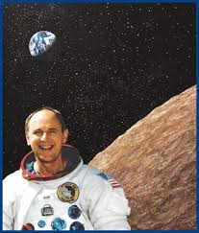
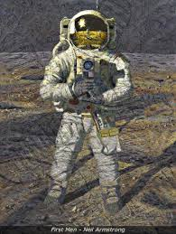
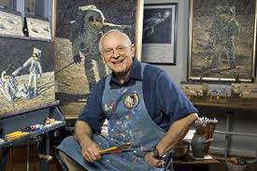
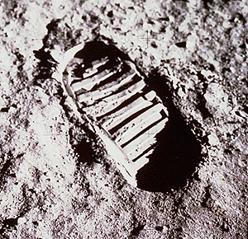
AIAA Houston Presents:
Alan Bean and “Reaching For Your Own Special Star.”
Event Details:
Thursday Oct 16 at NASA JSC Gilruth Center, Alamo Ballroom
Cash Bar beginning at 6:00pm
Dinner and program at 6:30pm
$15 for AIAA members
$20 for non members
Free if not having a meal
RSVP and more information at www.aiaahouston.org
Alan Bean is a former NASA astronaut and currently a painter. Bean was selected to become an astronaut by NASA in 1963. As the Lunar Module Pilot of Apollo 12, Bean was the fourth man to set foot on the moon. He explored the beautifully desolate landscape of the Ocean of Storms and later, as commander of Skylab Mission II. Bean spent 59 days in orbit around our fragile, blue-and-white Earth.
After retiring from the United States Navy in 1975 and NASA in 1981, Bean devoted himself to documenting his own experiences on the moon as well as those of his fellow Apollo Astronauts, one of the great explorations of history.

