Slide 1
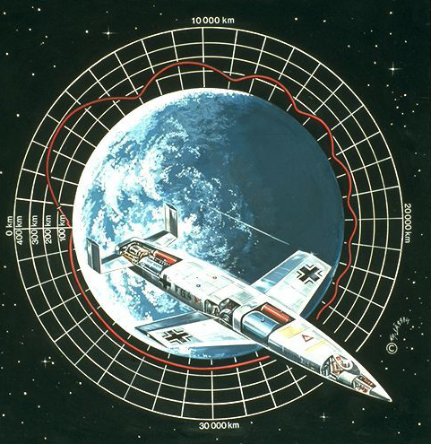
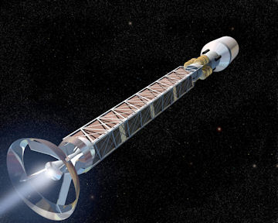
Eugen Sänger, From the Silverbird to Interstellar Voyages
Albert A Jackson
Visiting Scientist Lunar and Planetary Institute

Slide 2
Eugen Sänger Irene Sänger-Bredt Arthur C Clarke

Slide 3


Slide 4
Silbervogel probably 1930
Diagram from 1933 in Raketenflugtechnik
Mach-10

Slide 5
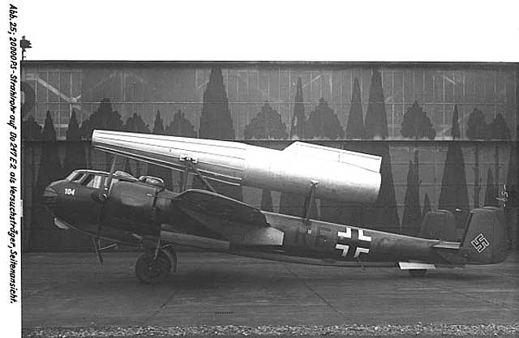

Slide 8
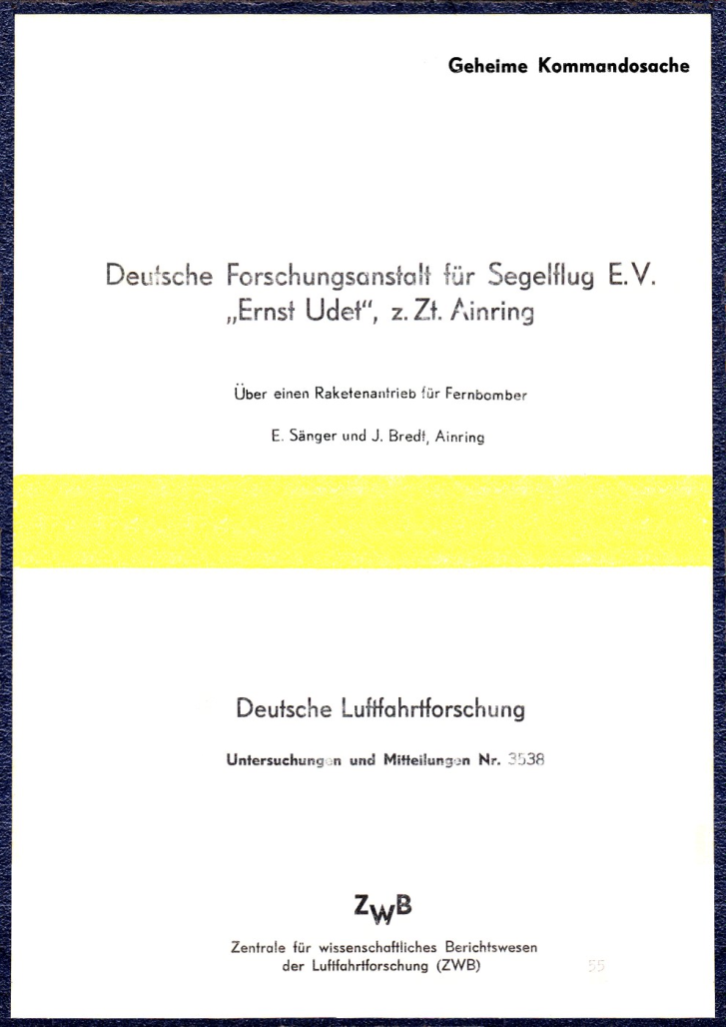

Slide 9
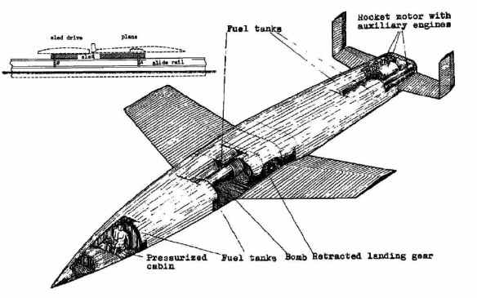
Length 28 meters, wingspan 15 meters, weight empty 9 tons, weight launch 100 tons
Main motor 610 tons of thrust for 11 seconds.

Slide 10
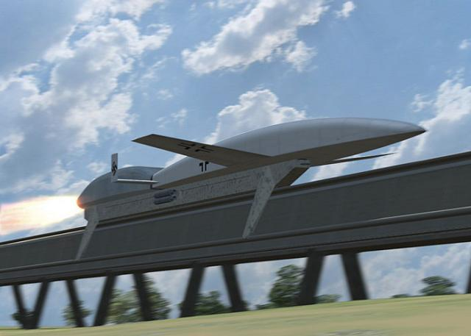
Silbervogel
Accelerate to M1.5 in 3km , ascend to 150 km in 8 minutes 10 to 20 gs

Slide 11
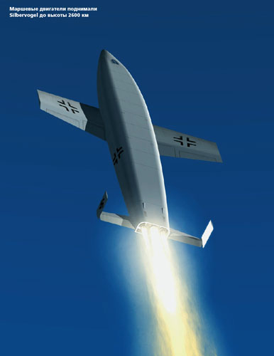
Ascend to 150 km in 8 minutes
Silbervogel

Slide 12
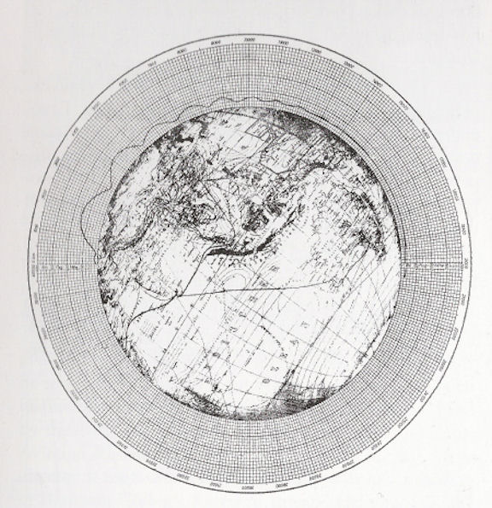

Slide 13
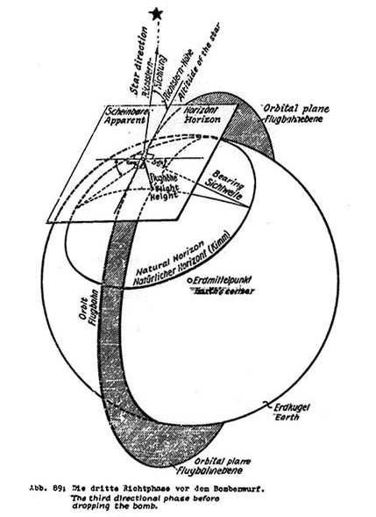

Slide 14
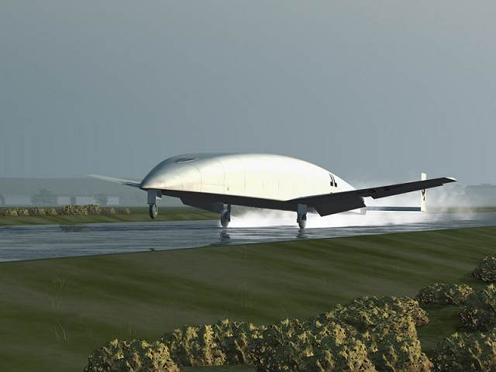

Slide 17
Kidnap them!
Grigori Tokaty
Vasily Stalin

Slide 18
Compared
Silbervogel L/D 5.0
Shuttle L/D 4.5
1944
~1981

Slide 19
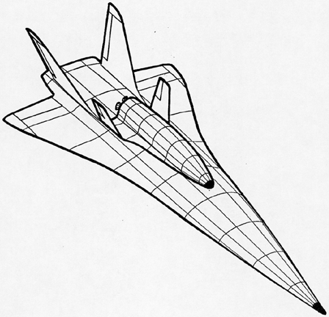
Sänger I 1962

Slide 23
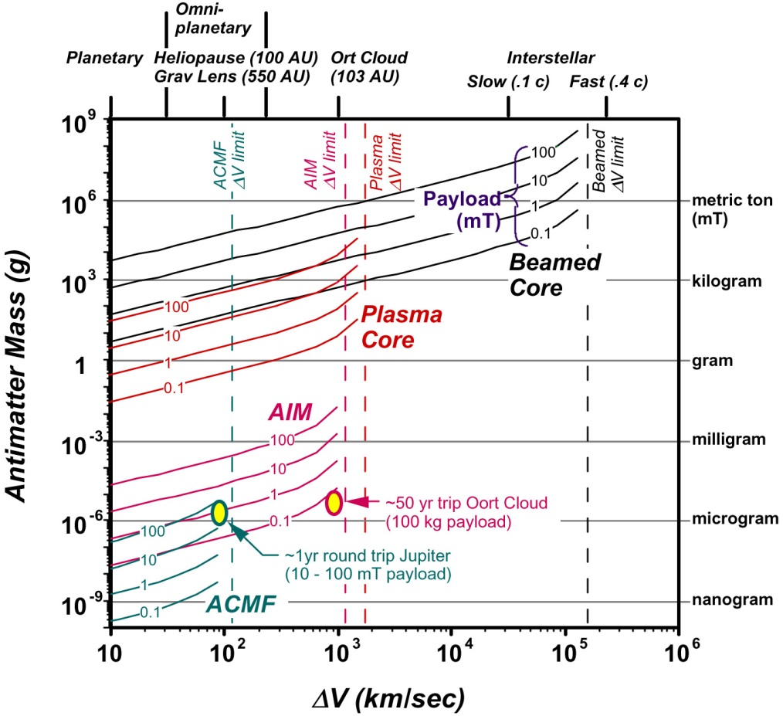
AIM - Antiproton-initiated Microfusion
ACMF Antiproton-catalyzed microfissio

Slide 25
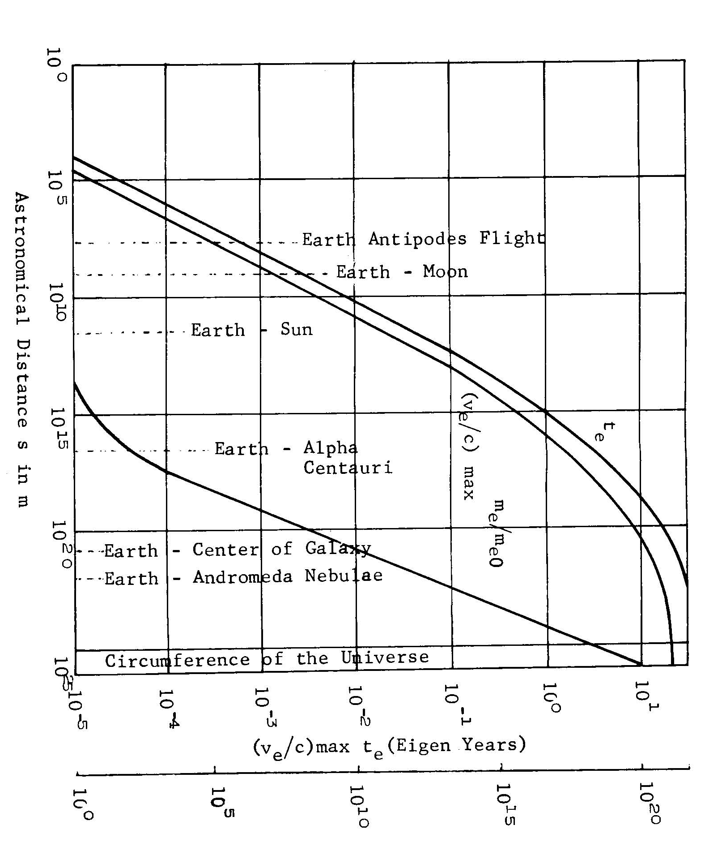

Slide 27
