Slide 1
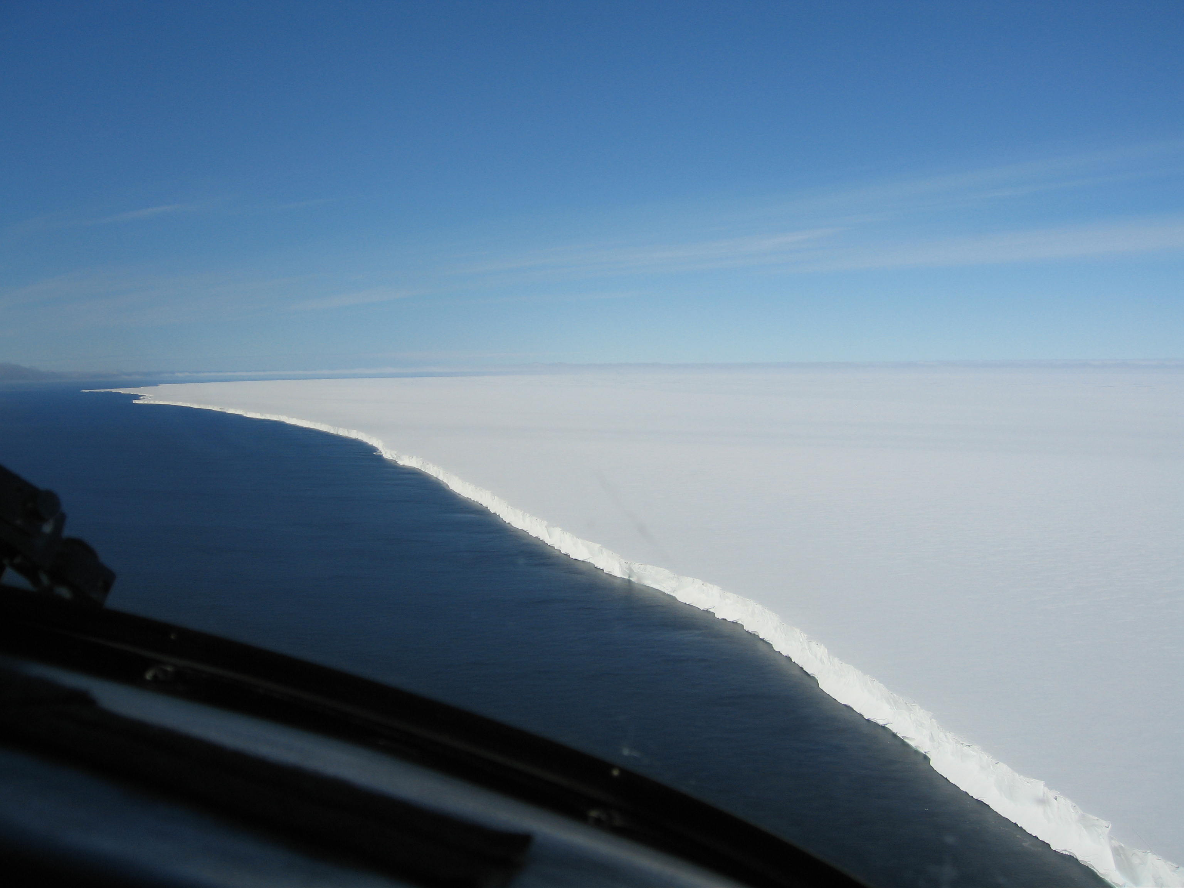
Climate change science and policy
Barry Lefer
University of Houston
Department of Earth and Atmospheric Sciences
19 February 2015
American Institute of Aeronautics and Astronautics
ANTCI, 2005

Slide 2
Climate vs. weather
Weather Climate
Shorter-term fluctuations Longer-Term Changes
Current atmospheric conditions Broad composite of average (or mean)
(e.g., temp, press, ws, wdir, condition of a region (e.g., temp, rain,
rainfall, etc.) snowfall, ice cover, winds, ocean temperature)
Hours, Days, Weeks Years (and longer), Typically 30 yr ave.
Specific location for specific time Mean state of a specific region
(e.g., continent, ocean, or entire planet)

Slide 3
How does Earth’s climate change?
Energy Input (E_{in}) ≠ Energy Output (E_{out})
ΔE_{in}:
Sun
Earth’s Orbit
Albedo
Clouds
Particles
ΔE_{out}:
CO₂
CH₄
N₂O
Clouds
Particles

Slide 4
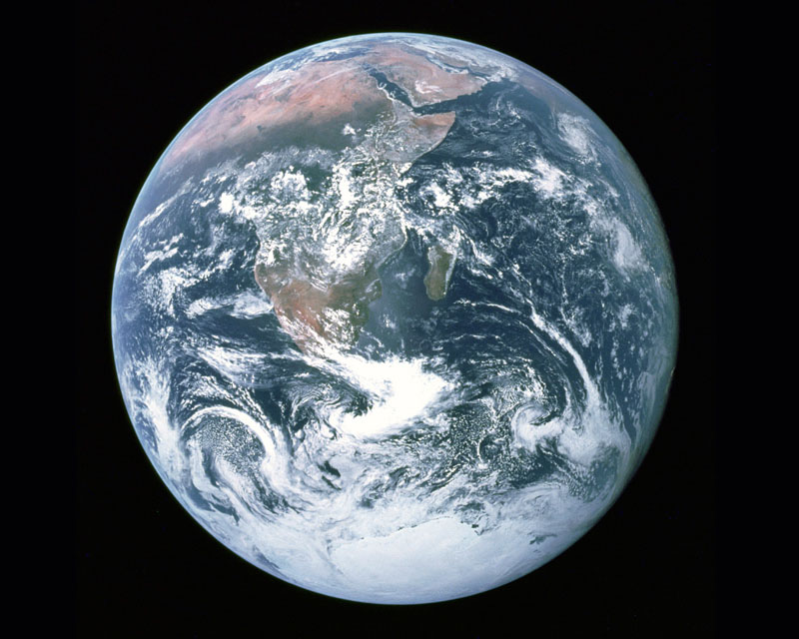
So the Earth absorbs an average of 238 W/m² from the Sun, but that does not mean that every square meter absorbs this amount. Where is it absorbing less? Where is it absorbing more?
90 W/m²
320 W/m²

Slide 5
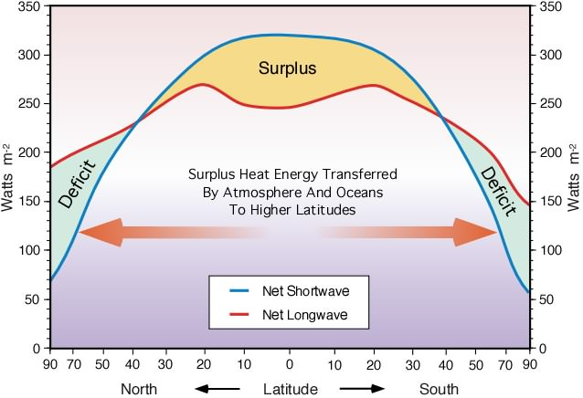
Energy Spatial Imbalance
www.physicalgeography.net

Slide 6
Also Tilt of Earth (~23.5 deg)
NASA Apollo 17 (12/7/1972)

Slide 7
Earth’s Energy Budget – No GHG
Sun
238
T_{Earth} = 257K = -16°C
238
Dessler, 2012

Slide 8
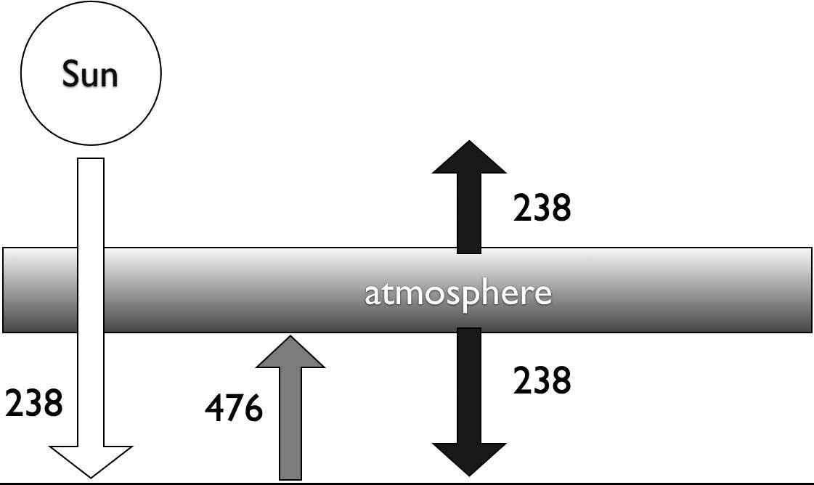
Earth’s Energy Budget – with atmos
Dessler, 2012

Slide 9
Earth’s Energy Budget – with atmos
Dessler, 2012

Slide 10
Earth’s Energy Budget – with atmos
Dessler, 2012

Slide 11
Earth’s Energy Budget – with atmos
2015 T_{Earth} = 289K = 16°C
Dessler, 2012

Slide 12
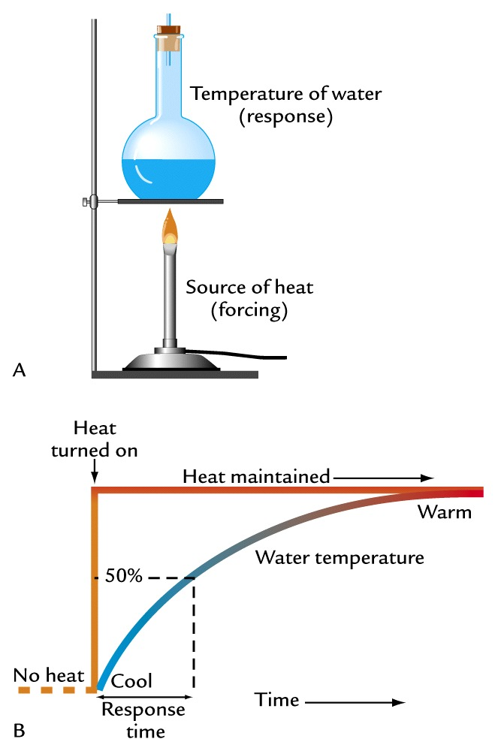
Climate system response
Ruddiman, 2008

Slide 13
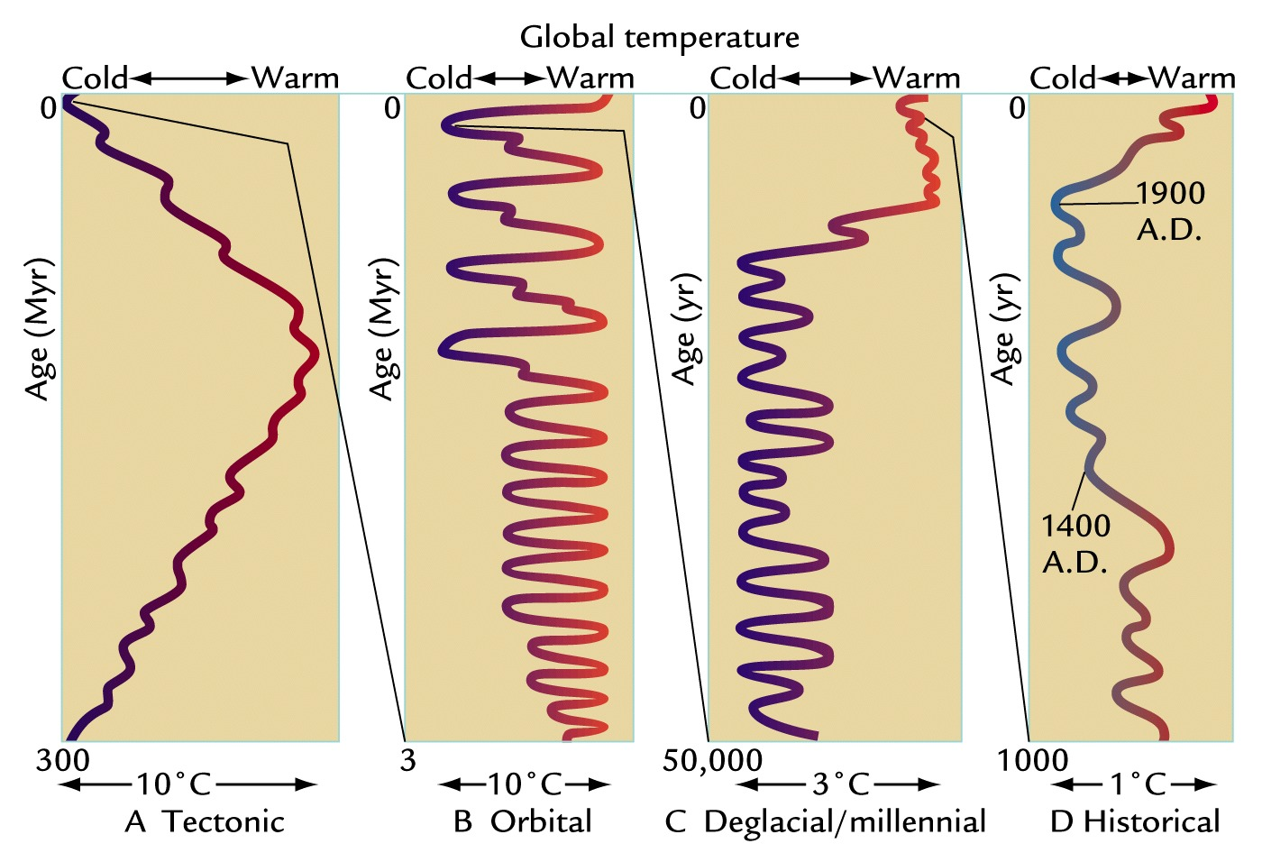
Time scales of climate change
Ruddiman, 2008

Slide 14
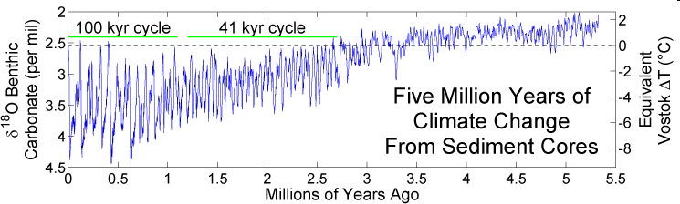
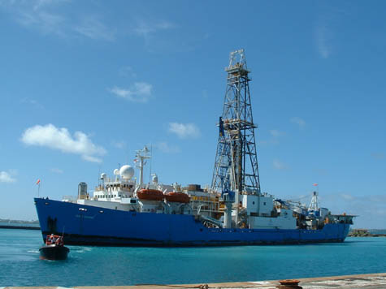
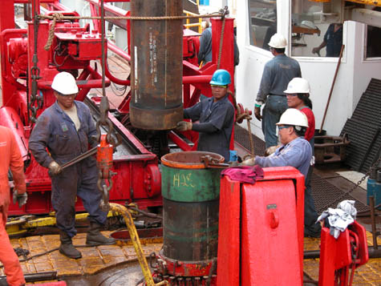
Ocean sediment core record
GlobalWarming Art (t), Ruddiman, 2008 (b)

Slide 15
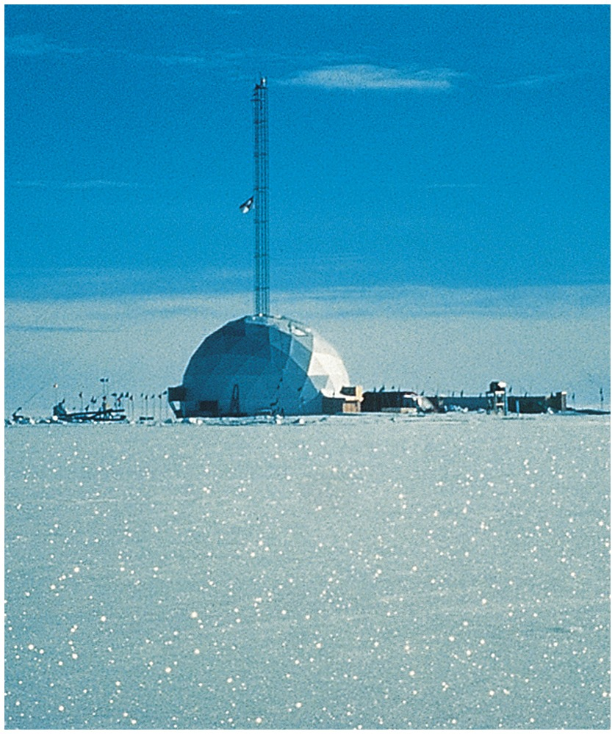
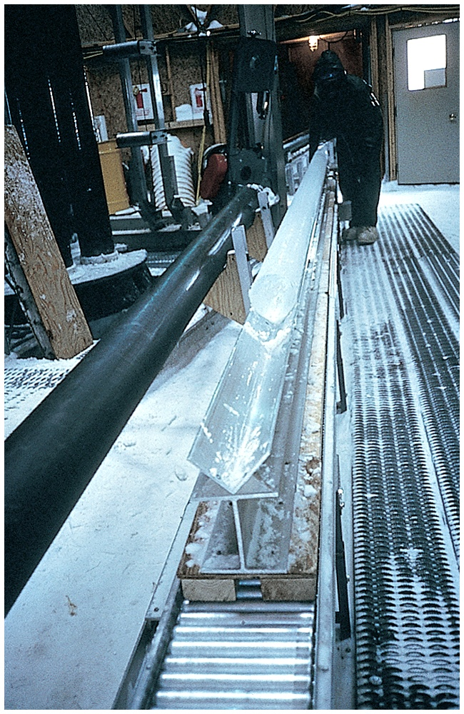
Coring Earth’s ice sheets
Twickler – GISP2 SMO (1994)

Slide 16

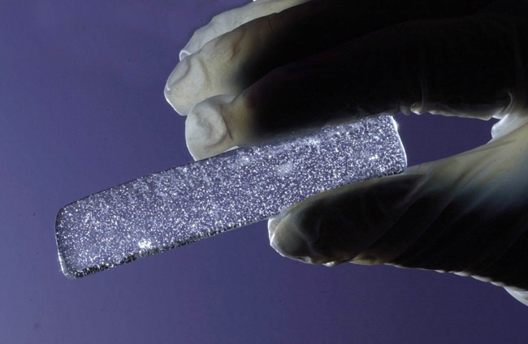
Bubbles trapped in ice core
EPICA (2004)

Slide 17
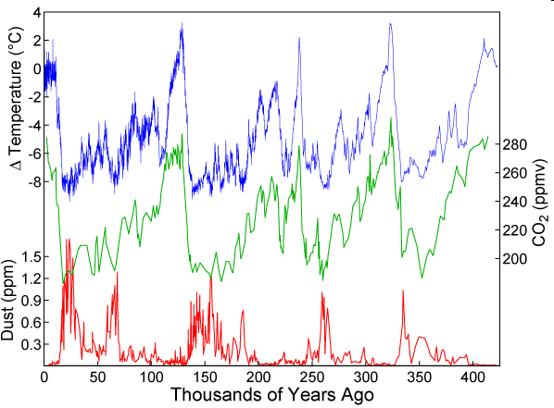
Ice core proxy T, CO₂, dust record
GlobalWarmingArt.com

Slide 18
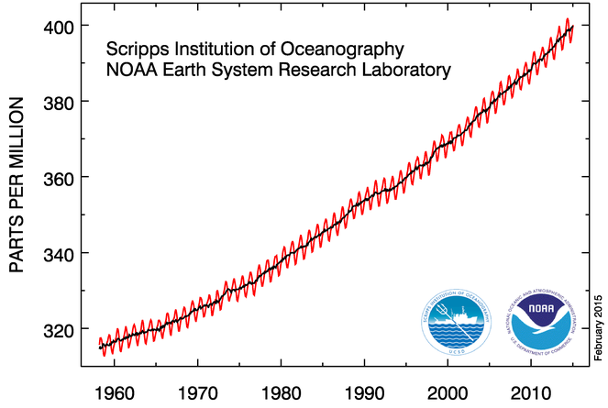
CO₂ measurement record
January 2015: 399.96 ppm
January 2014: 397.80 ppm
NOAA (2015)

Slide 19
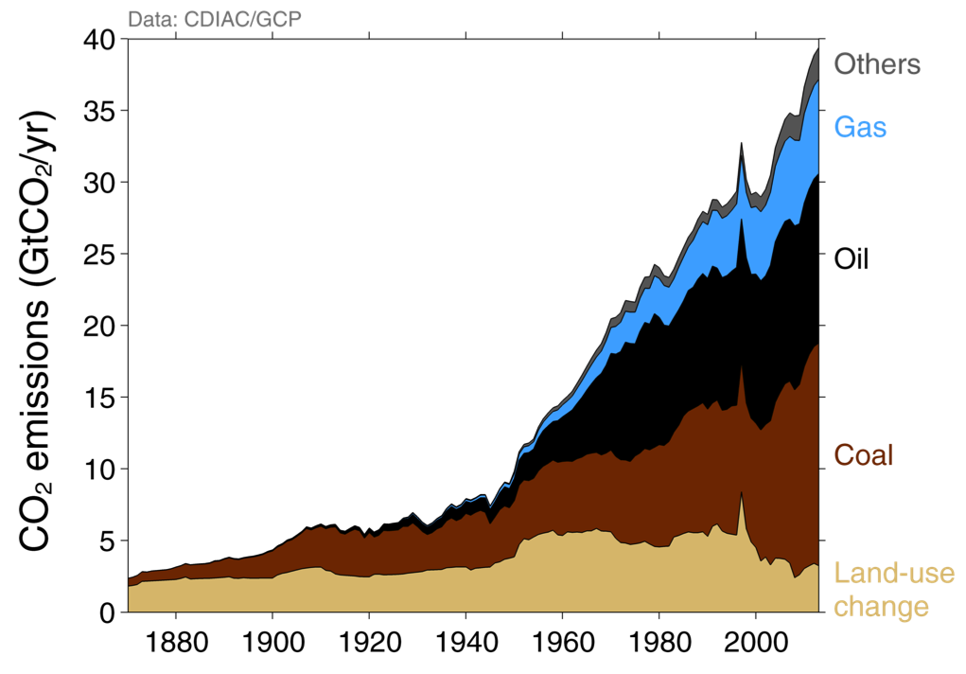
CO₂ Emissons (1870 – 2013)
CDIAC/Global Climate Project

Slide 20
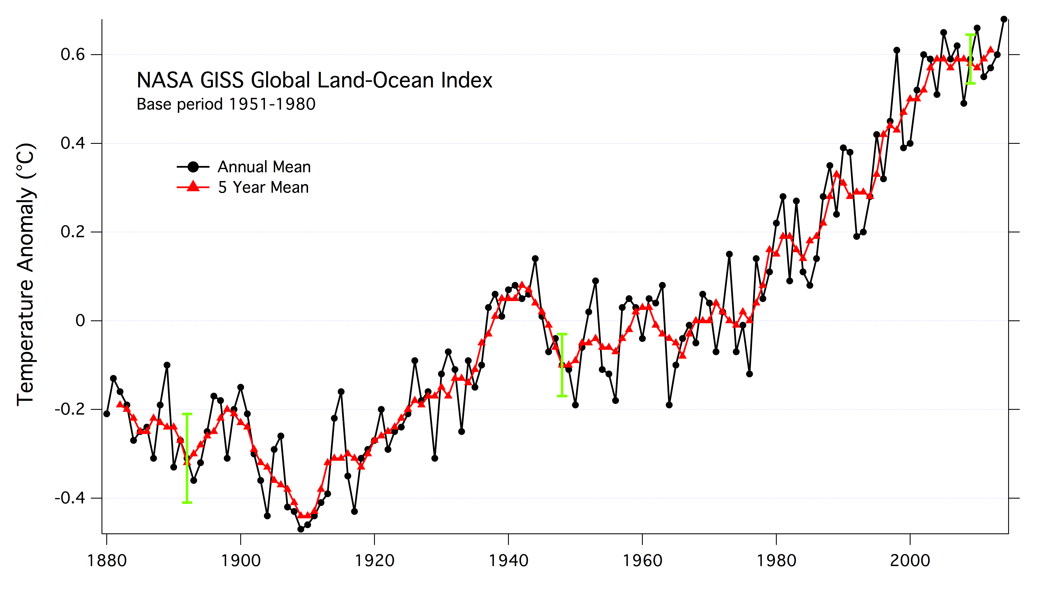
Global Annual Surface Temperature
NASA GISS (2015)

Slide 21
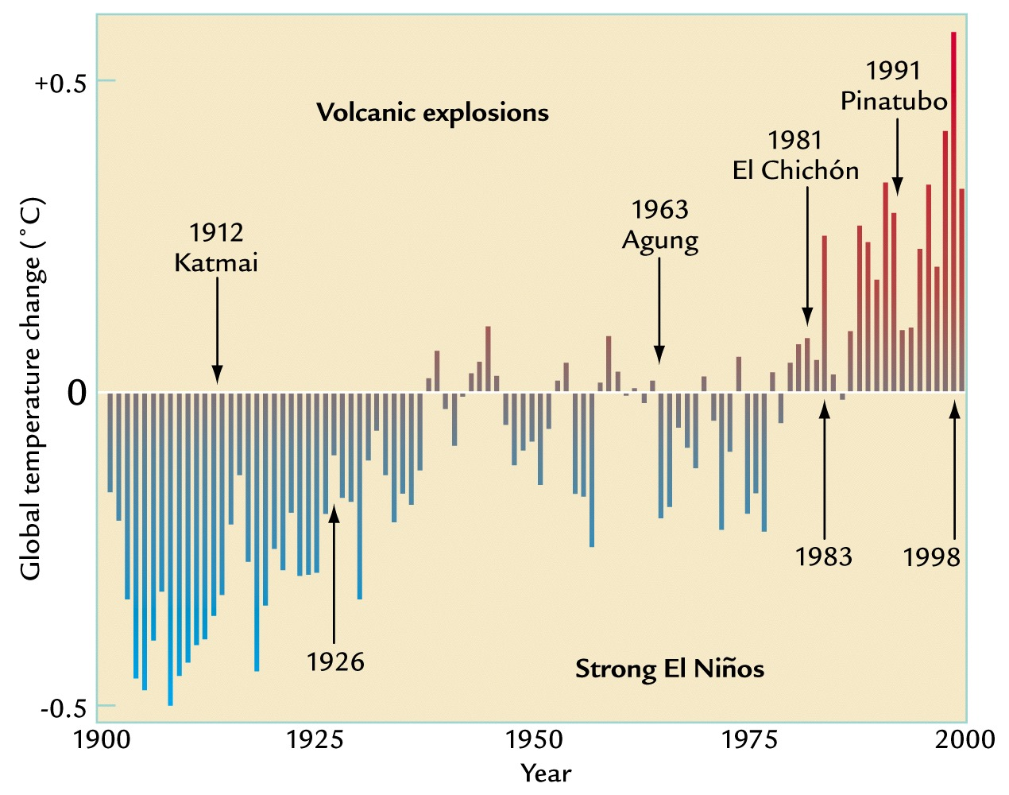
Volcanic cooling and El Niño warming
Ruddiman, 2001

Slide 22
Climate system response
Ruddiman, 2008

Slide 23
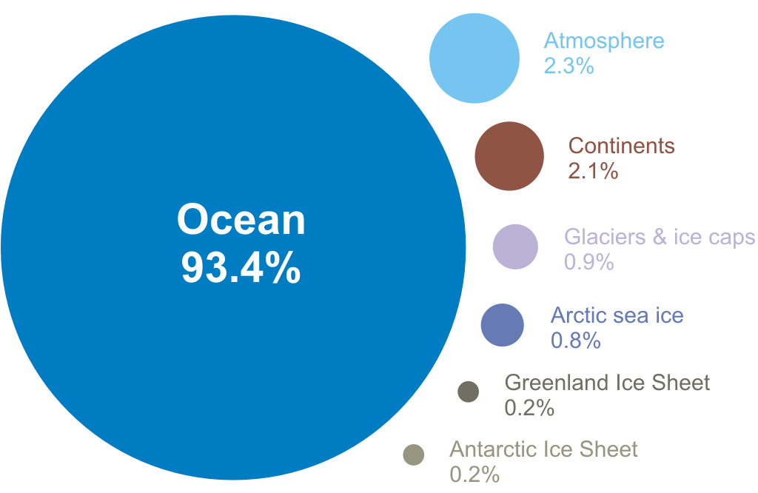
Where is the trapped heat being stored?
NOAA NESDIS (2014)

Slide 24
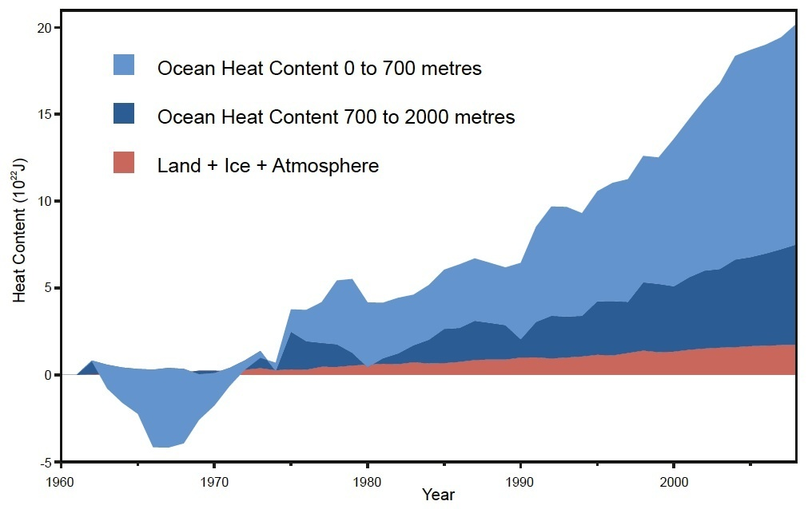
Total Heat Content
Church et al. (2011), Nuccitelli et al, (2012)

Slide 25
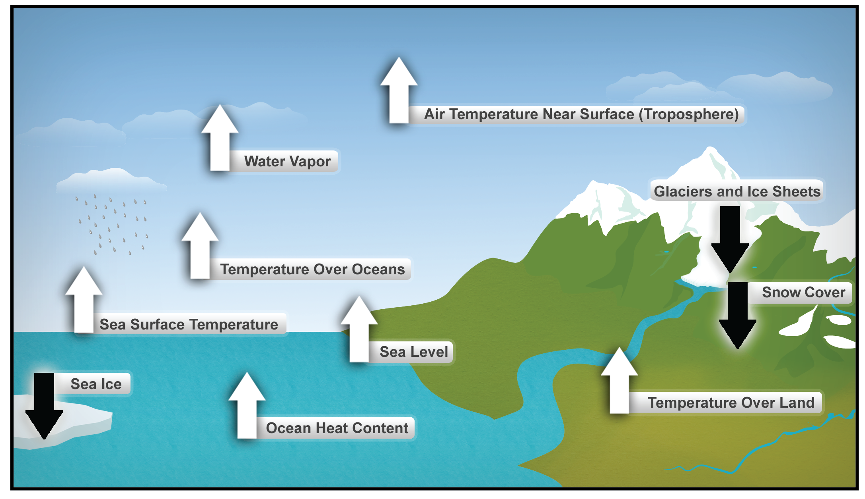
Ten Indicators of Warming
National Climate Assessment, 2014

Slide 26
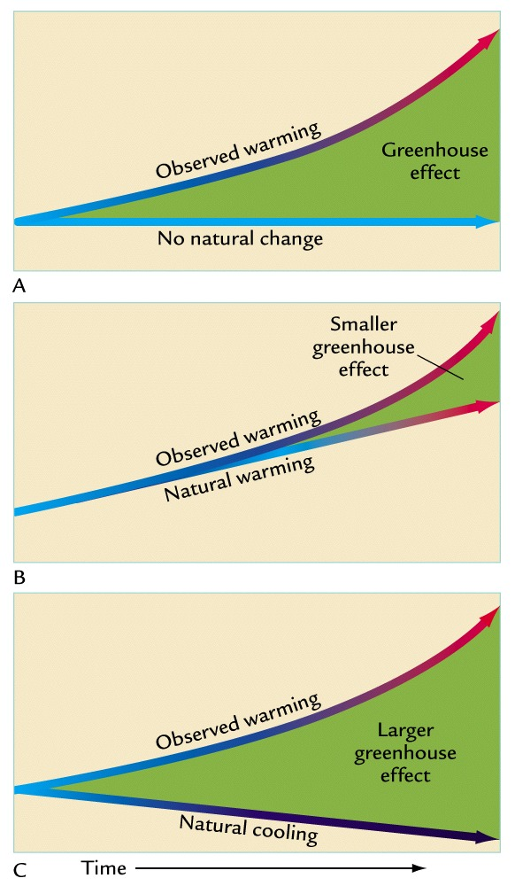
Natural warming and greenhouse effects
Ruddiman, 2008

Slide 27
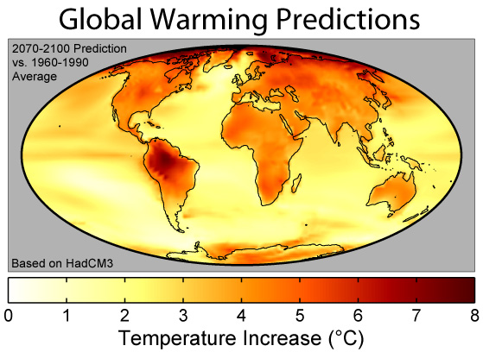
Another future global temperature forecast
Lefer 41 – iv. future cc
http://www.globalwarmingart.com/

Slide 28
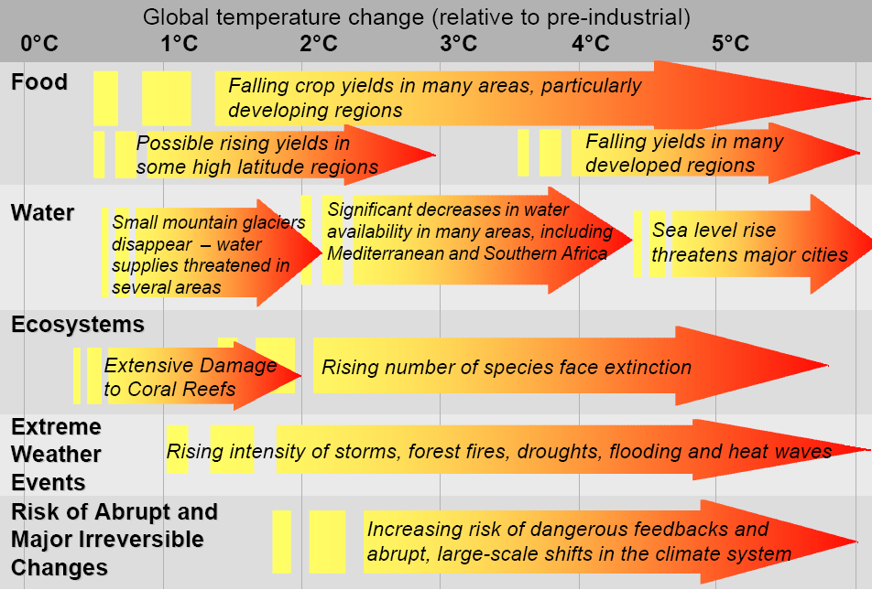
Projected impacts of climate change
IPCC, 2007

Slide 29
Projected impacts of climate change
IPCC, 2007

Slide 30
Projected impacts of climate change
IPCC, 2007

Slide 31
Projected impacts of climate change
IPCC, 2007

Slide 32
Climate Change Summary
We have explored the fundamental physics of climate change, and you all have seen greenhouse gases trap heat and warm the Earth’s surface and oceans.
The data leads us to confidently conclude that humans are changing the Earth’s climate.
The continuing addition of greenhouse gases to the atmosphere will bring significant changes to our climate over the next century and beyond.
Dessler, 2012

Slide 33
Climate Change Summary
We are not certain how bad this climate change will be, but the upper end of the range (global warming of 5° C or more by the end of the century) includes warming large enough for the experts to consider its impacts to be potentially catastrophic.
The lower end of the range (∼2 ◦C) will be challenging for the world’s poor as well as our most vulnerable ecosystems.
Possible responses to this risk, including mitigation, adaptation, and geoengineering.
Dessler, 2012

Slide 34
Should we reduce emissions?
This decision must be made with incomplete knowledge because we do not know the answers to all of these key questions:
1) How much warming will we experience if we do nothing?
2) How bad will that much warming be?
3) How expensive will it be to reduce emissions?
4) How much warming can we avoid?
Dessler, 2012

Slide 35
What is the Urgency?
Why must we make a decision now on whether to reduce emissions or not.
Because of lags in the climate system and in our economy, we must begin efforts to reduce emissions now in order to significantly reduce warming in the second half of the 21st century.
While we have a reduced capacity to affect the trajectory of temperatures over the next decade, our decision will determine the climate for 2050 and beyond.
Dessler, 2012

Slide 36
Decisions under uncertainty
This is not an unusual situation.
Many important policy decisions must be made in the face of uncertainty.
This includes important defense and economic decisions:
Should we aid the Syrian rebels?
Should we help the Ukraine?
Should we lower corporate taxes?
What to do about illegal immigrants?
Should federal government legalize marijuana?
Dessler, 2012

Slide 37
Values
These decisions contain implicit value judgments about the choices. Consider the following two arguments:
1) Because the worst-case scenario of climate change is so serious, we must take action now to reduce emissions, even though we don’t know exactly how bad climate change will be.
2) Because of the high cost of reducing emissions, we must be certain that climate change is serious before we take action.
Both statements argue that we must err on the side of caution in order to avoid a bad outcome. However, the bad outcome is different in these two arguments.
Dessler, 2012

Slide 38
Which potential error is worse?
Must we be certain beyond a reasonable doubt that climate change is a serious threat to mankind before taking action to reduce emissions?
Which error is worse:
Reducing emissions unnecessarily because climate change turns out to be a minor threat…
Or
Not reducing emissions and climate change turns out to be a serious threat?
Dessler, 2012

Slide 39
Advantages?
Energy security by reducing imports of oil from politically hostile countries AND reductions in air pollution.
Costs would be spread over the next several decades, at least some of the cost can be avoided by scaling back future efforts once we learn they are unnecessary.
Would a person in Year 2100 be upset that we reduced the use of fossil fuels in favor of other energy sources?
Dessler, 2012

Slide 40
Reducing emissions is reversible
If an action you take is irreversible, then you have to be more certain that it’s the right action than if a decision is easily reversible.
If we decide later that climate change is not that serious, then we can always change our policies and increase emissions of carbon dioxide.
But the converse is not true: If we continue emitting carbon dioxide, and then find out that climate change is a more serious problem, there is no practical way to remove carbon dioxide from the atmosphere.
Dessler, 2012

Slide 41
Costs of reductions
We know that putting a price on carbon will likely spur development of new technologies by providing a financial incentive to reduce emissions that does not exist in today’s economy.
The resulting estimated costs of reducing emissions cover a wide range; some analyses conclude it will be quite inexpensive whereas others conclude it will be ruinously expensive.

Slide 42
Costs of Climate Change
Estimating the costs of the impacts of climate change – and therefore the benefits of avoiding it – is even more difficult.
Converting estimated changes in climate into a dollar figure can be difficult and arbitrary.

Slide 43
Timing is an issue
Another problem in estimating the costs of climate change comes from the timing of climate impacts.
If 1 ton of carbon is emitted into the atmosphere today, it will warm the planet for centuries to come and will cause impacts over that entire time.
However, the cost of not emitting that ton must be paid today.
Dessler, 2012

Slide 44
Costs/Impacts not equally distributed
Many of the hardest-hit regions are also the poorest regions, and those that have contributed little to climate change.
The worst-case scenarios might include catastrophic outcomes such as abrupt climate changes and starvation.
For some people, uncertainty in how bad things can get trumps a quantitative cost–benefit analysis.
And the possibility of a true catastrophe in the next century compels aggressive action.
Dessler, 2012

Slide 45
Less than 2°C of warming
A simpler way to select a long-term goal is to simply pick a limit for temperature or atmospheric carbon dioxide above which you judge the climate impacts to be unacceptable.
The limit should be low enough that it gives us a good chance to avoid serious climate impacts, but high enough that it is politically and economically acceptable.
Over the past several years a consensus has grown up around a target of 2°C of warming above pre-industrial temperatures.
Dessler, 2012

Slide 46
How to get there?
Cut emissions by 50–80% in 35 years, so we would need to reduce emissions by, on average, 1–2% per year.
Dessler, 2012

Slide 47
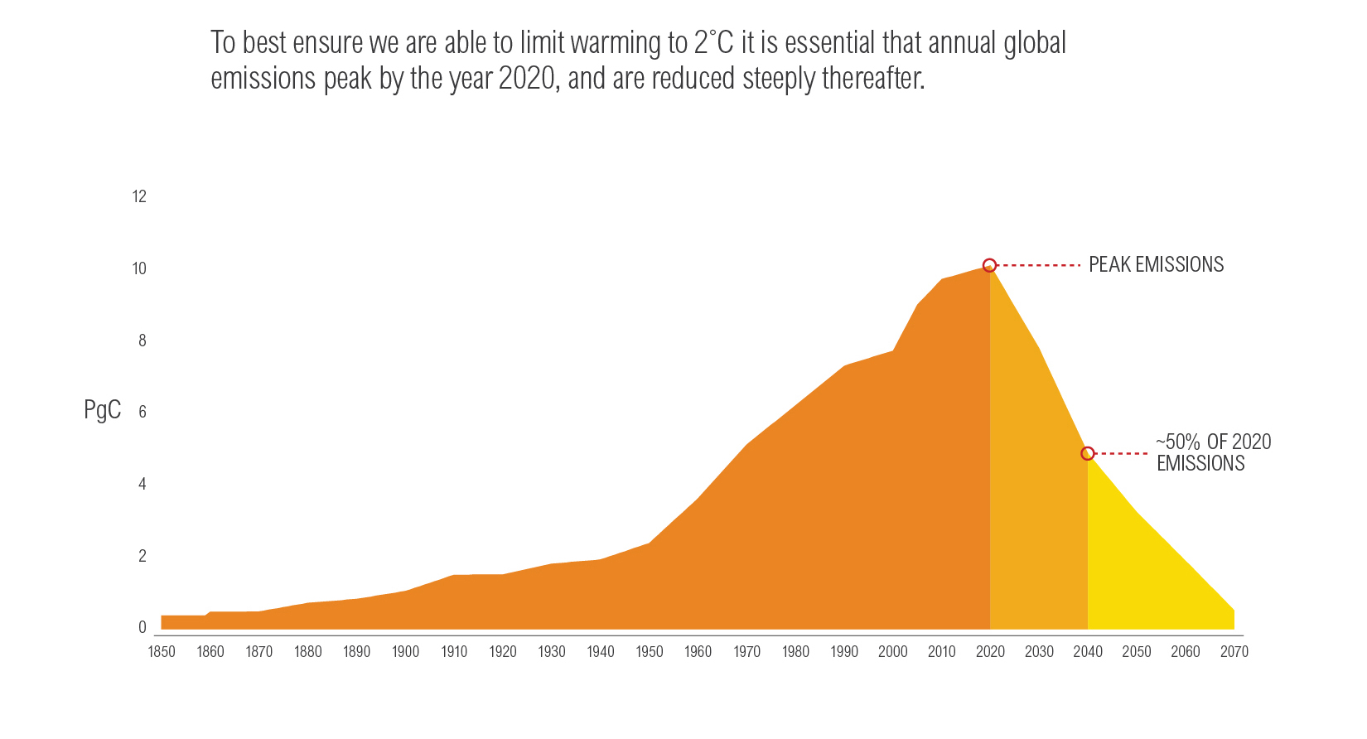
The challenge
IPCC, 2007

Slide 48
Global CO₂ Emissions
Note: 1 ton C = 3.67 tons CO₂
CDIAC/GCP, 2014

Slide 49
What factors control emissions of GHG? (PAT)
Emissions trends reflect a combination of economic factors:
P = Population
A = Affluence = per capita output (GDP/population)
T = Technology = Energy Intensity and Carbon Intensity
Energy Intensity (EI) = energy use per dollar of GDP
Carbon Intensity (CI) = CO₂ emissions per unit of energy
Dessler, 2012

Slide 50
Is it possible to cut GHG emissions 50%
Both the population and affluence of the world will increase by 2050. Estimates are that population growth over the next 50 years would be,1% per year, and affluence will grow at 2–3% per year.
In order for emissions to decrease at 1–2% per year while population and affluence are growing, we would need to reduce the greenhouse-gas intensity by 4–6% per year.
Dessler, 2012

Slide 51
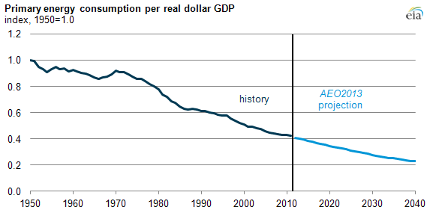
Trend in US Energy Intensity (EI)
EIA, 2013

Slide 52
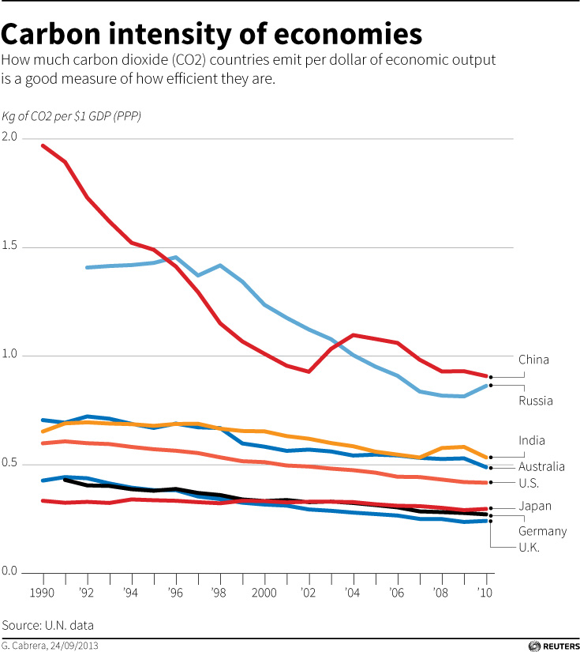
Trend in Carbon Intensity (CI)
Reuters, 2012

Slide 53
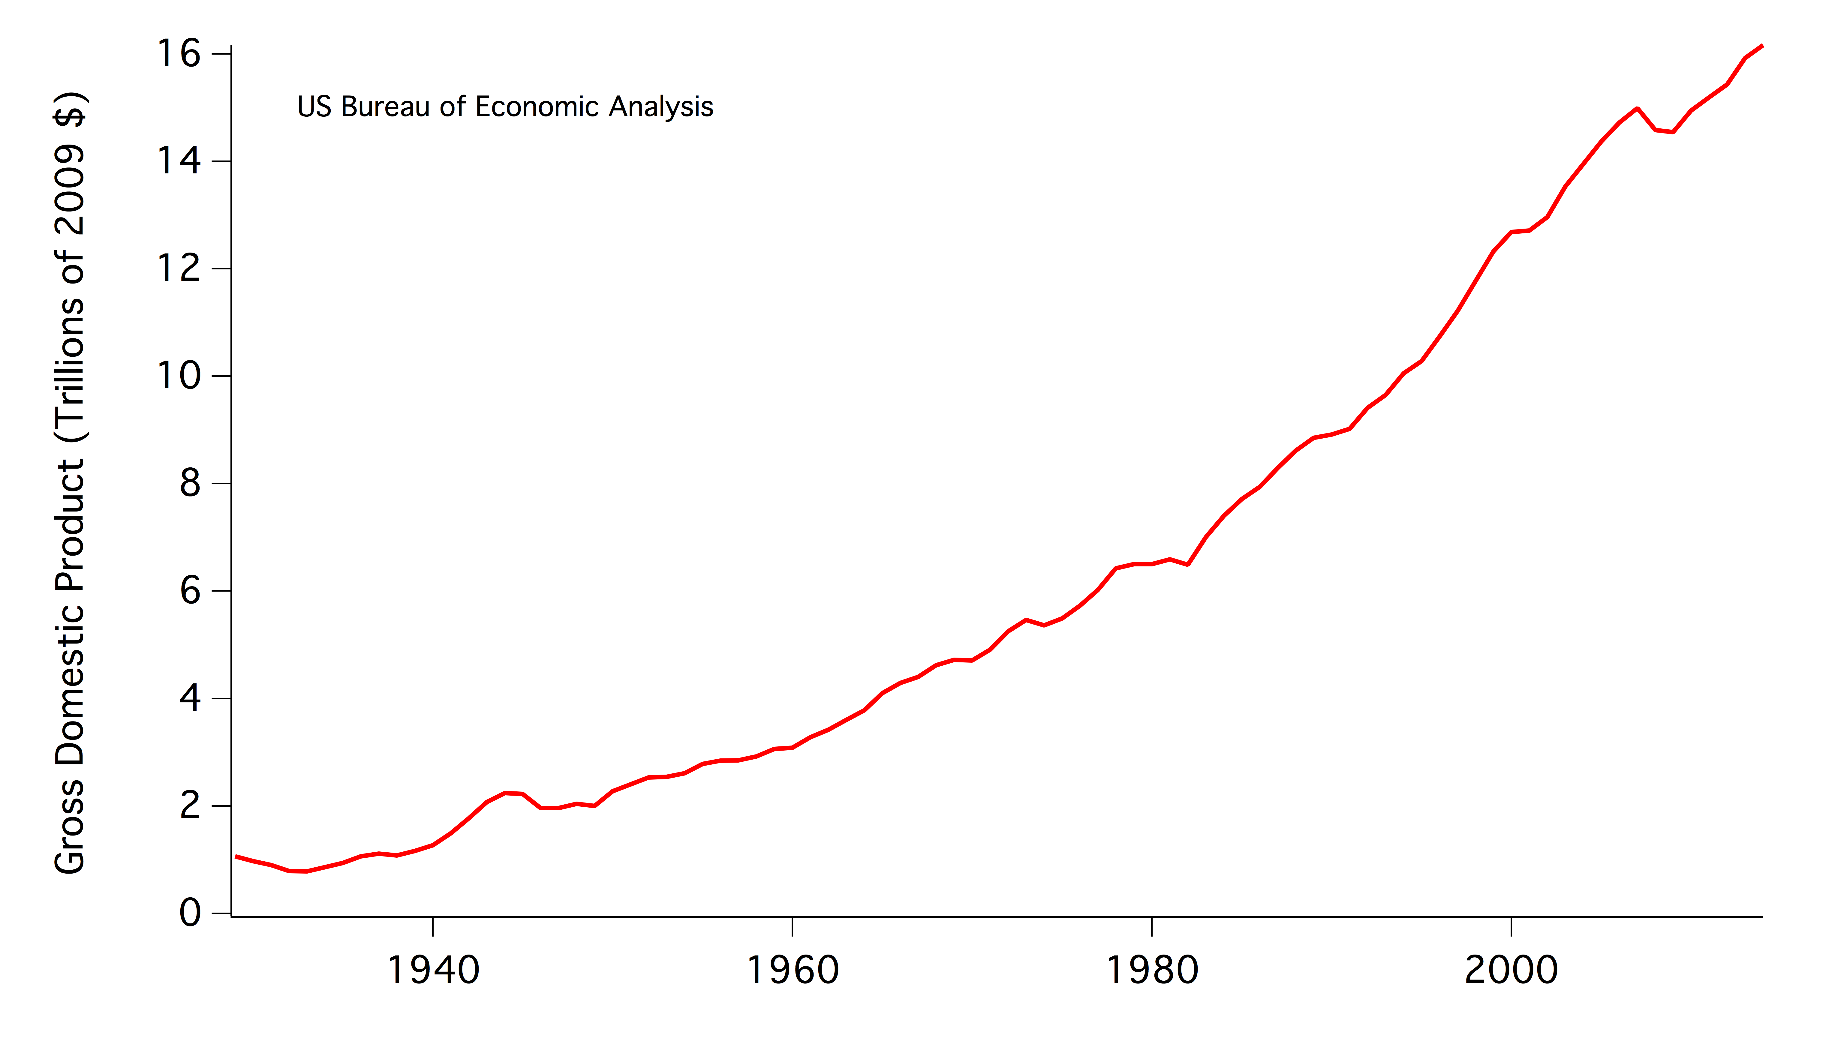
Trend in U.S. Real GDP
USBEA, 2014

Slide 54
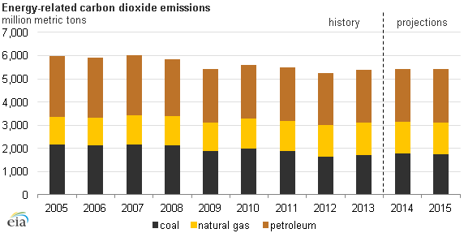
Recent Trend in U.S. CO₂ emissions
EIA, 2014

Slide 55
How to get there?
Rapidly switch to energy sources that release less (and/or do not release any) greenhouse gases.
By “rapidly”, would need to construct approximately 1 billion watts (1 GW) of carbon-free power every day between 2015 and 2050 to meet this target.
A typical coal or nuclear power plant generates roughly 10 GW. This is not an impossible challenge, but difficult. (e.g. China).
Dessler, 2012

Slide 56
Six steps towards a solution
Put a price on emissions of carbon dioxide and other greenhouse gases.
Efficiency standards and incentives to encourage careful energy use.
Fund the research and development of new technologies.
Prepare to adapt to climate change.
Research the geoengineering options.
Review and amend policies as new information (re: science and technology) arises.
Dessler, 2012

Slide 57
Costs unknown
The climate change challenge is not unique; we almost never know in advance how much it will cost to comply with environmental regulations.
Before regulations to ozone depletion were passed in the 1980s, some advocates were predicting that the regulations would cause severe economic hardship, with people in the developed world having to get rid of their air conditioners and millions dying because of a lack of food refrigeration.
It turned out that the cost of complying with ozone layer protection regulations was inexpensive.
Dessler, 2012

Slide 58
Mid-course corrections allowed
Whether this will happen or not in this case is impossible to know until we put a price on carbon.
If it turns out that reducing emissions is too much of a hardship economically, then the policies can be reversed and we can return to consuming fossil fuels without regard for the climate.
But if reducing emissions turns out to have an acceptable cost, then we will be on the road to heading off a potentially severe climate impacts.
Dessler, 2012

Slide 59
Climate change common ground
Climate scientists agree that:
1) Earth’s total heat content has increased over the past 50 years, a conclusion based on direct measurements.
2) Concentrations of CO₂, CH₄, N₂O, and other greenhouse gases have built up in the atmosphere over the last 100 years due to human activities.
3) Climate change will result in significant (negative) impacts to our environment and society.
4) World should act now to invest in both adaptation and mitigation efforts to reduce impacts of climate change to society.

Slide 60
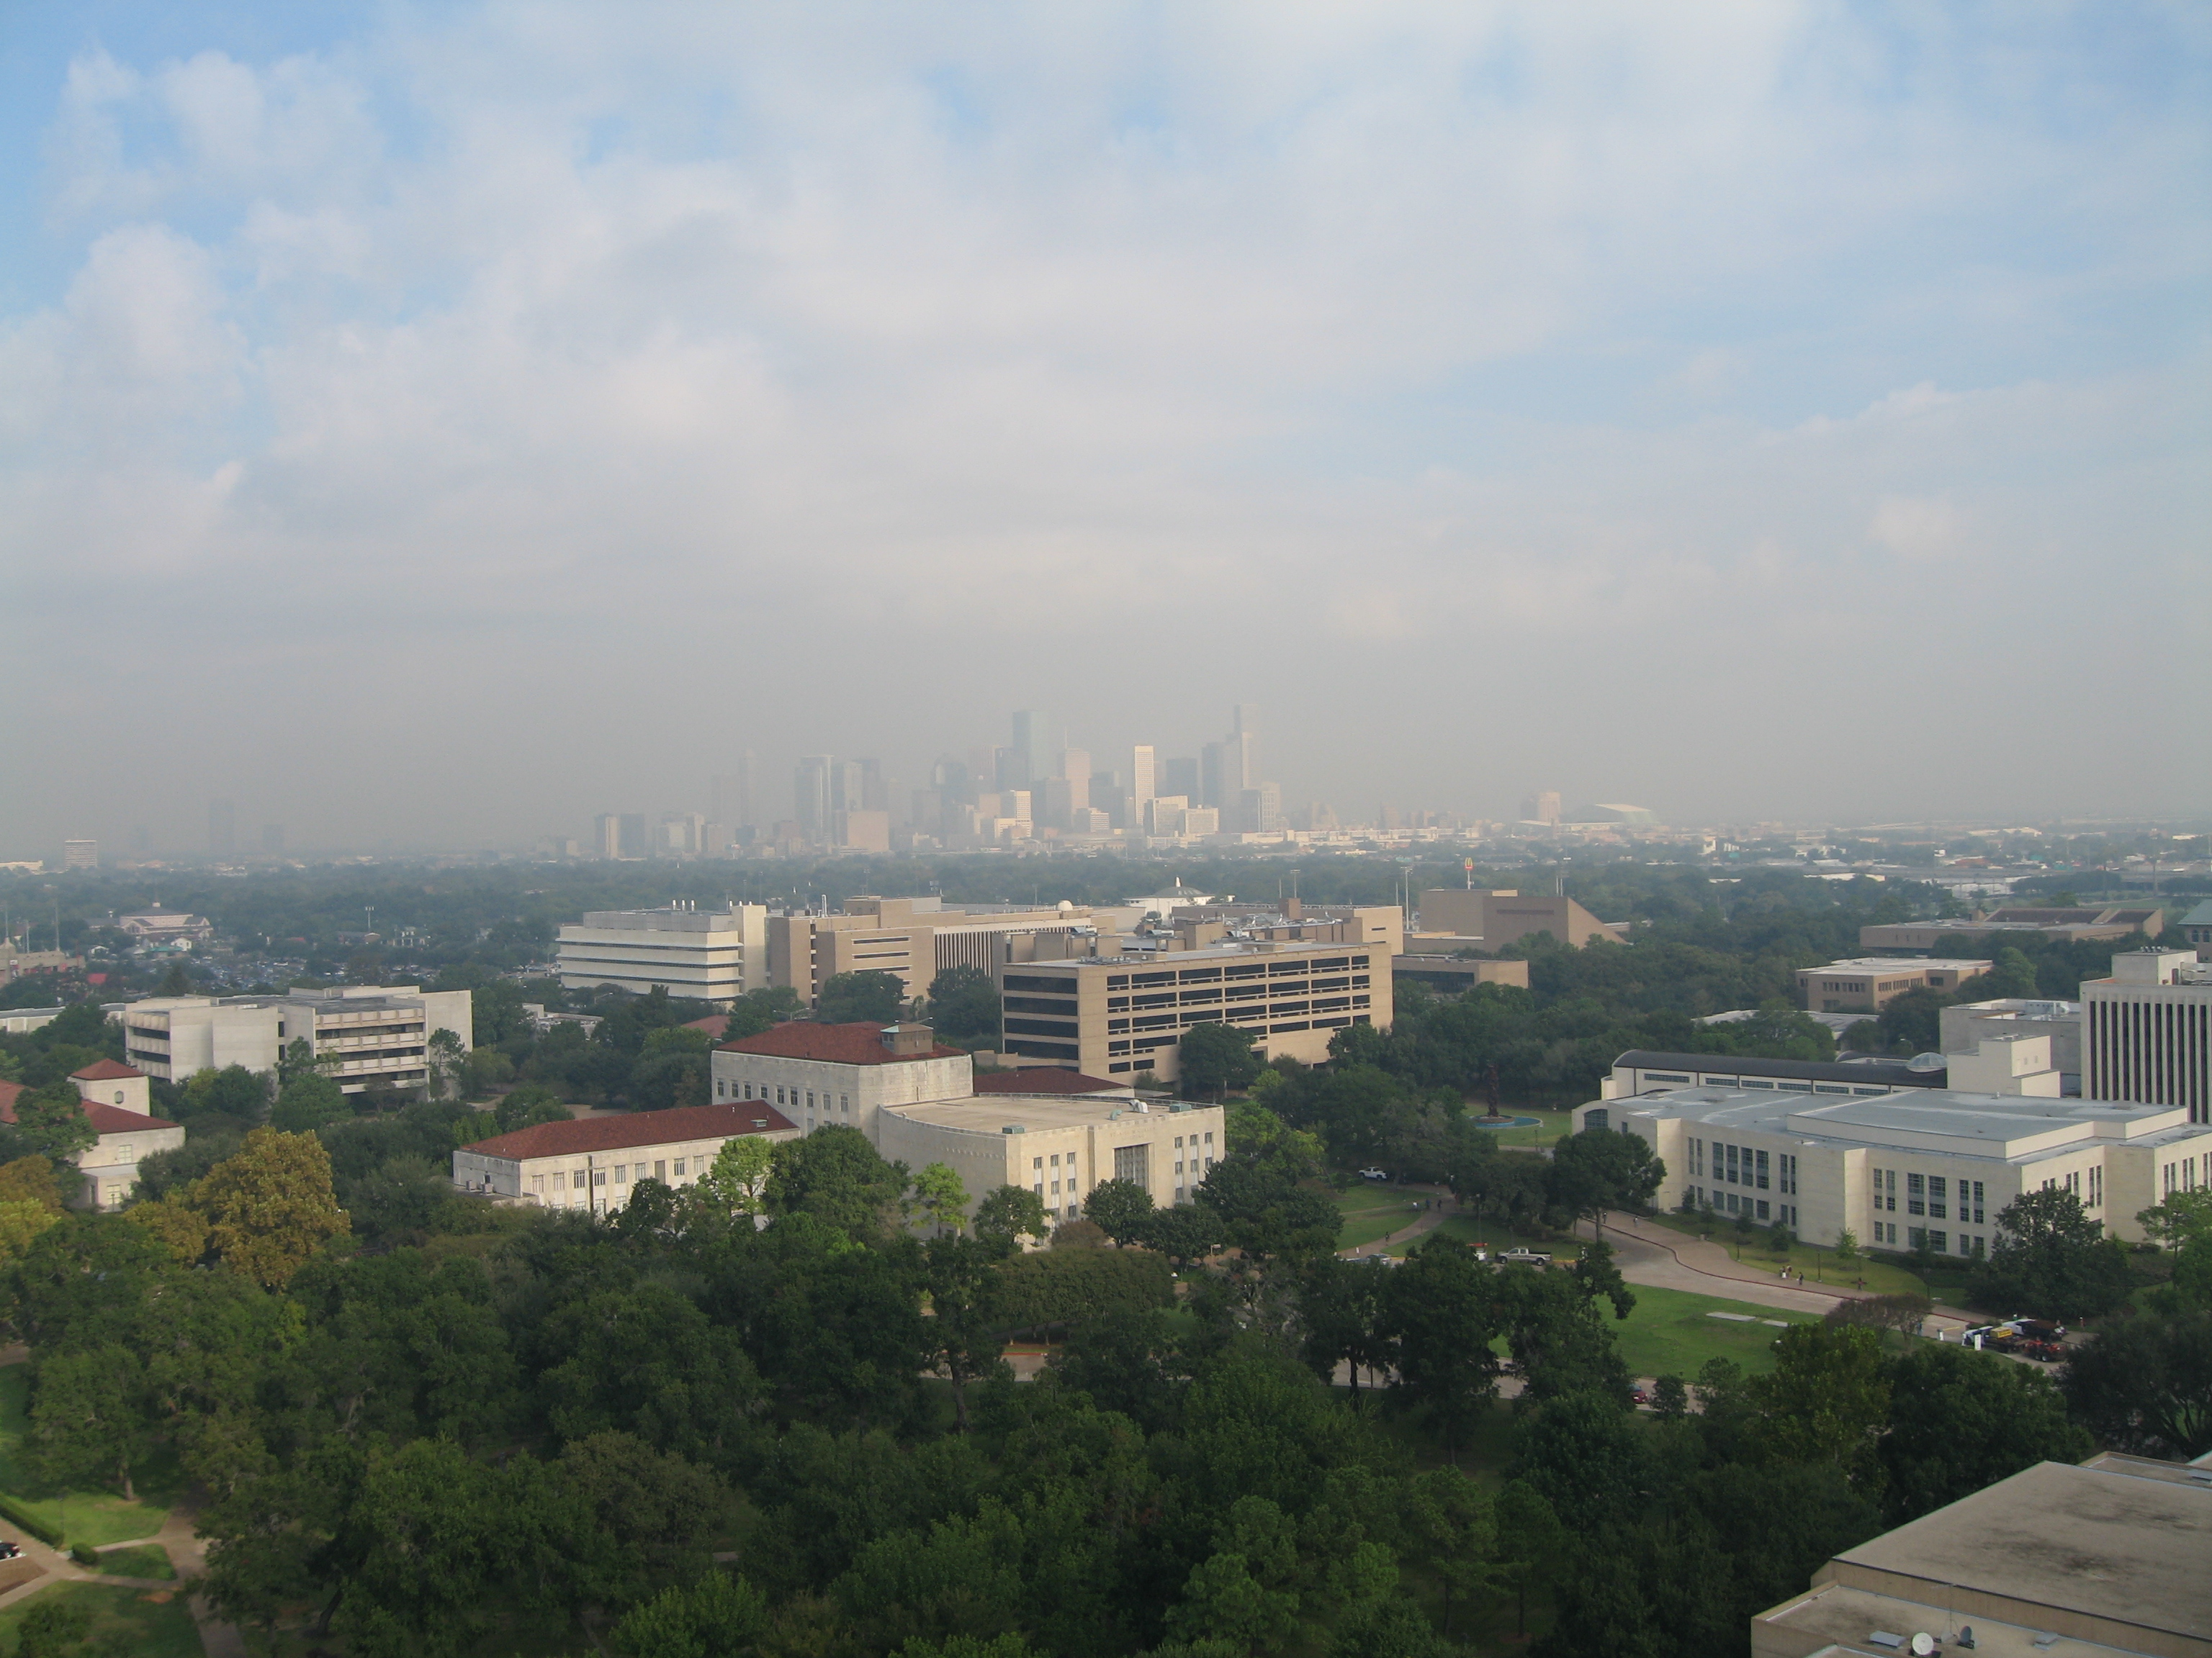
Questions?
Dessler, 2012

Slide 61
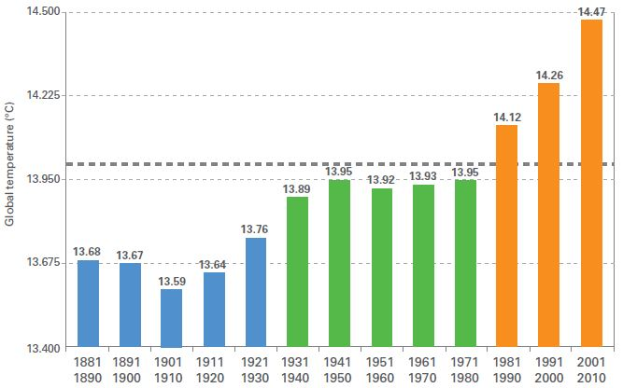
Decadal global surface temperature
WMO, 2014

Slide 62
Climate system response
Lefer 11 – i. basics
Ruddiman, 2008

Slide 63
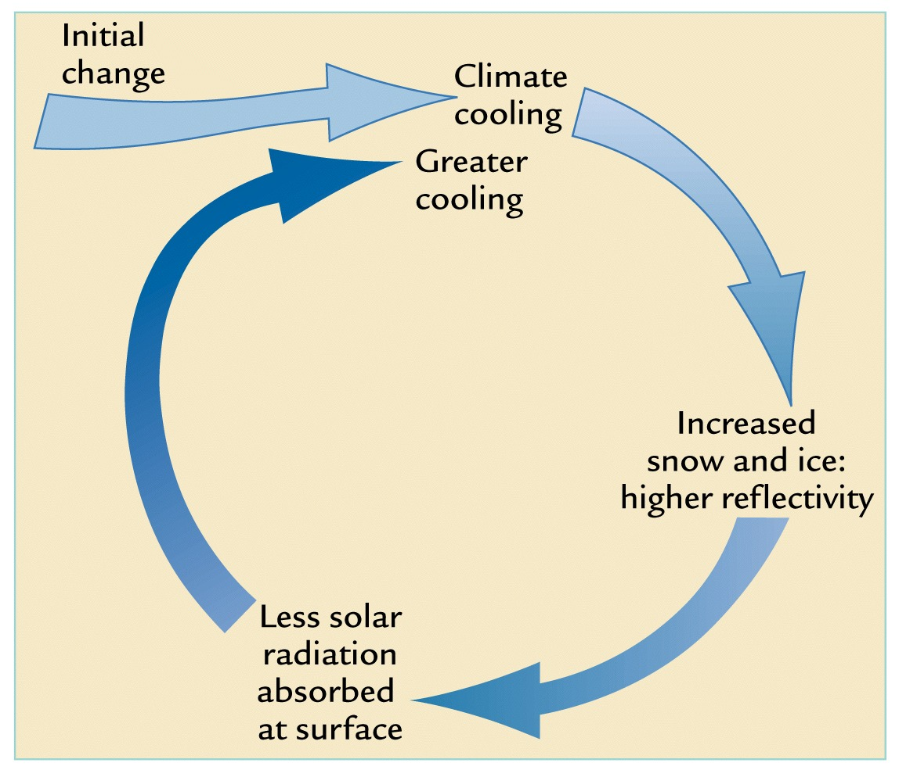
Albedo-temperature feedback
Lefer 13 – i. basics
Ruddiman, 2008

Slide 64
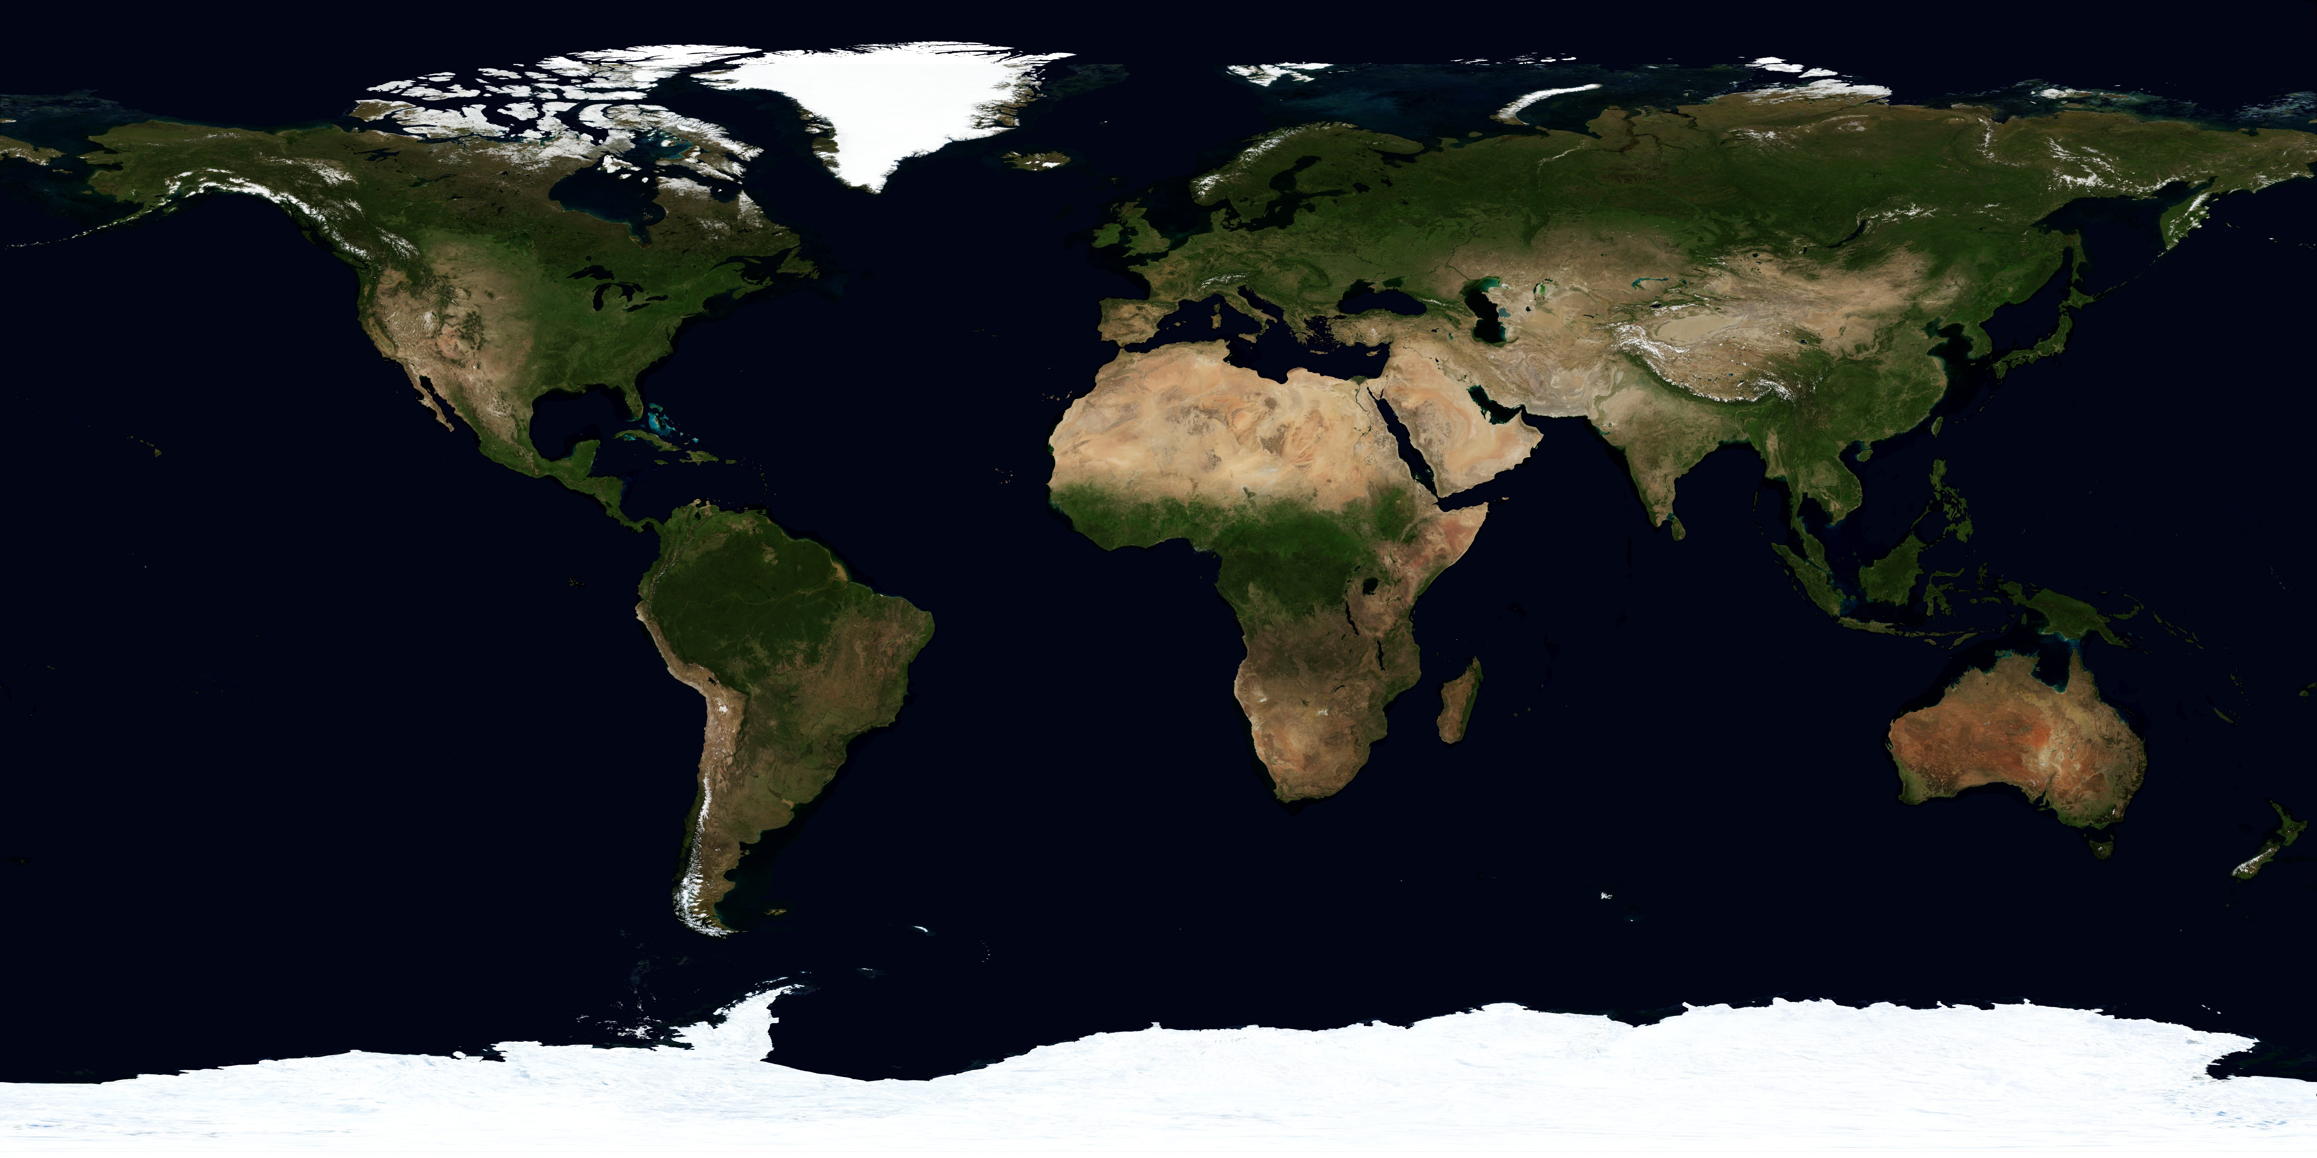
Albedo-temperature feedback
Lefer 14 – i. basics
Source: NASA

Slide 65
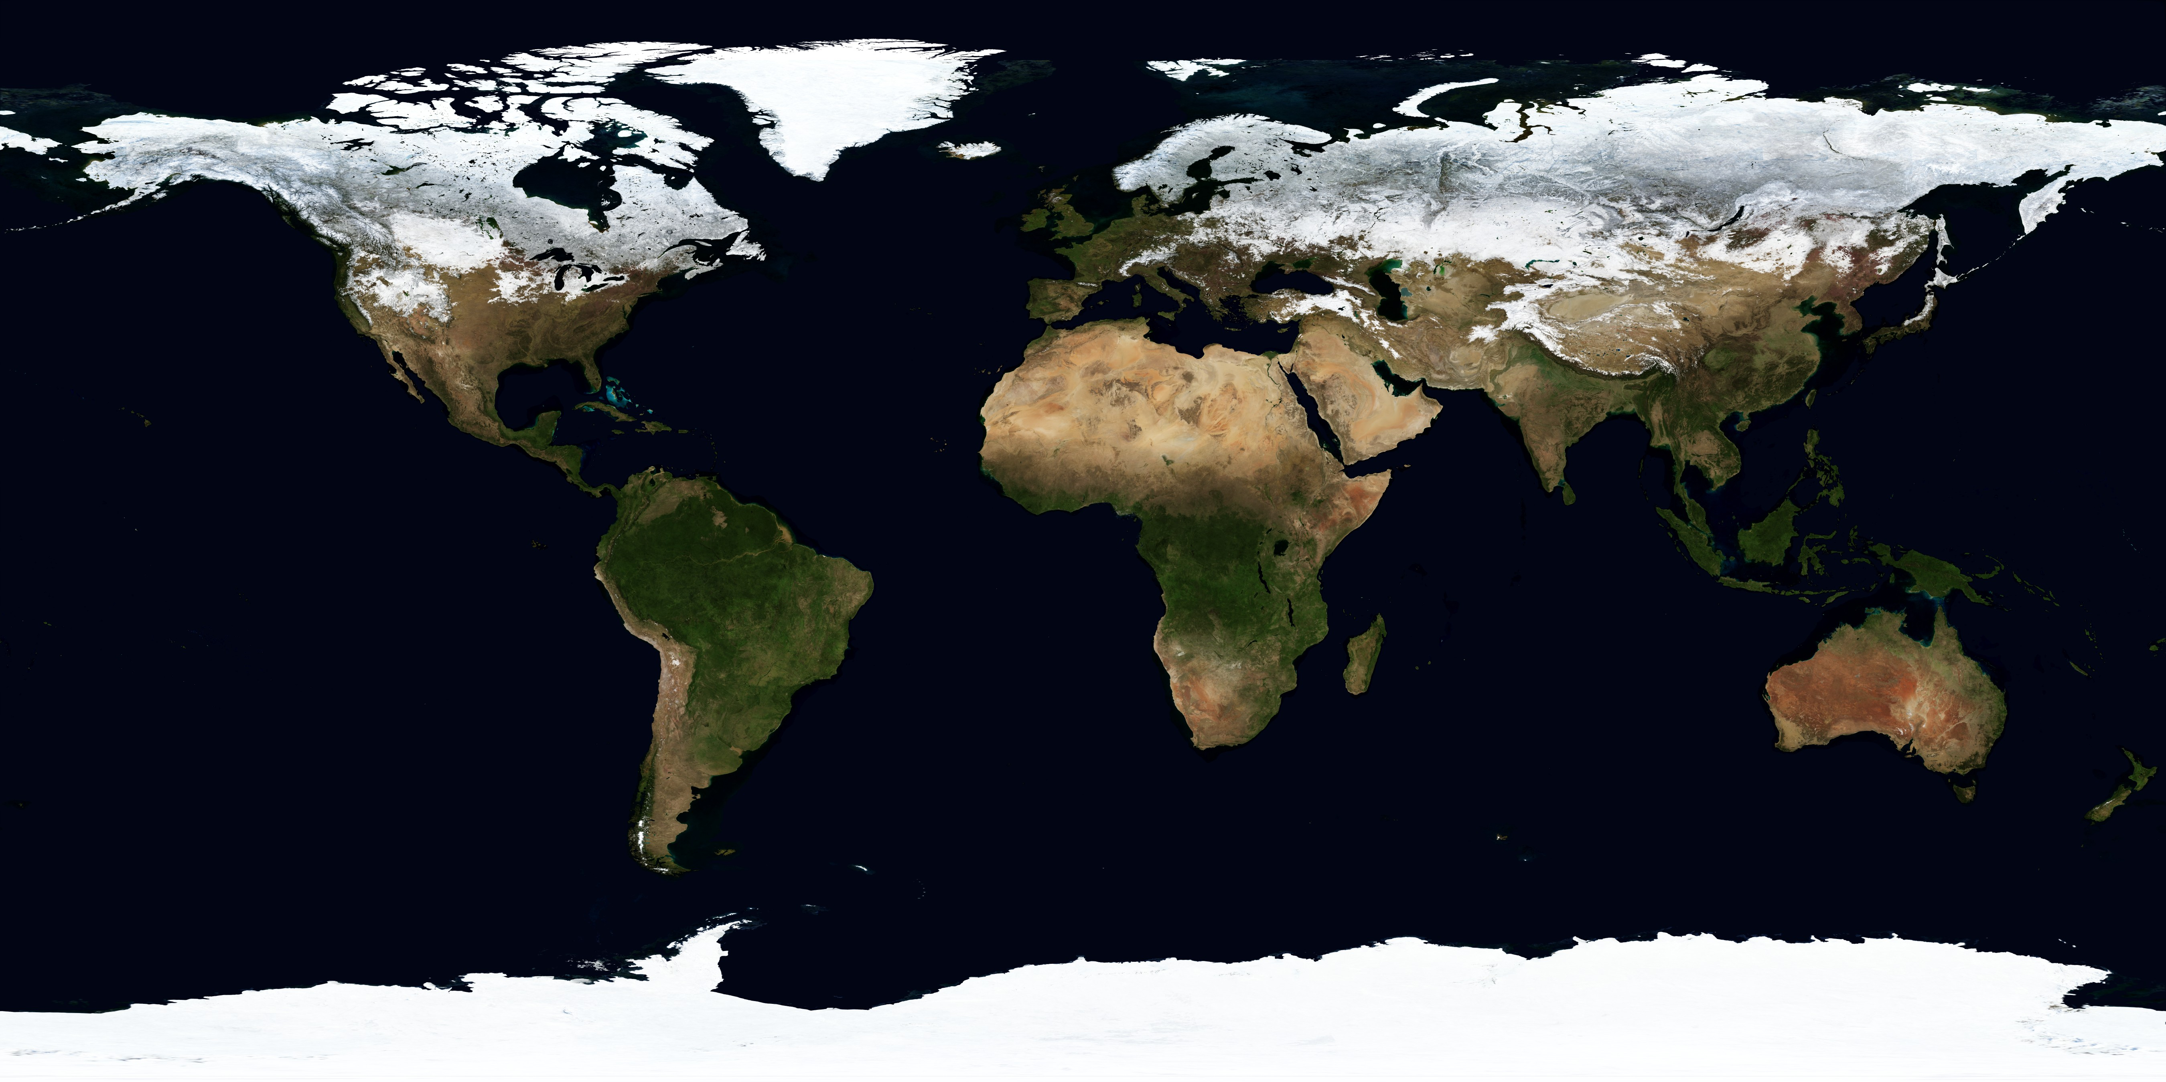
Albedo-temperature feedback
Lefer 15 – i. basics
Source: NASA

Slide 66
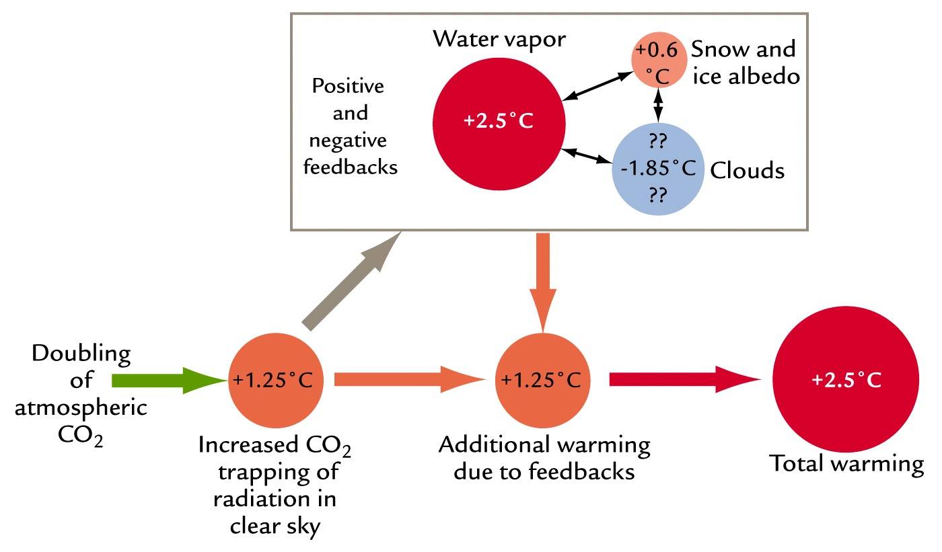
Positive and negative feedbacks
Lefer 17 – i. basics
Ruddiman, 2008

Slide 67
Coring Earth’s ice sheets
Lefer 20 – ii. past climates
Twickler – GISP2 SMO (1994)

Slide 68
Bubbles trapped in ice core
Lefer 20 – ii. past climates
EPICA (2004)

Slide 69
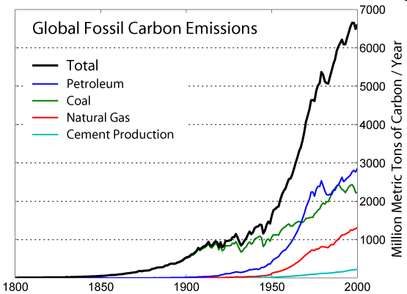
Anthropogenic CO₂
Lefer 25 – iii. natural & anthro cc
GlobalWarmingArt

Slide 70
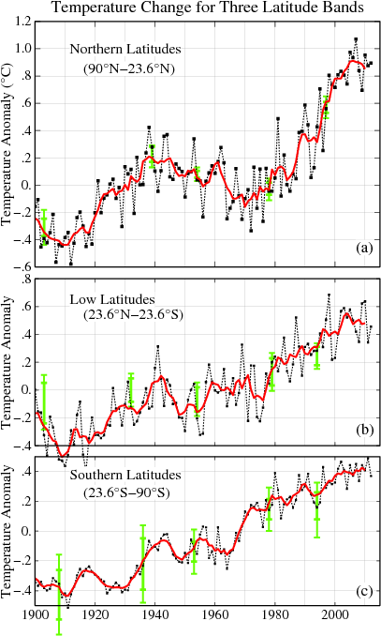
Lefer 27 – iii. natural & anthro cc
NASA GISS

Slide 71
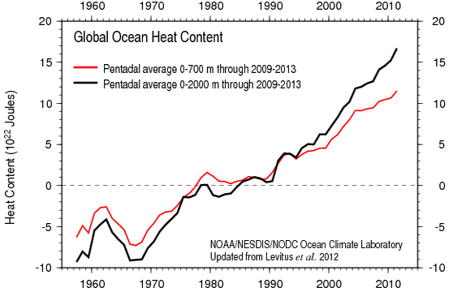
Global Ocean Temperature
Lefer 26 – iii. natural & anthro cc
NASA GISS

Slide 72
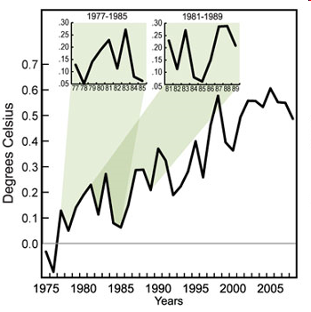
Natural interannual variability
Lefer 34 – iii. natural & anthro cc
Science, 2010

Slide 73
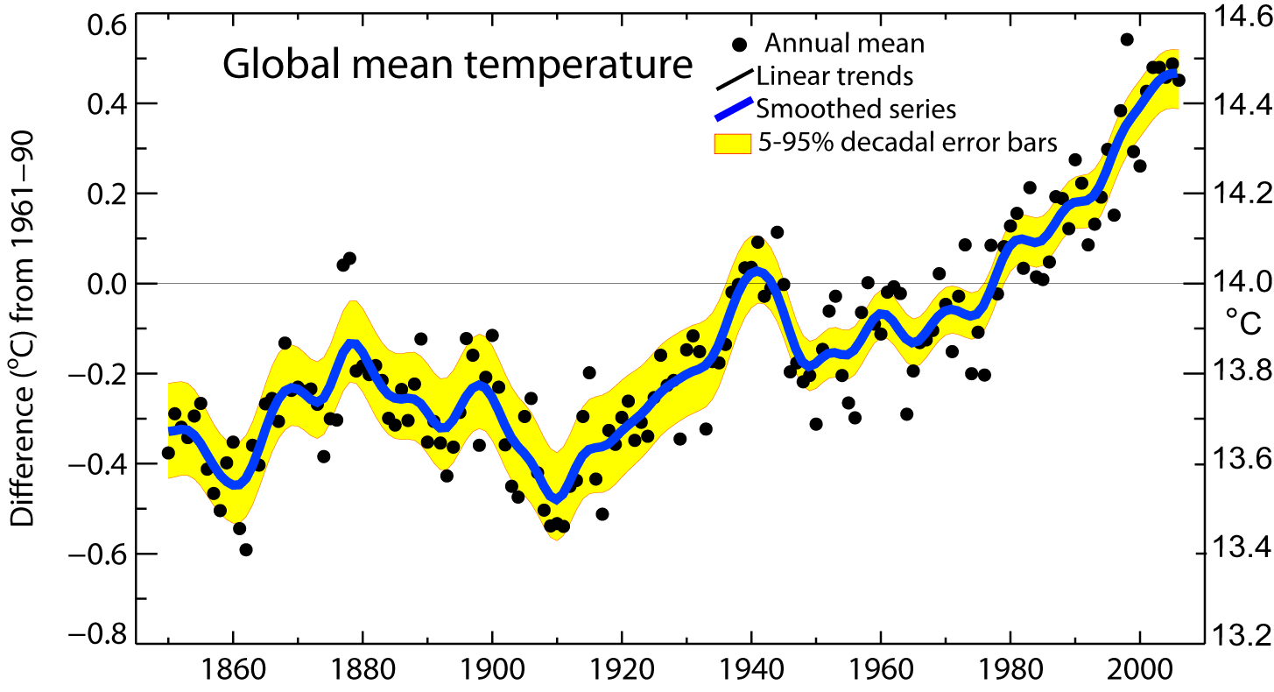
Rate of global temperature rise
Period Rate
Years °/decade
25 0.177±0.052
50 0.128±0.026
100 0.074±0.018
150 0.045±0.012
Lefer 35 – iv. future cc
Kevin Trenberth, 2008

Slide 74
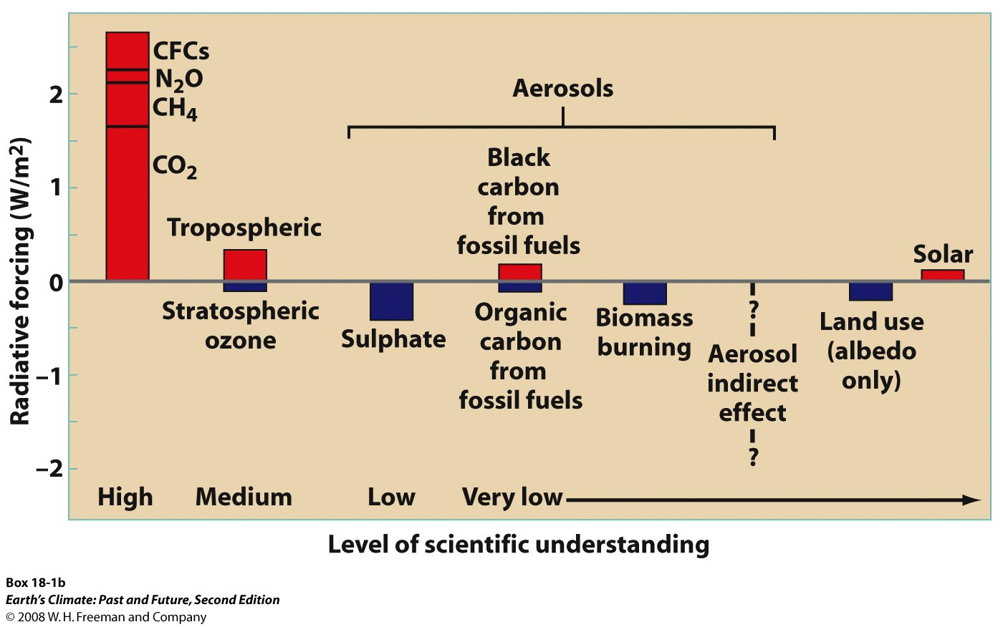
Radiative forcing of recent warming
Lefer 36
Ruddiman, 2008

Slide 75
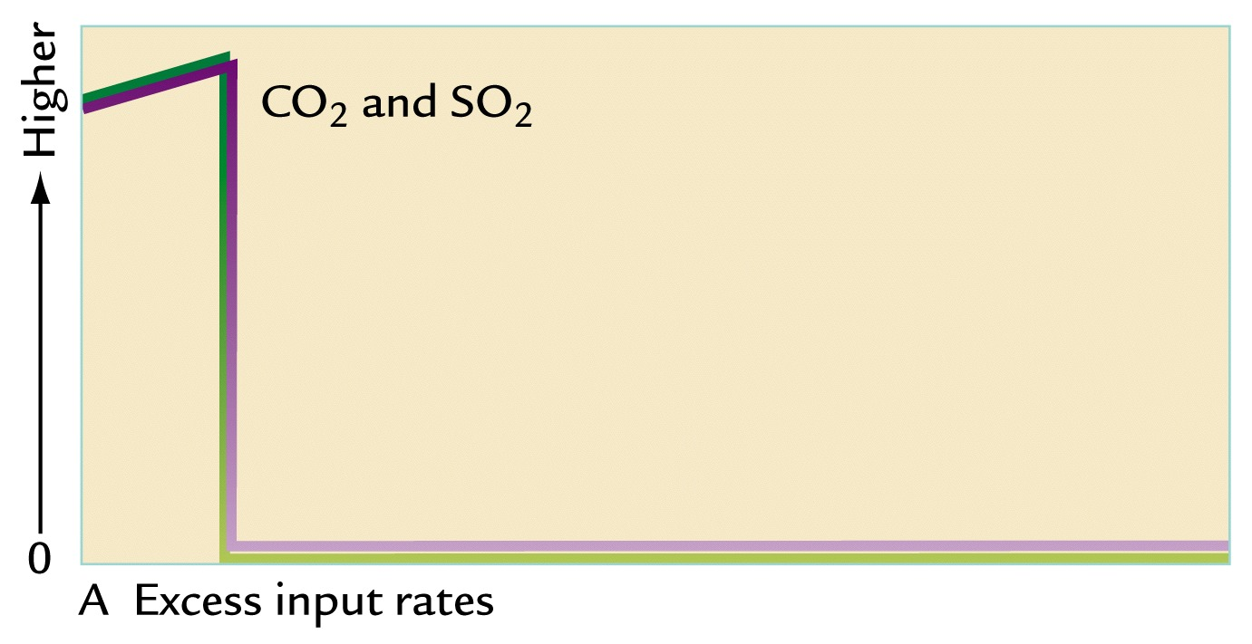
Response to abrupt ΔCO₂ and SO₂ emissions?
Lefer 37 – iv. future cc
Ruddiman, 2008

Slide 76
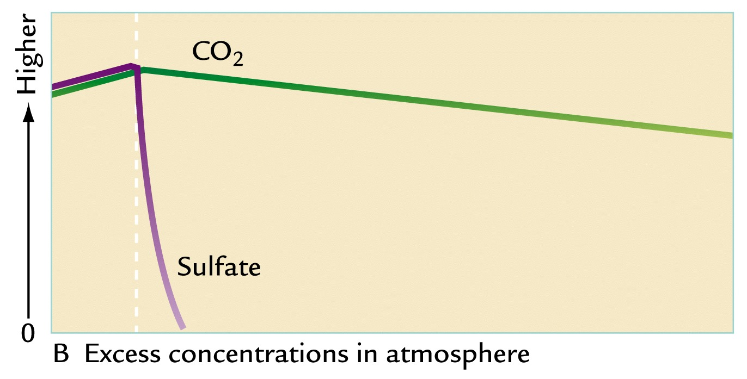
Response to abrupt ΔCO₂ and SO₂ emissions?
Lefer 38 – iv. future cc
Ruddiman, 2008

Slide 77
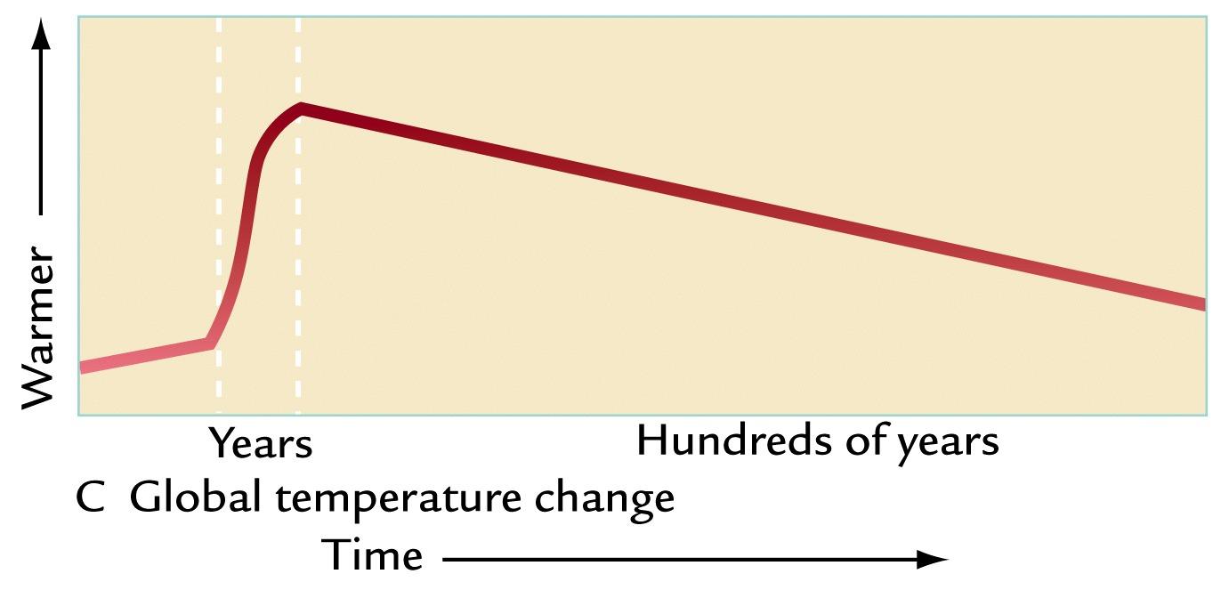
Response to abrupt ΔCO₂ and SO₂ emissions?
Lefer 39 – iv. future cc
Ruddiman, 2008

